Slide 1
COVID-19 Mortality Rate Trends in Countries and US States
Joel Elvery
Updated June 29, 2020

Slide 2
Introduction
The charts in this presentation use the same data sources as the charts in two April 2020 District Data Briefs. Please see these reports for additional details.
Getting to Accuracy: Measuring COVID-19 by Mortality Rates and Percentage Changes
A Speeding Rate Starts to Slow: COVID-19 Mortality Rates by State
Since those reports were completed, additional evidence shows that COVID-19 deaths have been underreported, both in other countries and in the United States. The following charts present the latest the Center for Systems Science and Engineering at Johns Hopkins University (CSSE) data through June 28, with no attempt to further correct for underreporting.
Some large revisions in COVID-19 data have been smoothed. See slide 9 for details.
The charts have been modified from those in the reports to better convey the current status of the COVID-19 epidemic in the United States.
All dates in this presentation refer to the year 2020.

Slide 3
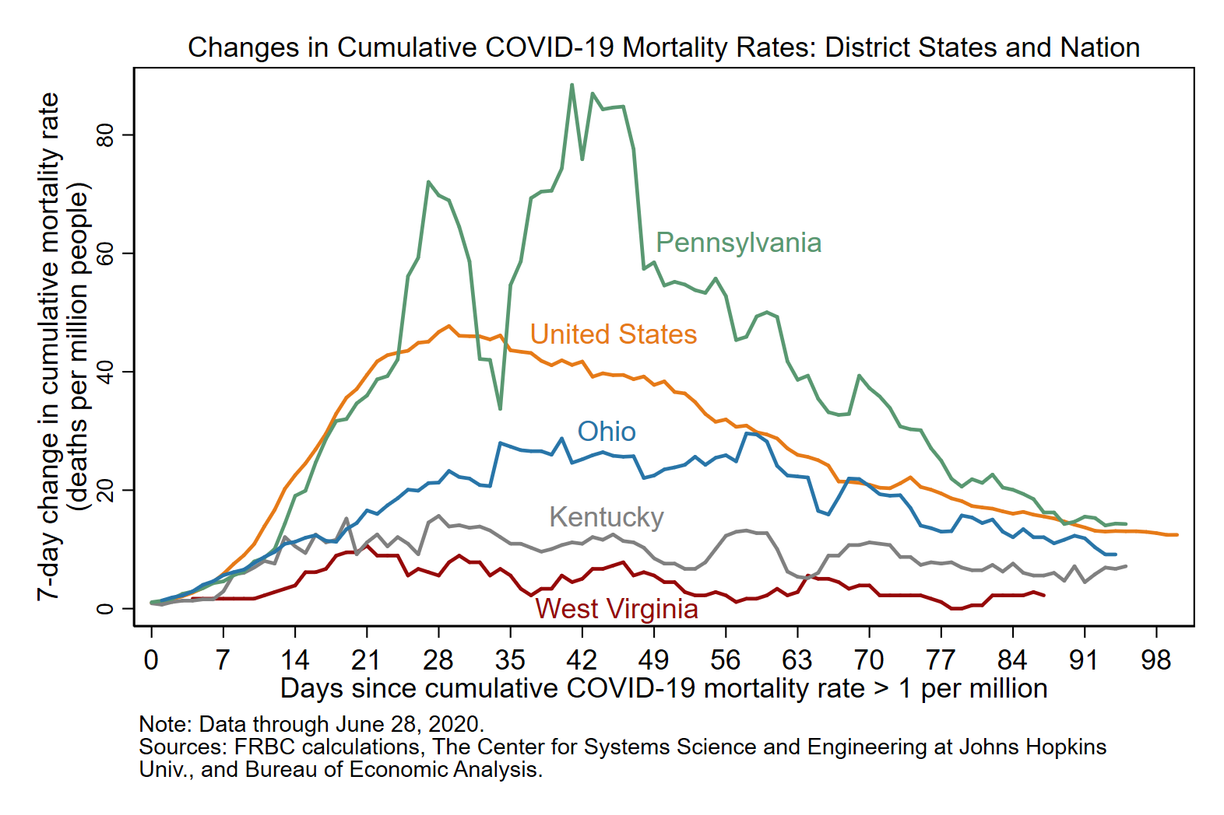
In the week leading up to June 28, the population-adjusted number of COVID-19 deaths per week rose in KY and WV and declined in OH, PA, and the US as a whole.

Slide 4
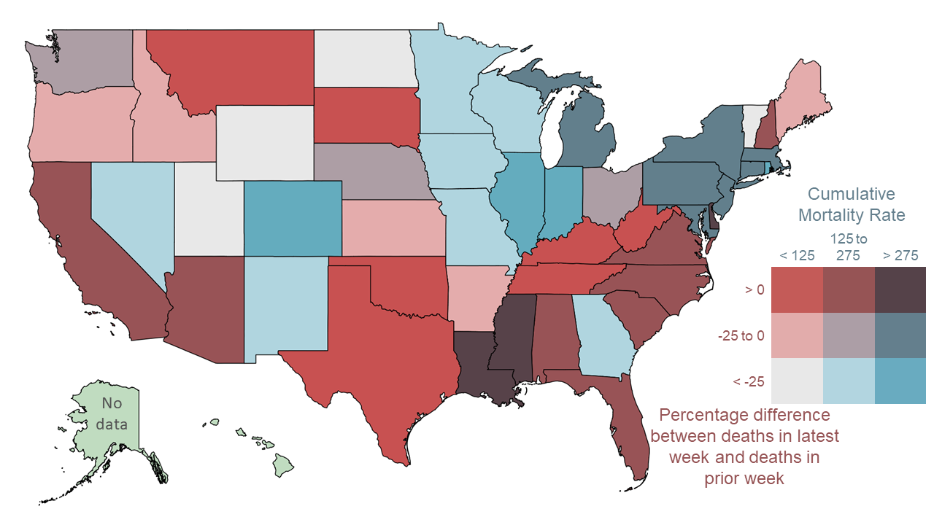
Between June 15 and June 28, the number of COVID-19 deaths per week rose by more than 25 percent in 10 states (including AZ and VA) and by less than 25 percent in 8 states (including CA, LA, and TX).
Notes: States with no data (AK and HI) had no deaths between 6/15 and 6/21. The District of Columbia is in the bin with mortality rate > 275 and percentage difference between -25 and 0. The color bins on this map are changed with each update to better represent the latest data.
Data for June 28, 2020, accessed on June 29, 2020
“Latest week” is 6/22 to 6/28, “prior week” is 6/15 to 6/21.
Sources: FRBC calculations, CSSE, and BEA

Slide 5
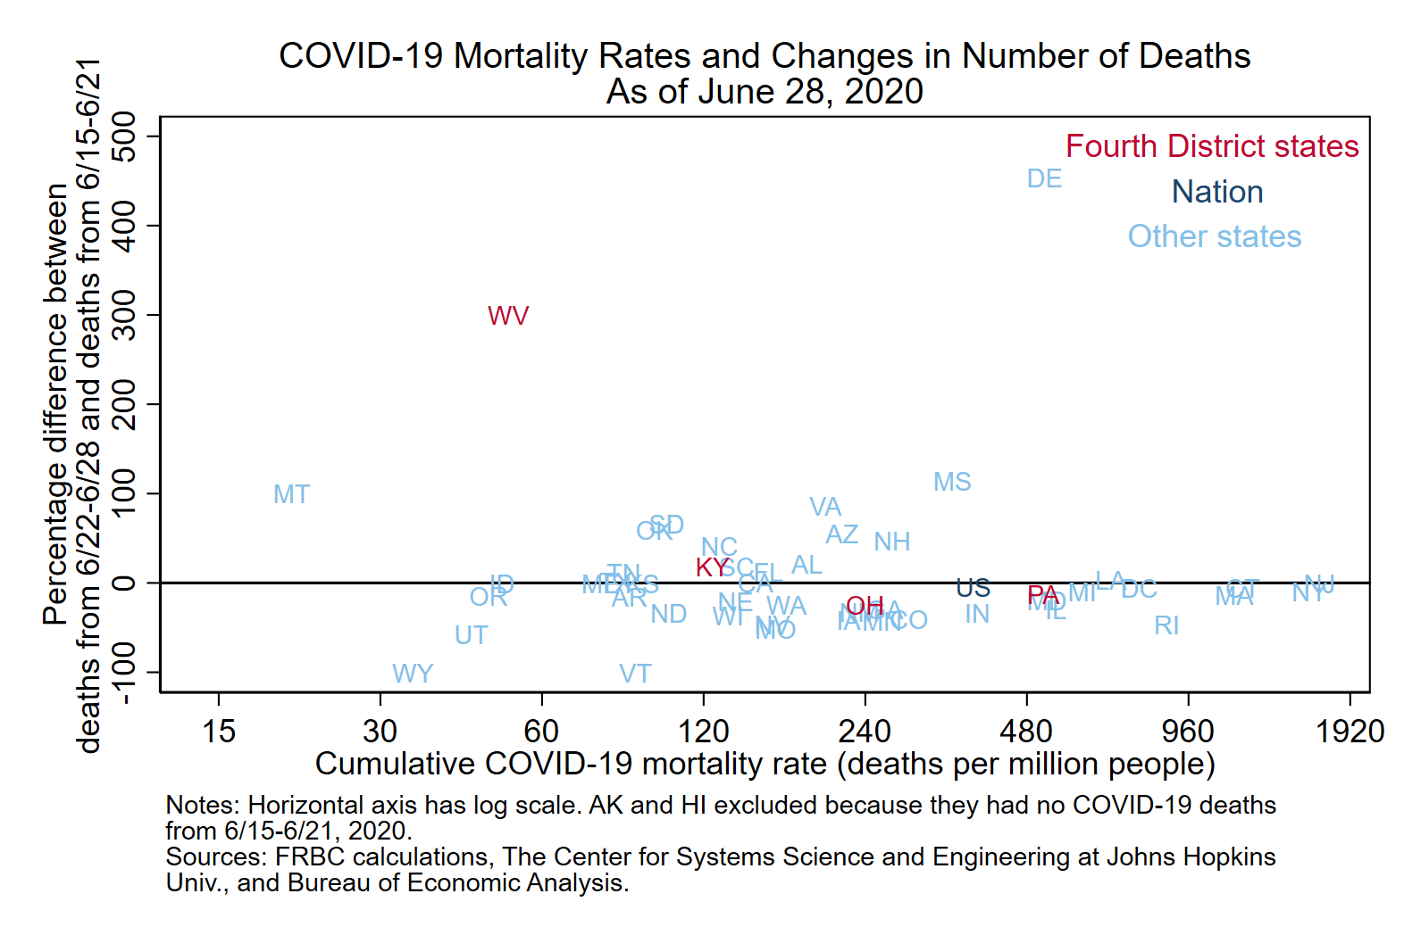
This chart gives similar information to the map, but it is more precise and includes the nation as a whole.

Slide 6
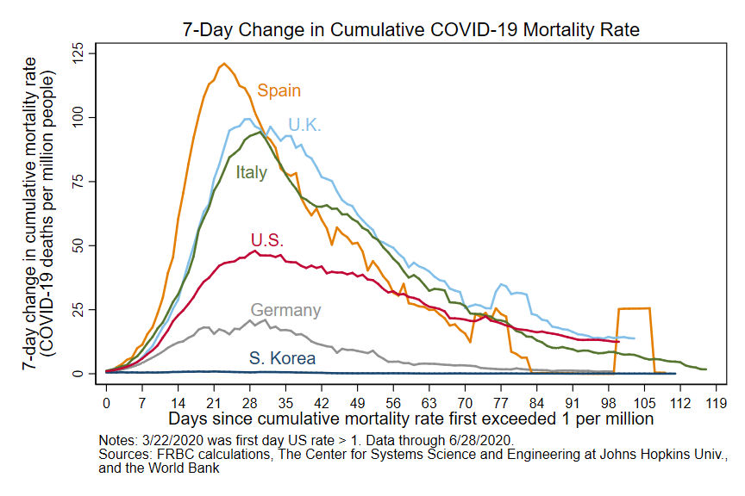
The epidemic curve of the US peaked at a lower weekly change in the cumulative mortality rate than the curves of Italy, Spain, and the UK. However, the decline from the peak has been relatively small in the US.

Slide 7
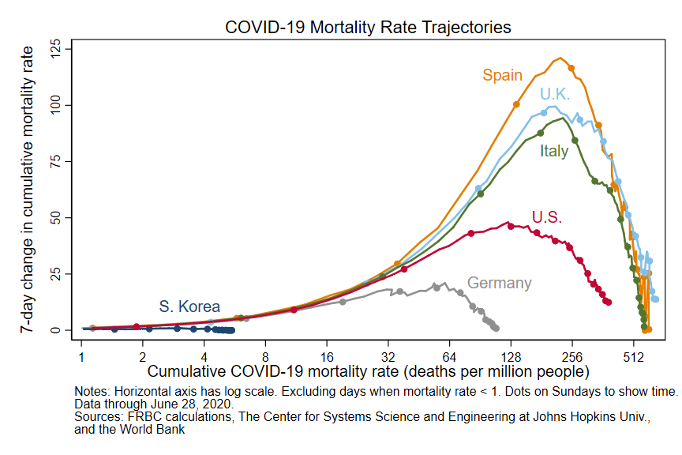
As of June 28, the COVID-19 mortality rate of the US is 389 deaths per million people. This is more than triple that of Germany and more than half those of Spain and UK.

Slide 8
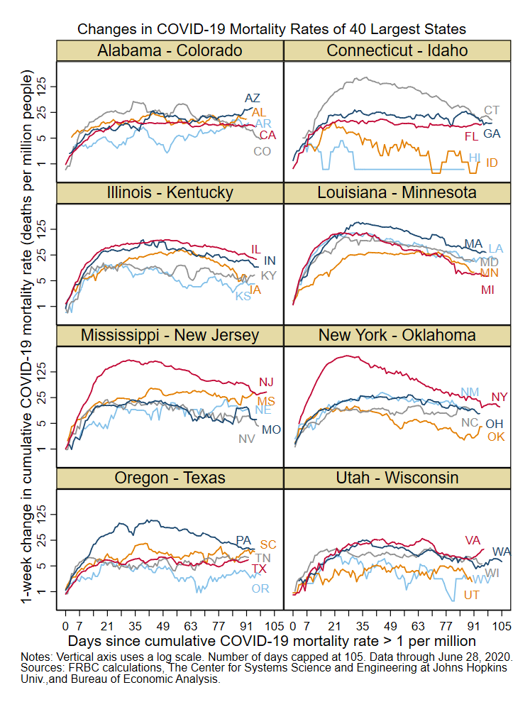
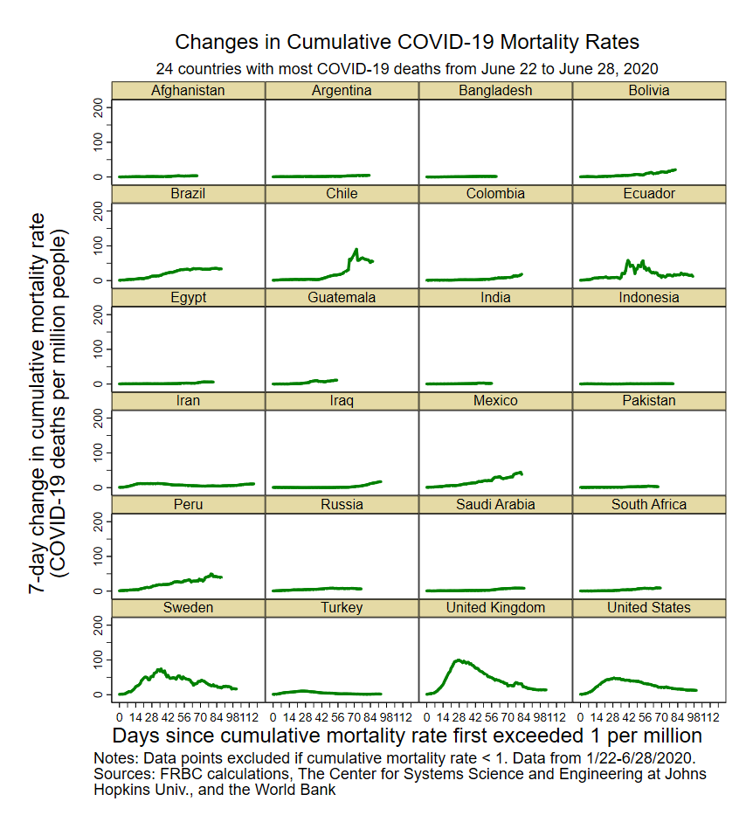
These charts show the changes in COVID-19 mortality rates for the 40 largest US states (left) and the 24 countries with the highest number of COVID-19 deaths in the week leading up to June 28 (right).

Slide 9
Appendix: Adjustments for data revisions
Some large revisions to the reported number of COVID-19 deaths cause large single-day jumps.
I smooth some of these jumps by multiplying daily changes for a period of time by a scaling factor so that the adjusted series meets the post-revision series.
I have used this approach for the following revisions and periods:
Spain revised deaths downward on May 25; data are adjusted from 3/3 to 5/24.
New Jersey revised deaths upward on June 25; NJ and US data are adjusted from 3/10 to 6/24.

