Slide 1
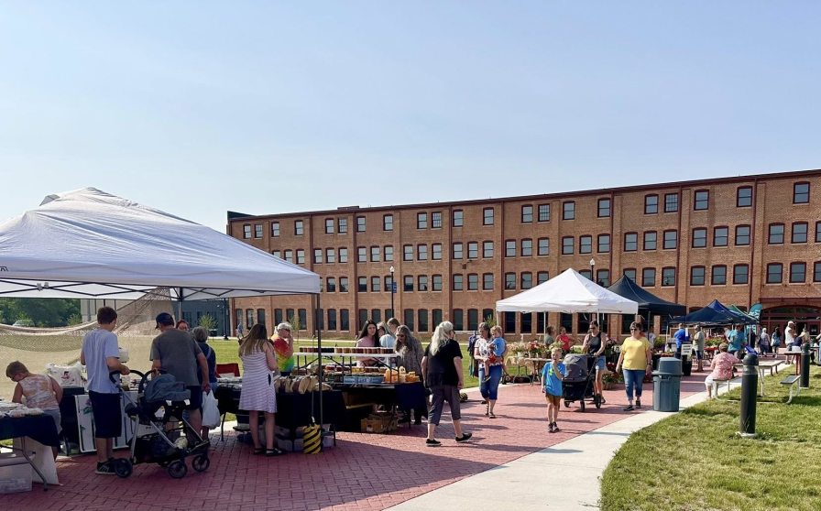
Newton, Iowa
Population: 15,760 (2020 census)
County Seat for Jasper County
35 Miles from Des Moines, Iowa. Close, but not considered a suburb
Urban Amenities
Small-town Feel
Strong heritage around innovation and industry

Slide 2
Quality of Life Initiatives
Newton as a Compelling Destination to Live, Work, Play
Main Street Program
Downtown Grants
Community Amenities- parks projects, infrastructure improvements
Recreation Specialist
Engaging Planning Processes with Regular check-in

Slide 3
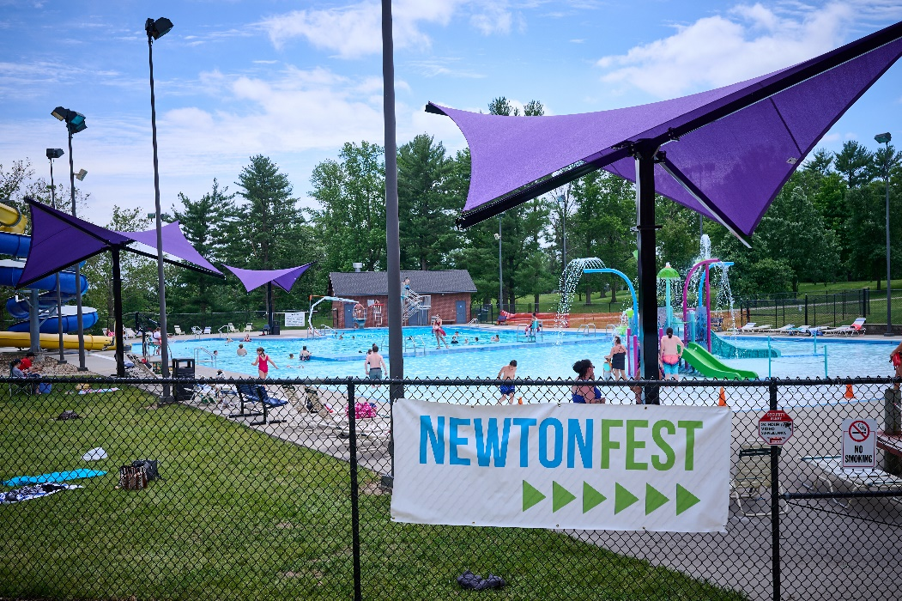

Slide 4
Flexible approach to Zoning
Minimal R-1 (Single Family Only) zoning in the City
Detached secondary residential Structures
Collaborative, Solution-focused mindset to zoning vs. black and white regulatory mindset
Zoning should reflect community desires

Slide 6
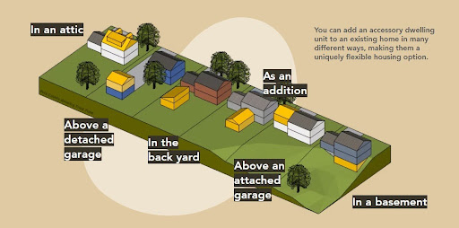
Statewide Legislation- ADUs
ADUs: Accessory Dwelling Units
Effective July 1, 2025
By right, single family homes are allowed at least 1 ADU
Image courtesy Business Record

Slide 7
Housing Initiative: 2014-Present
Addressing Housing Quantity and Quality in the Community
$10,000 new homebuyer incentive in lieu of tax abatement
Funding Newton’s D&D Program
Created D&D 2.0 Program
Address property nuisances
Infill Development
City collaborating with housing partner as “developer”
Downtown Living

Slide 8
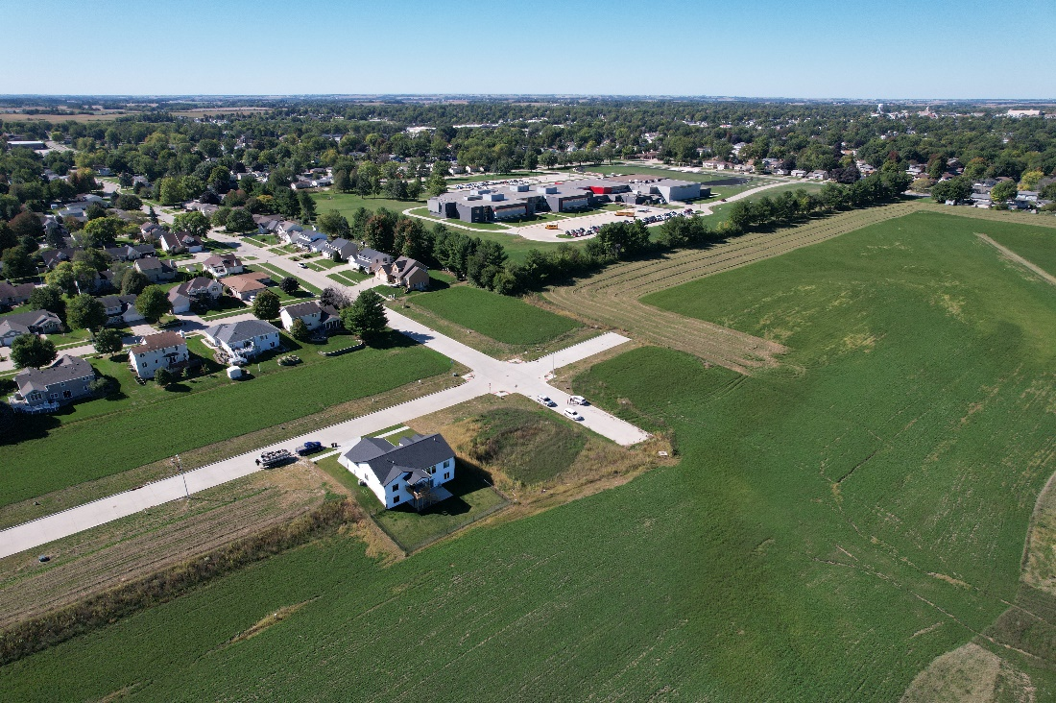
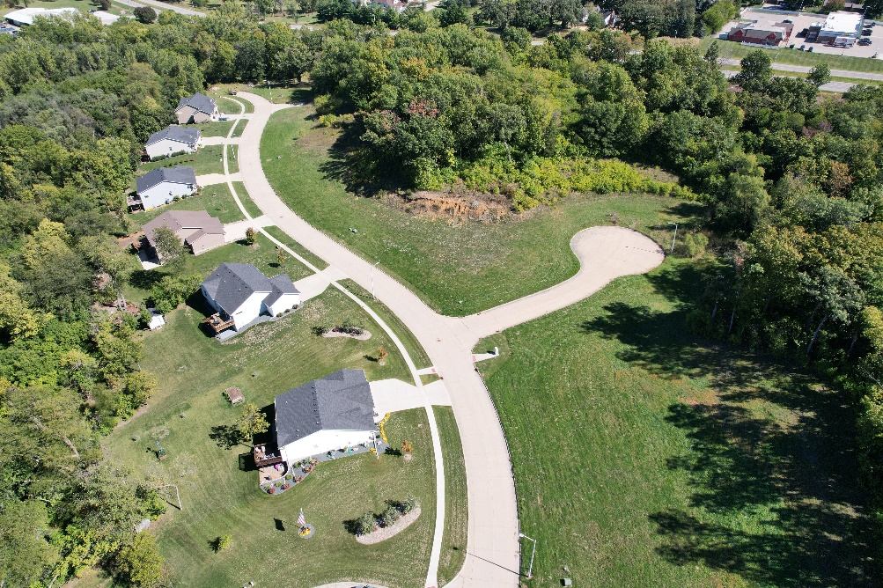

Slide 9
City D&D Program & Infill Development
Clearing blighted properties (100+ since 2014)
Lots available for redevelopment
City selling at significant loss, to encourage infill development
Homes for Iowa
Habitat for Humanity

Slide 10
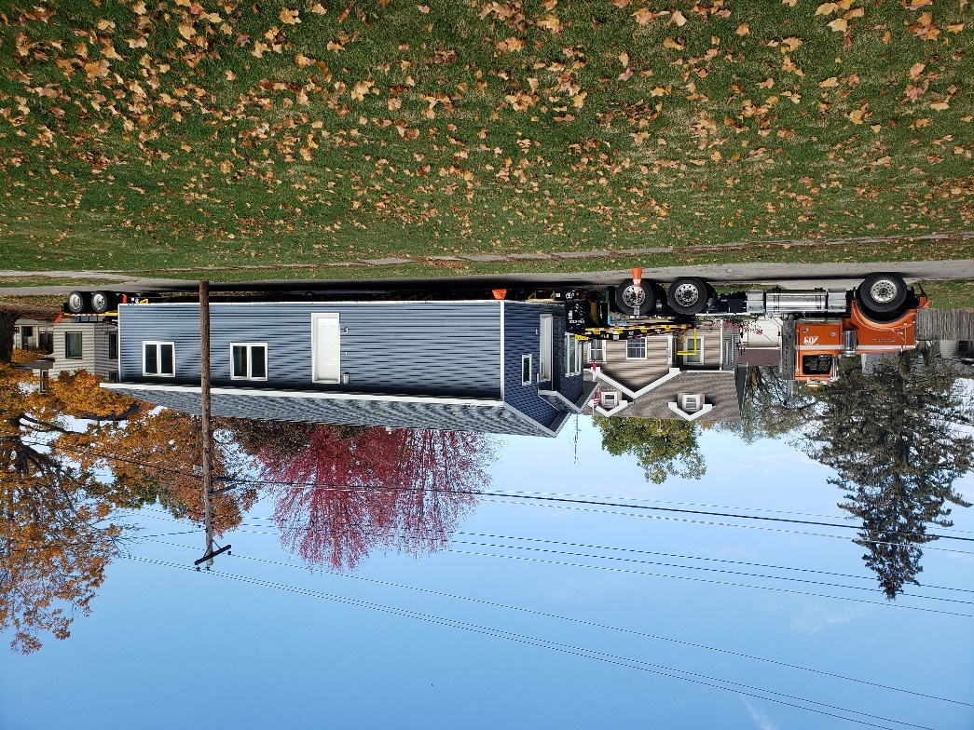

Slide 11
Tax Increment Financing for Housing
City and Newton Housing Development Corporation (NHDC) as developer
Residential TIF
Low-Moderate Income Housing Set-aside Fund

Slide 13
Partnerships
Newton Housing Development Corporation (NHDC)
Main Street
Newton Development Corporation
State of Iowa- State Main Street Office, Dept. Cultural Affairs, Iowa Finance Authority, Iowa Economic Development Authority
Habitat for Humanity
Chamber of Commerce
HIRTA (regional public transport)
YMCA
Arboretum

Slide 14
WAUNAKEE, Wisconsin
Population: 16,587 (2024 Wisconsin DOA Estimates)
11.5% growth since 2020
5th largest community in Dane County
12 miles from State Capitol Building (Madison, WI)
Urbanizing suburb
Avg home value ~$480,000
Small-town atmosphere
80%+ assessed residential

Slide 15
Quality of Life Initiatives
6 active TIF districts
31 parks
Combined Village Center and Senior Center
Active development & redevelopment
Active volunteer community
Proactive infrastructure maintenance/ improvements
Comprehensive Plan Update, Comprehensive Outdoor Recreation Plan, Sustainability Plan (in progress), corridor visioning plans, housing task force report

Slide 16
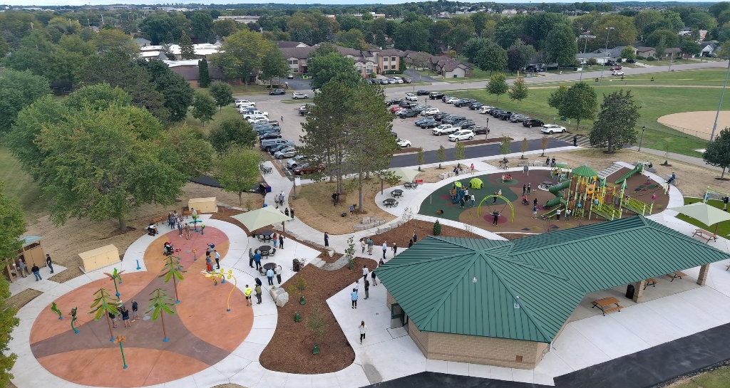
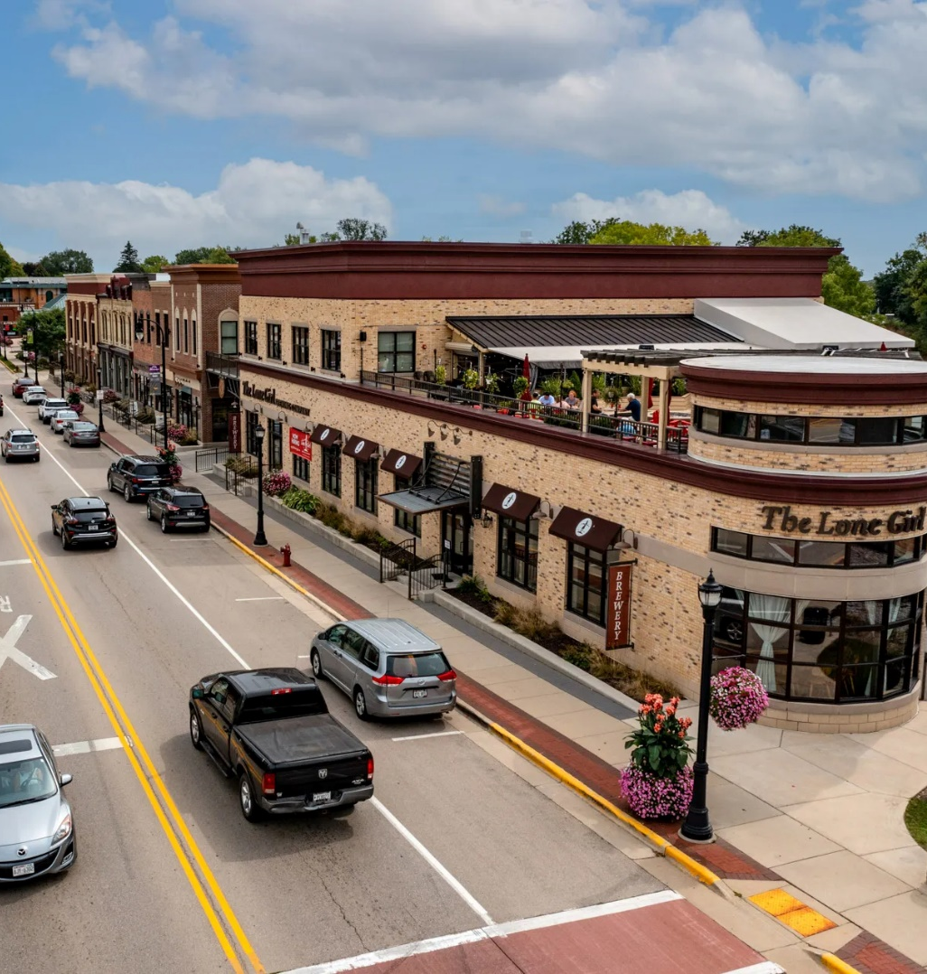
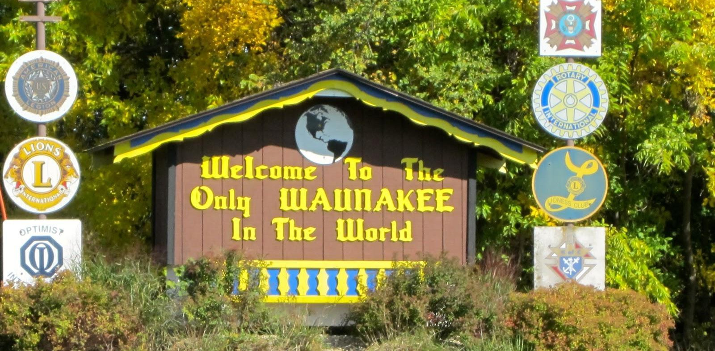

Slide 17
Zoning
Old, dysfunctional zoning code
Last official codification in 1998, but likely much older
Most new development is zoned PUD and governed by a GDP
Essentially mini zoning districts unique to each neighborhood/development
Saving fund balance for rewrite of zoning code after Comp Plan Update

Slide 18
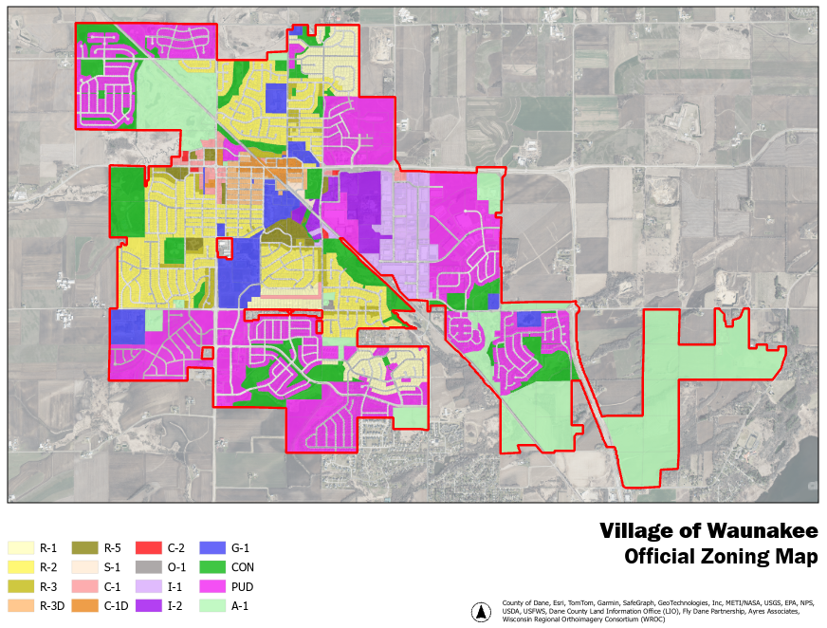

Slide 19
Recent Changes
Accessory Dwelling Units (ADUs)
Effective June 2024
All single family lots in traditional zoning districts are allowed up to one ADU (attached or detached)
ADU must meet all of the requirements of an accessory structure in addition to ADU regulations
Theoretically possible, but practically difficult
Lot coverage maximums
Bulk regulations
Accessory structure maximums

Slide 20
State Laws
No tax abatement
TIF for housing only allowed up to 35% of the area of real property in a mixed use TID
One-year extension for Affordable Housing
After TID has met its obligations
Can extend increment capture for up to 1 year
75% of funds must go toward affordable housing
25% can be used to benefit housing in general

Slide 21
Housing Now
Build ~120 new homes per year
Avg home starting price around $400,000
Most actively developed PUDs require 1600 sq ft minimum
Future development requires annexation
Pervasive community sentiment against density and apartments
Waunakee Housing Betterment Fund
$2,000 to $10,000 matching grant for maintenance and improvements of older housing stock
Meet HUD income guidelines
Home value below the local assessed median
1 LIHTC mixed use apartment/commercial building (40 low-income, 10 market rate units)

Slide 22
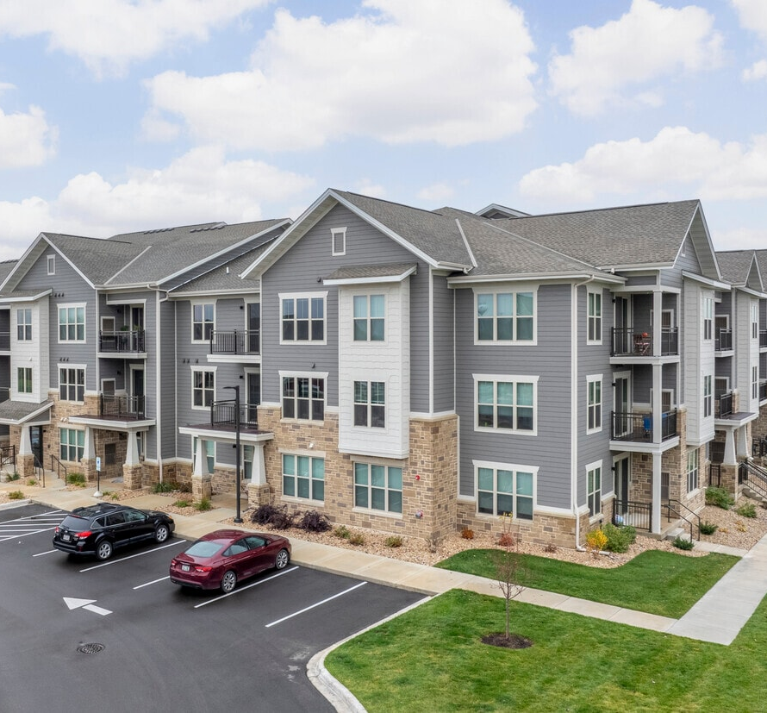
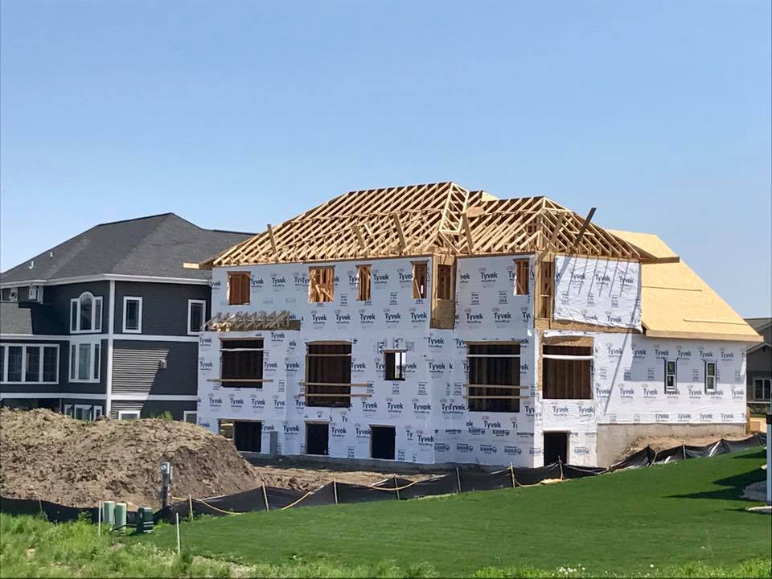
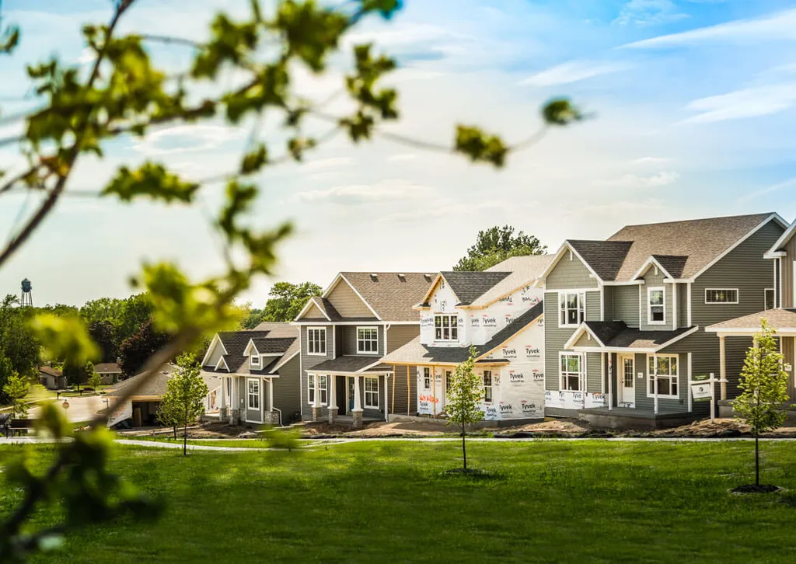

Slide 25
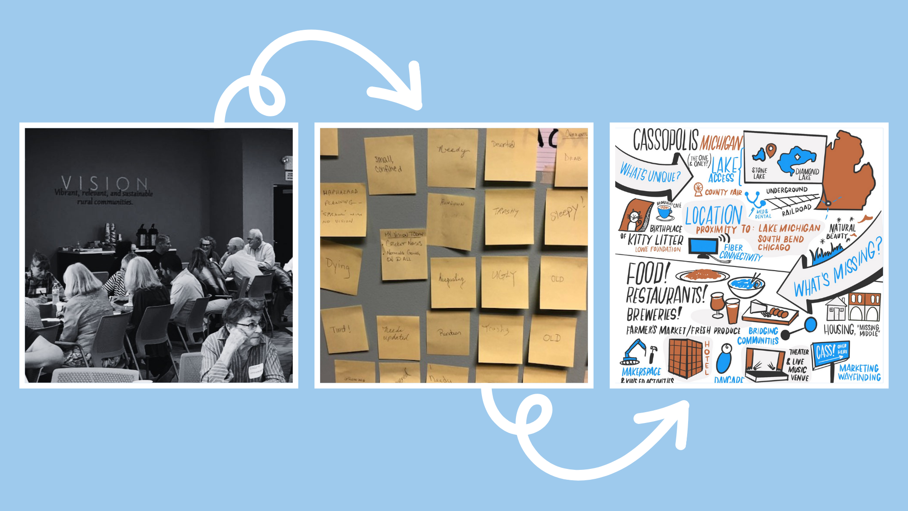

Slide 30
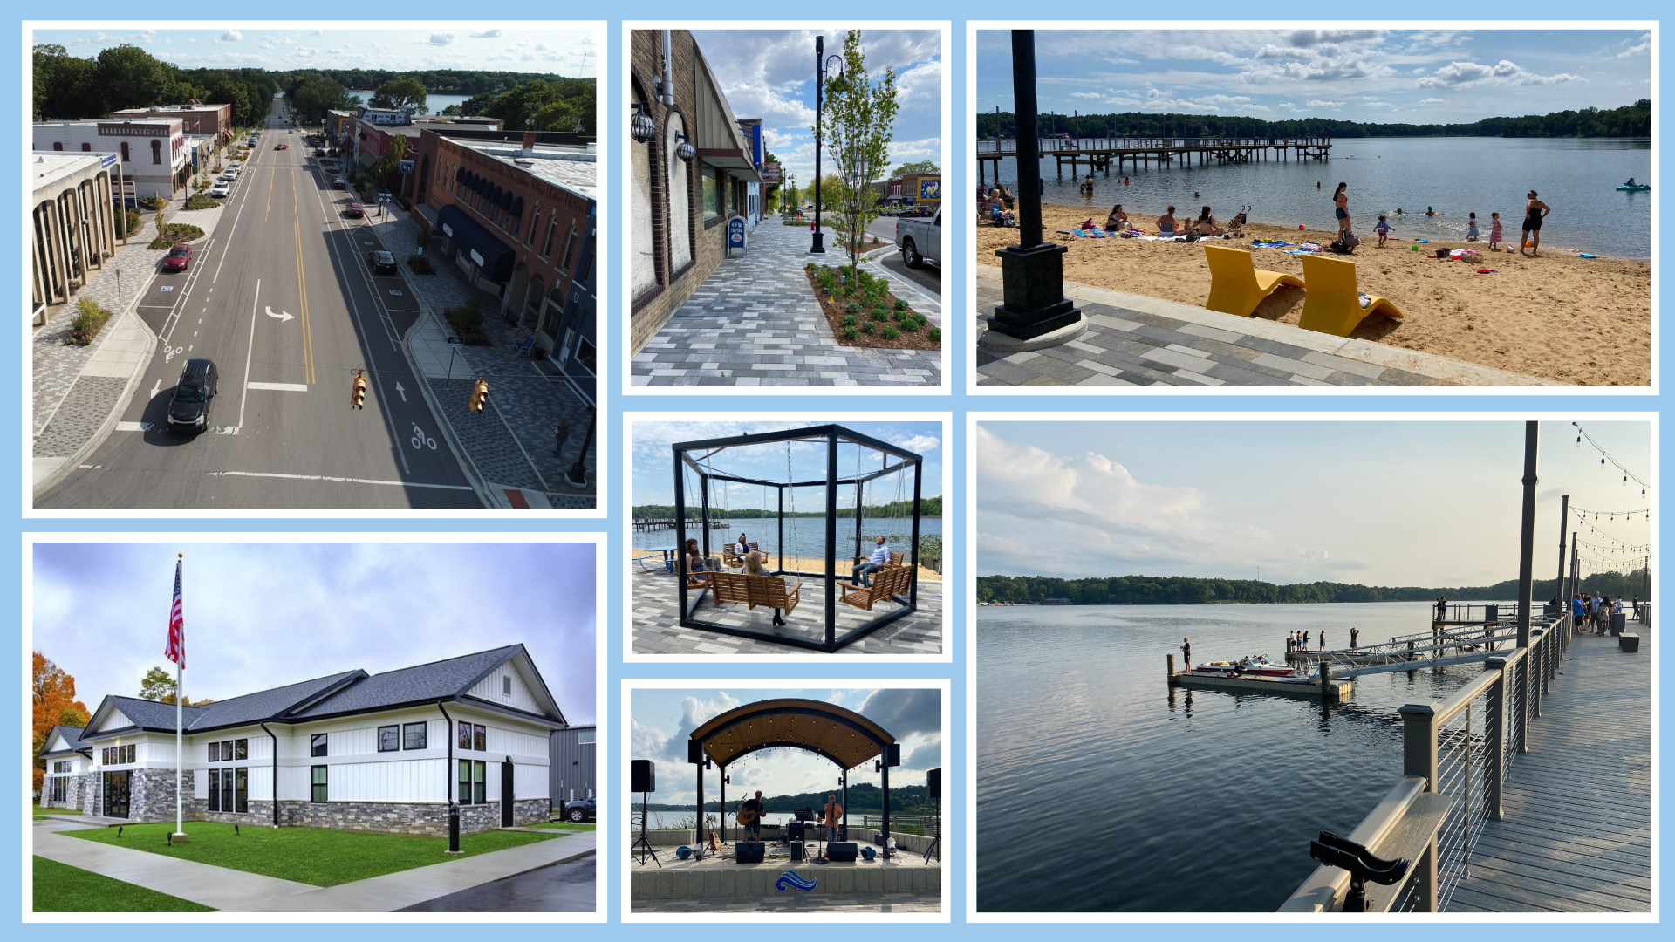

Slide 31
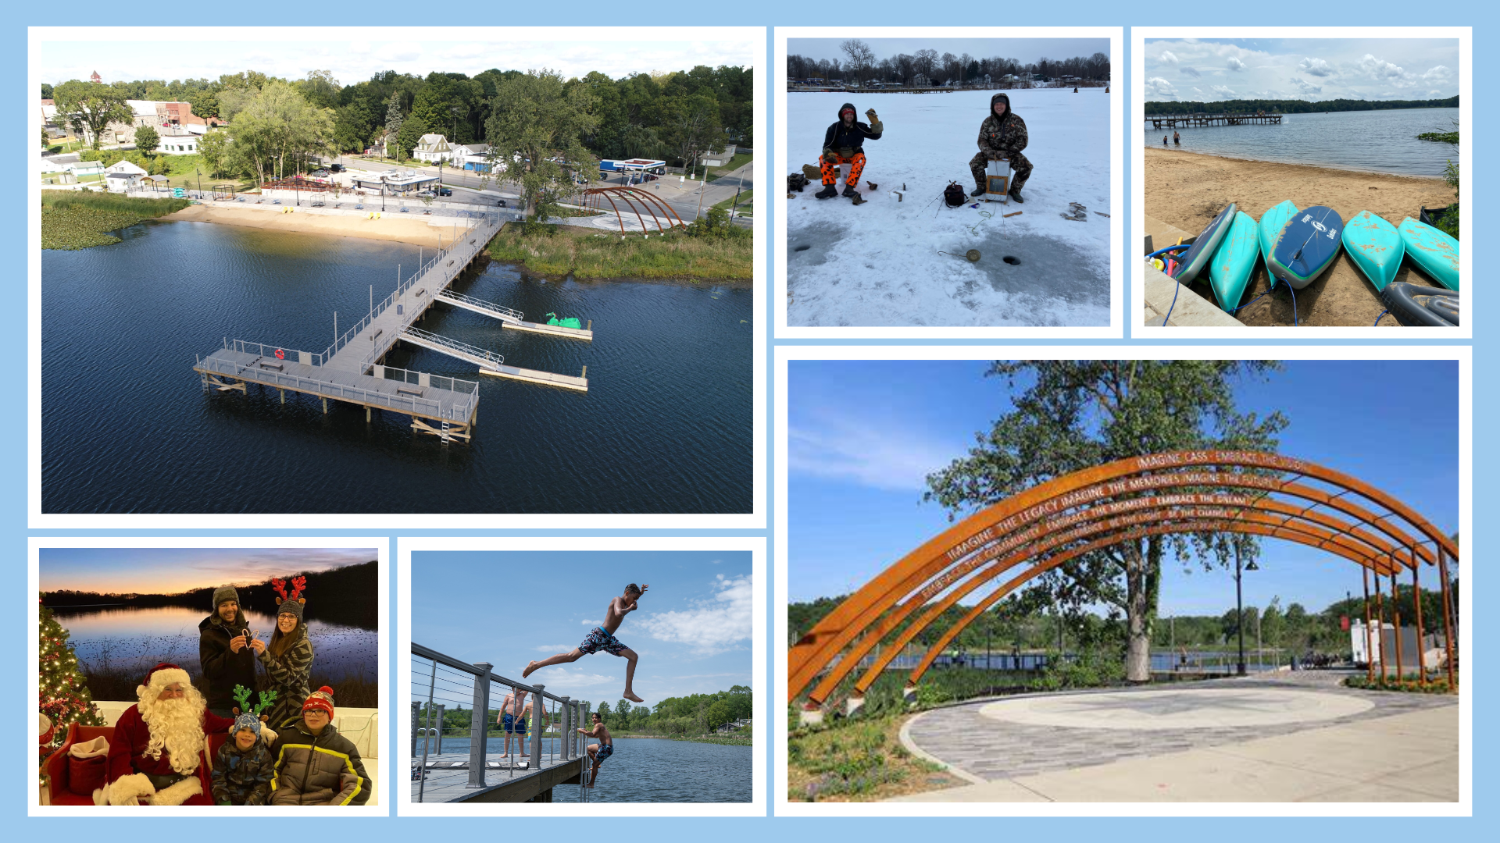

Slide 34
