Slide 1

The Challenges and Opportunities Facing Detroit’s Housing Market
Federal Reserve Bank of Cleveland
Policy Summit
July 27, 2025
David Palmer, MPA
Associate Broker, Realtor
david@kiteandkeypartners.com

Slide 2
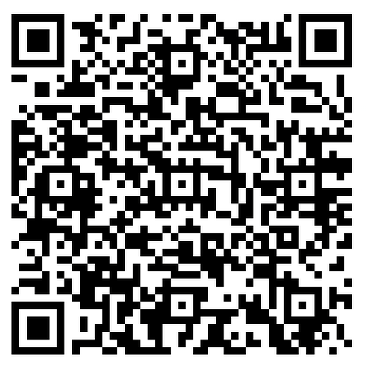


Detroit Dreams Deferred: Thousands Mortgage Ready but Many Miss Out (2021)

Slide 3
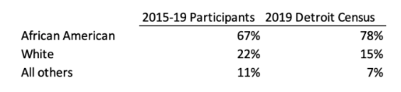
First-time buyer demand, Detroit
Data from 2015 to 2019, via 14 HUD-certified education providers in Detroit
Completions of pre-purchase homebuyer education classes: 7458
Participants who reported purchasing a home: 1445
78% of participants below 80% AMI

Slide 4
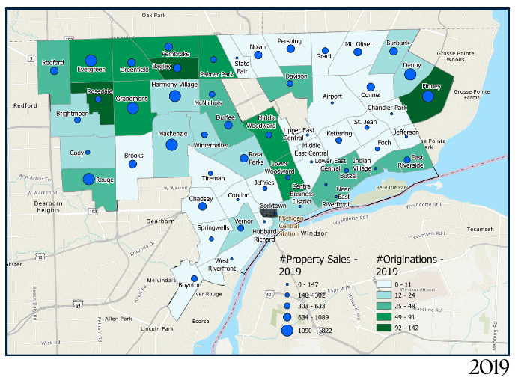
In 2019, about 2/3 of the City of Detroit had no functioning mortgage marketplace.

Slide 5
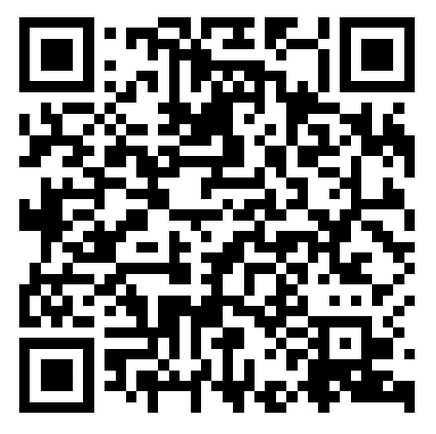
Detroit Dreams Deferred - 2024 Update

Slide 6
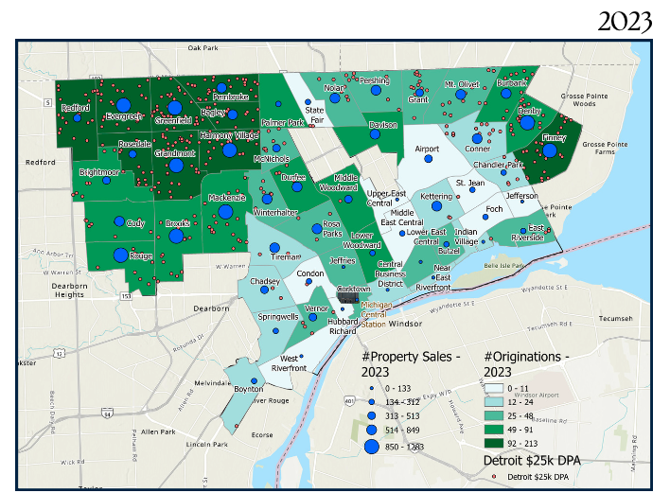
Without Detroit’s down payment assistance program, many of these loans would likely not have been possible.

Slide 7
Originations
434 transactions analyzed
Each cross-referenced to the Realtor’s Multiple Listing Service (MLS)

Slide 8
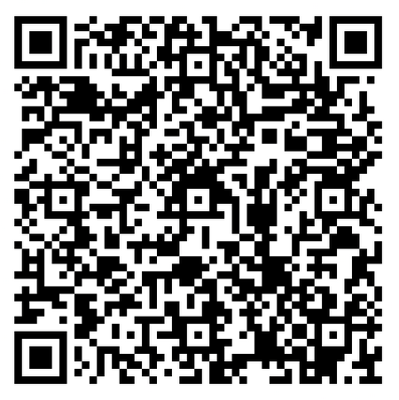

Analysis & Mapping of Michigan Licensed Appraisers (2024)

Slide 9
Appraisers as a regulated occupation are a workforce development challenge in Michigan
Active licenses as of 2022: 3175
  23% are in another state!
76% loss of appraisers in Metro Detroit since 2000
93% loss in the City of Detroit since 2000
Total number of African American appraisers: <95
  Less for all other non-white racial/ethnic measures

Slide 10
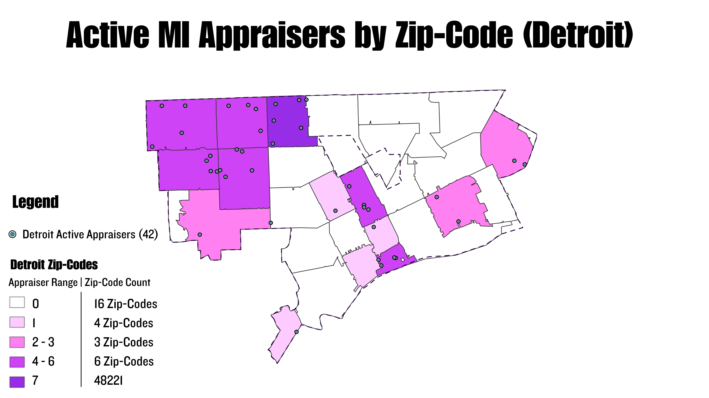

Slide 11
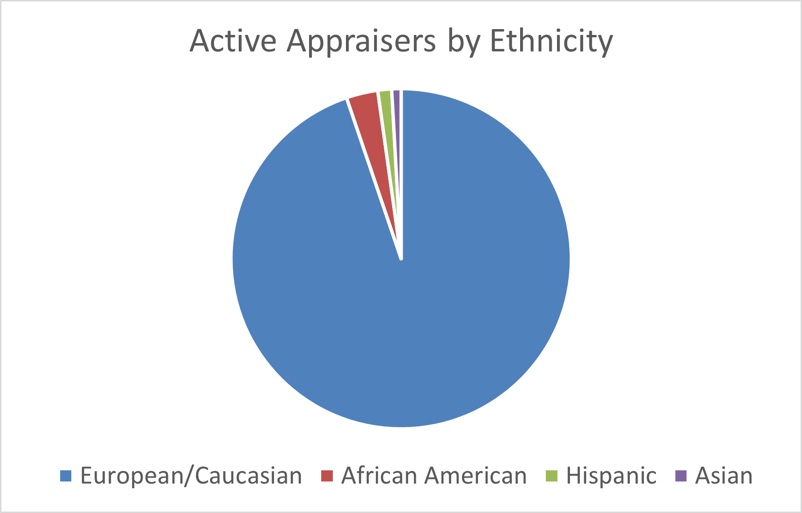
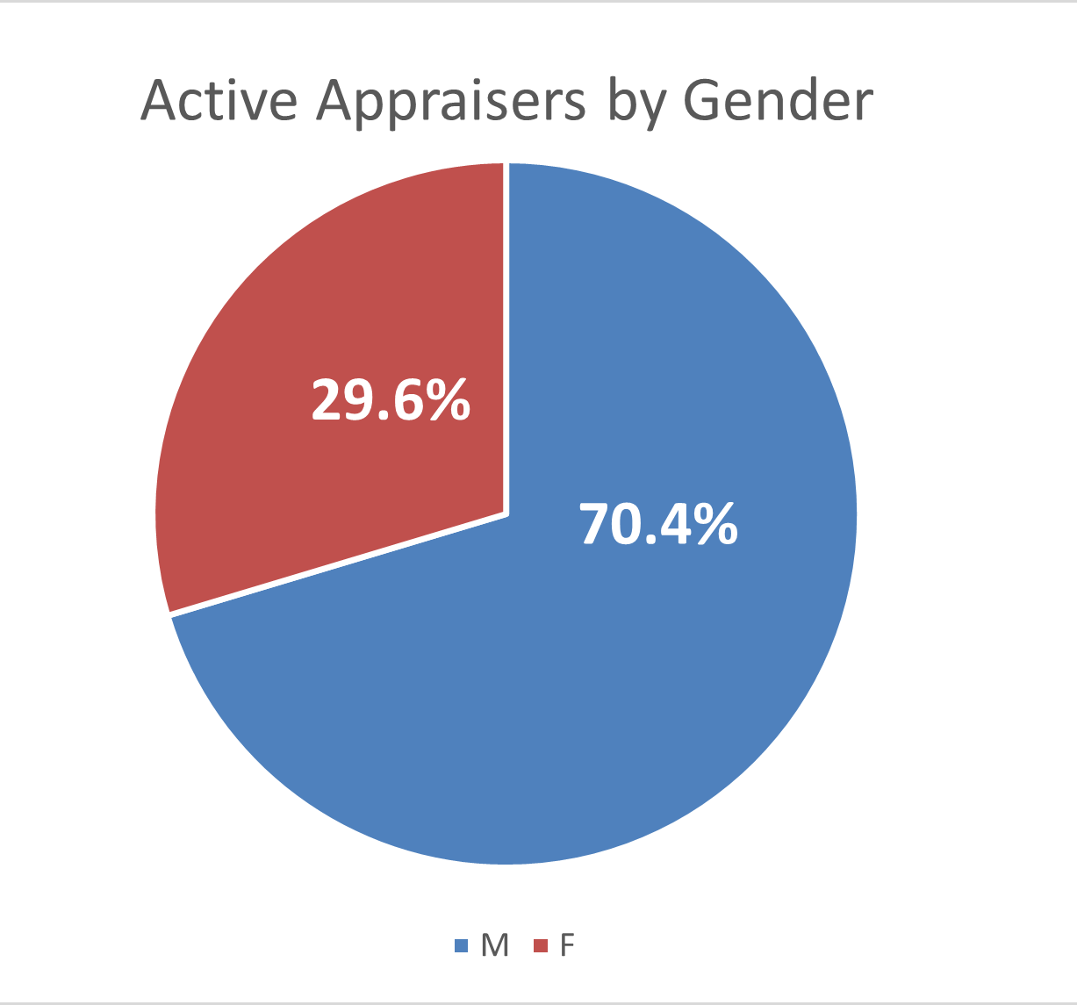
European/Caucasian: 94.8%
African American:
3.0%
Hispanic:
1.3%
Asian:
0.9%
There is no “diversity” to speak of in the 2022 appraiser licensure data

Slide 12
Opportunity
Economic impact of new homeowners
Scarcity to Assets
Convening & workforce development
Recenter on circular economies

Slide 13

Thank you!!
David Palmer, MPA
Associate Broker, Realtor
david@kiteandkeypartners.com

