Slide 1

Financial Health Vital Signs
Policy Summit 2025: Building Strong & Sustainable Communities
June 26, 2025
Notes:
I’m going to briefly walk you through the origins of our work on financial health, and how we got to the financial health vital signs, to make sure we are all on the same page for the rest of our discussion today.

Slide 2
Financial Health is Embedded in OCC Mission and Strategic Plan
Mission: The OCC ensures that national banks and federal savings associations operate in a safe and sound manner, provide fair access to financial services, treat customers fairly, and comply with applicable laws and regulations.
2023-2027 Strategic Plan: Focus on safeguarding the public trust and supporting “a strong and fair banking system, which enables individuals, communities, and the U.S. economy to thrive. Those stakeholders’ health, resilience, and trust are the ultimate measures of our success.”
Goal 3. The OCC leads on supervision as the banking system evolves.
  Elevate fairness—i.e., ensure that the federal banking system provides fair access and treats customers fairly—and integrate it with safety and soundness.
  a. Advance financial inclusion and economic opportunity for all through thoughtful policies, supervisory activities, and innovative programs such as Project REACh.
  b. Support expanded financial literacy and financial health through outreach, collaboration, and enhancing OCC expertise.
Notes:
Briefly, I’ll note that financial health is embedded in OCC’s mission and strategic plan.
“The OCC ensures that national banks and federal savings associations operate in a safe and sound manner, provide fair access to financial services, treat customers fairly, and comply with applicable laws and regulations.”)
Our current strategic plan describes the agency’s focus it notes that stakeholders’ health, resilience, and trust are the ultimate measures of our success.”
Financial health is a key element of elevating fairness in our supervision of an evolving banking system.

Slide 3
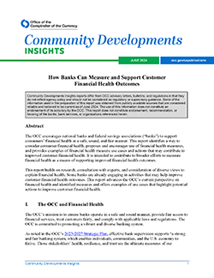
June 2024 Releases on Financial Health Measurement
Community Developments Insights: How Banks Can Measure and Support Customer Financial Health Outcomes
Notes:
Last June we issued a paper on How Banks Can Measure and Support Customer Financial Health Outcomes.
The focus of these is on how banks can use data that they have to better understand customers’ financial health and work to improve it
The report is intended to contribute to broader efforts to measure financial health as a means of supporting improved financial health outcomes.

Slide 4
How We Got Here
Research on other Financial Health and similar measures, including.
  CFPB Financial Well-Being Scale
  UN and International Work
  Financial Health Network Pulse
  FRB and other US government survey data
Stakeholder Consultations
  Banks
  Consumer Advocacy Organizations
  Think Tanks and Academics
  Financial Inclusion and Other Organizations
Notes:
Given the importance of understanding customers’ financial health to consumers and knowing it can be a win-win for banks, we did a lot of work to understand what to measure. We heard a lot of interest in improving financial health, but also challenges in understanding financial health through the data banks have.
We researched financial health and related measures and consulted with many stakeholders, including organizations here today. We did not find existing metrics that used real-time bank data to understand financial health consistently.
We also heard that there was interest in continuing conversations with OCC on advancing financial health measurement and interest in learning from others in the industry, understanding that this work is in a development stage.

Slide 5

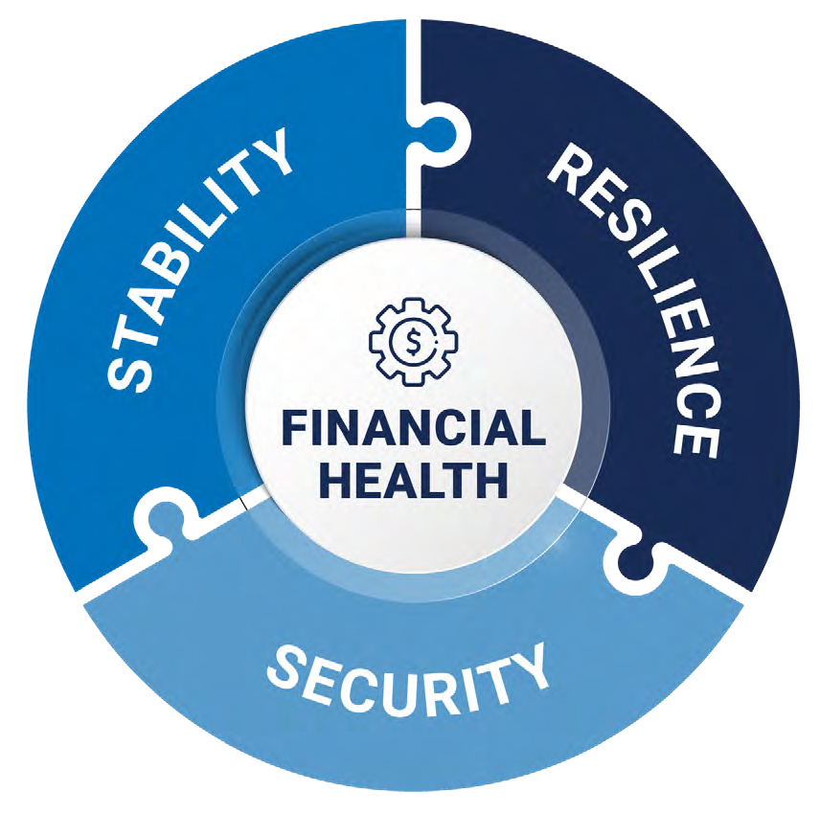
The OCC developed Financial Health Vital Signs to support efforts by banks to understand their customers’ financial challenges, to improve product and service offerings, and to empower customers to improve their financial health.
KEY ELEMENTS OF
FINANCIAL HEALTH
STABILITY
Easily and affordably meet regular financial obligations
Ability to pay on time and in full for housing, utilities, transportation, healthcare, childcare, food, and other necessities
RESILIENCE
Ability to withstand financial shocks
Ability to cover emergency expenses
Having assets or insurance adequate to recover from a significant shock
SECURIT Y
Feeling secure about long-term financial resources
Having assets for the future and positive net worth
Notes:
After several conversations, there seemed to be general agreement and alignment across sources on the key elements of financial health:
Stability – the ability to manage regular obligations
Resilience – the ability to withstand shocks, and
Security – the ability to manage the long-term

Slide 6
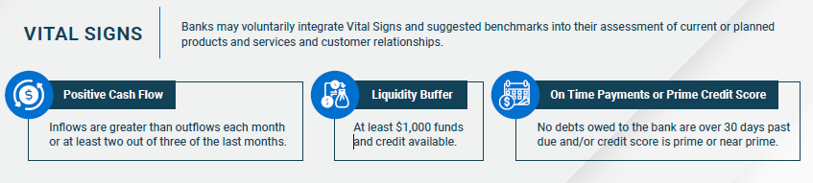
Positive Cash Flow defined | Liquidity Buffer defined | On Time Payments/Prime Credit Score defined
Inflows exceed outflows in aggregate in all liquid accounts (transaction and savings held at the bank). | Total amount available in all liquid accounts (transaction and savings) and credit available on any revolving line | Current on debts or have prime or near-prime credit score. Prime and near-prime credit scores are not defined by the OCC but rather are widely used in the financial industry. The Consumer Financial Protection Bureau defines prime as 660 to 719 and super-prime as 720 or above, and near-prime as 620 to 659. See Consumer Financial Protection Bureau, Borrower Risk Profiles (accessed May 2, 2024).
Vital Signs and Benchmarks Defined
Notes:
We had a lot of good discussions on developing a simple set of Vital Signs and benchmarks to measure indicators of financial health.
The idea was to find something simple that could be relatively easily implemented, and comparable across customers and banks. We know this is not a comprehensive measure.
Just briefly, we talk about cash flow, liquidity buffer, and on time payments or prime credit score.
Cash flow is seen as important to managing day to day needs and can also indicate the ability to manage debts and build resources for the future.. Because consumers may build savings in transaction accounts and spend from savings accounts, we are recommending all liquid accounts be considered. Different banks have some different time frames that they look at, in addition to point of time, to smooth seasonal variation. Different banks may use different ways to consider cash flow, including more precise measures looking at sources of income and types of expenditures.
In determining a measure of liquidity, a number of options were considered to capture where people keep their assets and how much is reasonable to account for short-term needs. We have settled on a measure that allows consumers to draw on liquid accounts and available credit to meet a short-term need of $1000. We know that there are many different benchmarks for “enough buffer” and those amounts may vary by the customer’s life stage.
Regarding managing debt, we recommend two measures to be considered if the consumer is a borrower from the bank. Current in paying debts indicates whether the borrower is substantially behind on any debt to the bank, which is a likely sign that the person is in financial trouble. Credit scores are widely used, and are useful in showing trends of credit behavior, even though it may be a lagging indicator. Banks may want to track significant change in the credit scores and moving from credit invisible to visible.
Again, these were intended as starting point for a discussion about how to use existing data to measure financial health.

Slide 7
Examples in Practice
Cash Flow
Offer low- or no-cost transaction accounts such Bank On Accounts
Offer Money management apps, online tools. For example, provide alerts about duplicate charges, remind customers about upcoming bills and other recurring charges, and show customers their spending trends.
Offer Accounts that do not allow overdrafts or with no or low overdraft fees.
Make it easier for customers to direct deposit their pay into and provide access to the funds as soon as the bank receives the funds through ACH (e.g., early direct deposit).
Provide information about community resources.
Liquidity Buffer
Offer low- or no-cost savings accounts linked to primary transaction accounts; offer accounts with automatic savings features that enable regular savings from payroll deposits; and enable customers to transfer small amounts from their transaction account into savings with each debit card purchase (round-up savings).
Provide savings and goal setting tools, such as tools that enable customers to set goals and track their savings progress and those that show customers funds that can be moved from checking to savings.
Offer savings incentives, such as chances to win prizes.
Debt/Low Credit Scores
Offer small consumer loans at reasonable rates and terms.
Offer secured credit products to build or repair credit scores.
Underwrite loans based on transaction account history.
Provide tools to help customers monitor their credit scores and credit reports and provide information on how to improve credit scores.
Provide information on credit counseling and other financial coaching and education resources offered by trusted nonprofit organizations.
Notes:
The report also describes examples in practice that could be deployed more effectively with better understanding of customer financial health.
It will be interesting to hear today from our panelists about how they are using them.
For example, if a customer experiences negative cashflow over one calendar month, bank may take simple action:
Offer small dollar loan product to help manage cash flows.
Give information and tools on managing expenses, adjusting bill payments.
Then, additional diagnosis may enable more actional insights, for example: looking at consumer's cashflow trends over the last 6-12 months + cash buffers:
Offer early direct deposit of wages.
Offer savings options that may include rewards/incentives for savings, goals-based savings, automated savings.
Offer insights around seasonality/timing of inflows/outflows to help consumer plan.
Provide information about trusted non-profit financial education and coaching resources.

Slide 8
Sample Publications and Other OCC Resources
Financial Capability Fact Sheet explains how financial capability programs can help people make informed financial decisions and actions.
Financial Literacy Resource Directory provides information about programs and initiatives.
Financial Health Resource Directory provides information and resources for banks that are interested in expanding access to financial services to consumers who may be considered unbanked or underbanked,
Financial Literacy Update is a quarterly publication of financial literacy events, initiatives, and resources. The publication is distributed to the OCC’s email list service. Interested parties can subscribe to receive the newsletter via the Community Affairs email list.
HelpWithMyBank.gov provides answers to commonly asked banking questions and includes an online complaint form for bank customers wishing to register their concerns to the OCC.
Safe Money – Guarding Against Financial Frauds & Scams Safe Money is a series of informational fact sheets developed by the Office of the Comptroller of the Currency (OCC) to help consumers recognize and avoid common financial frauds and scams.
BankWise - Your Rights Simplified is a series of informational fact sheets to help consumers understand the federal consumer protection laws and regulations applicable to national banks and federal savings associations. View and share these fact sheets to learn about these laws and regulations, their key protections and requirements, and how to get assistance or file a complaint.
Notes:
This slide just for reference if needed

Slide 9
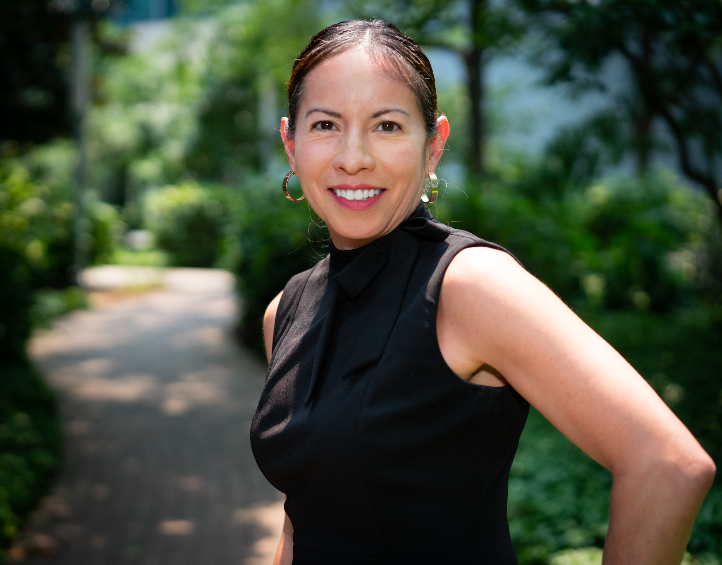
Contact Information
Norma Polanco-Boyd
Community Affairs Officer
Norma.polancoboyd@occ.treas.gov
202-373-8413

Slide 10
Mission: Change Machine builds financial security through people-powered technology.
Vision: An equitable economy in which we all thrive.
Mae Watson Grote, founder & CEO
https://www.linkedin.com/in/mae-watson-grote/

Slide 11
Our Financial Security Outcomes Framework
Achieve an Action-Driven Financial Goal
Increase Consistent Savings
Reduce Financial Transaction Costs
Increase Credit Score
Decrease Debt
Save a Portion of a Tax Refund for a Goal

Slide 12
Demonstrated Impact
$1,721
$1,009
33
Average debt reduced by trial participants
Average credit score improvement by trial participants
Average dollars saved by trial participants
Savings Increase
Debt Reduction
Credit Improvement
Change Machine’s financial coaching framework was rigorously evaluated in the field’s first randomized controlled trial, commissioned by the CFPB and led by Urban Institute.
Notes:
Notes

Slide 13

Who We Are
Who I Am
LISC is one of the country’s largest community development nonprofits, helping forge vibrant, resilient communities across America.
Laura
D’Alessandro
Laura co-directs LISC's national Income & Wealth Building program, leading Financial Opportunity Center® initiatives focused on wealth-building and credit-building strategies. Data-driven programming is a passion of hers and her work at LISC focuses on data to improve programming. Laura holds a master's in public administration from New York University.
We work with residents and partners to close gaps in health, wealth, and opportunity so that people and places can thrive.

Slide 14


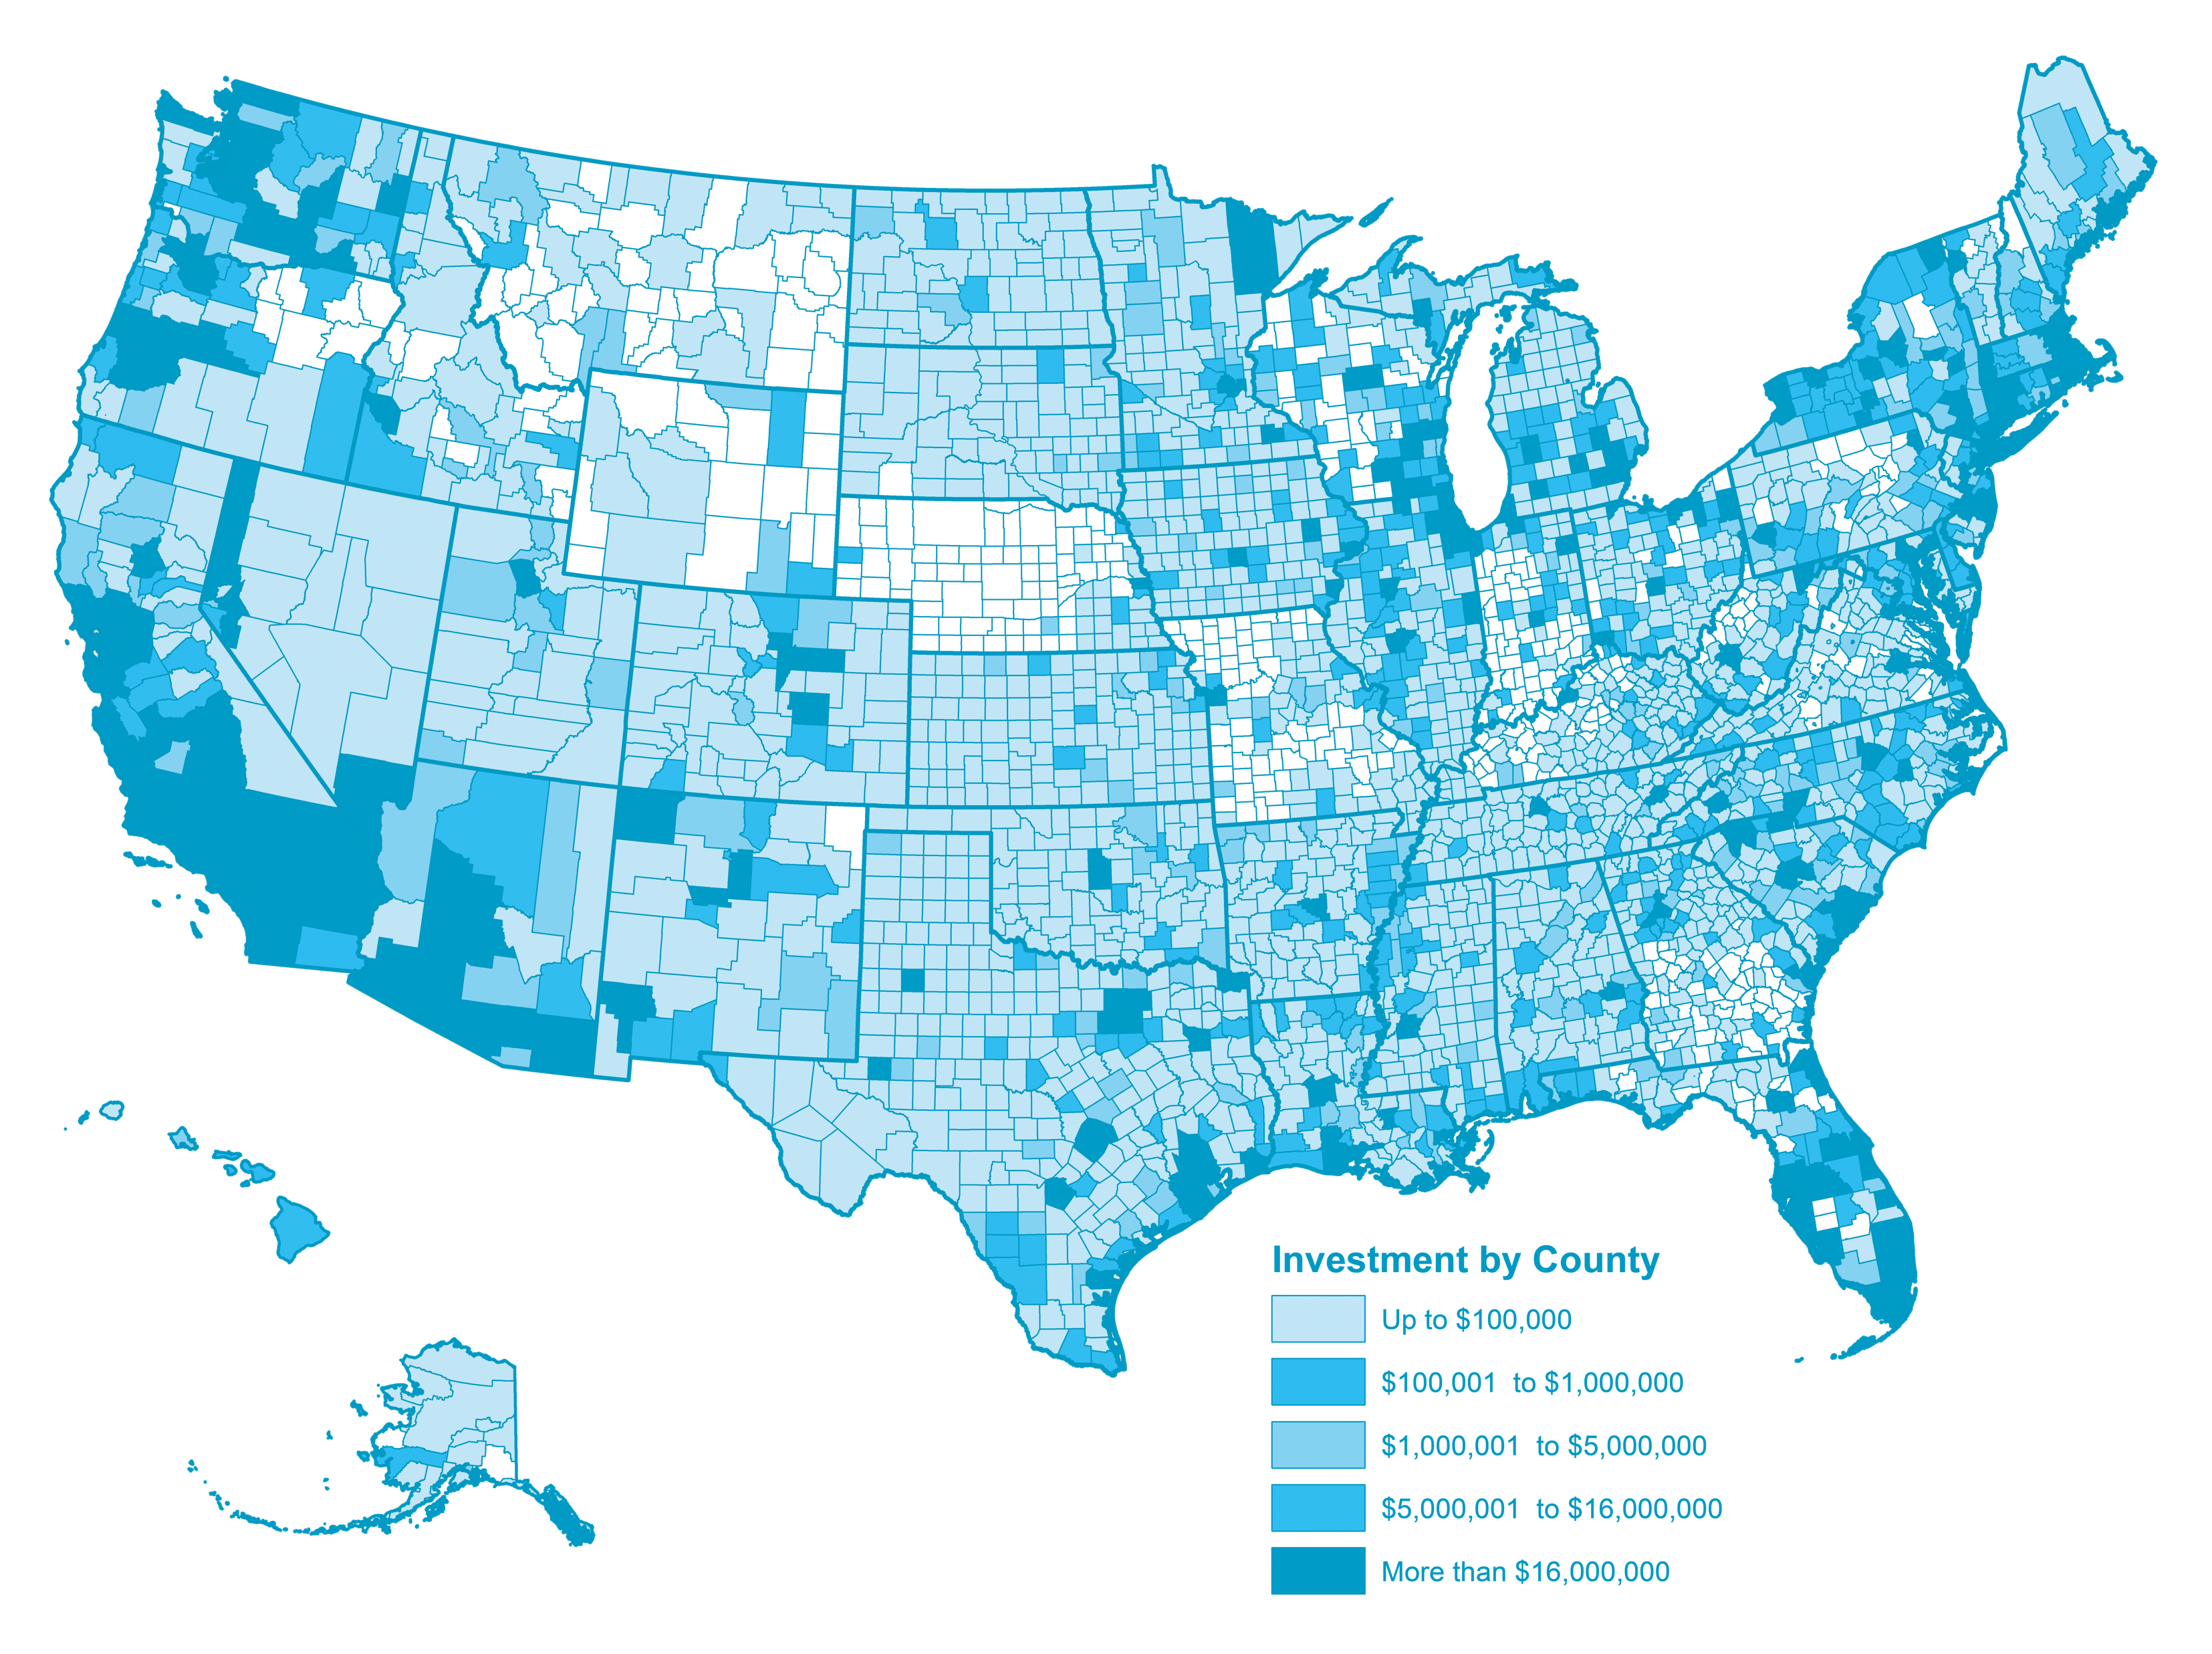



How LISC Works
We do this through:
Our network of
37 local markets and
nationwide rural program
Our four fund-management
and tax credit
syndication affiliates
10 program areas that
address all the building blocks
of community wellbeing

Slide 15


Panelist Introduction
Ben Mendelsohn
SVP, Director of Product Management
Head of Everyday Banking for Consumer and Small Business
Chair, Consumer Bankers Association Deposits & Payments Committee

Slide 16

Top performing regional bank with local scale and national reach
Assets
$213 billion
Ranked 10th in the U.S.¹
Leading position in the markets we compete in³
Toronto office
Deposit share rankings⁴
#3
Fifth Third footprint
Deposits
$164 billion
Ranked 9th in the U.S.¹
#2
Midwest
#6
Southeast
Top 10 deposit share in ~90% of retail footprint
U.S. branches
1,084
Ranked 8th in the U.S.¹
Significant locational share in notable MSAs
Chicago, IL
#3
Tampa, FL
#6
Midwest footprint
Nashville, TN
#3
Grand Rapids, MI
#1
London office
Commercial Payments
Top 5 market share
across several TM
product categories⁵
Southeast footprint
Charlotte, NC
#4
Columbus, OH
#3
Key Southeast MSAs of focus
Cincinnati, OH
#1
Indianapolis, IN
#3
Major FITB markets² with a top 5 deposit share
Assets, deposits, and branches as of 3/31/25; ¹Rankings as of 9/30/24 and consist of US commercial banks and exclude foreign, trust, & traditional investment banks; ²Includes MSAs with $5BN+ in deposits on a capped basis (deposits per branch capped at $250MM per June 2024 FDIC data); ³Data sourced from S&P Global Market Intelligence; ⁴Deposits per branch capped at $250MM per June 2024 FDIC data; Midwest and Southeast rankings represent in footprint deposit market share; ⁵Source: 2023 Cash Management Services Survey administered by EY

