Slide 1
Housing for Good:
Exploring Community Land Trusts (CLTs)
The Policy summit 2025
Federal reserve bank of Cleveland
June 26, 2025

Slide 2
Disclaimer
The views expressed here are those of the presenter and do not necessarily represent the views of the Federal Reserve Bank of Chicago or the Federal Reserve System.

Slide 3
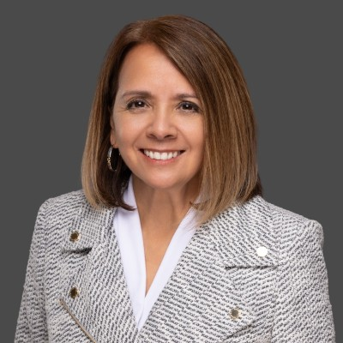
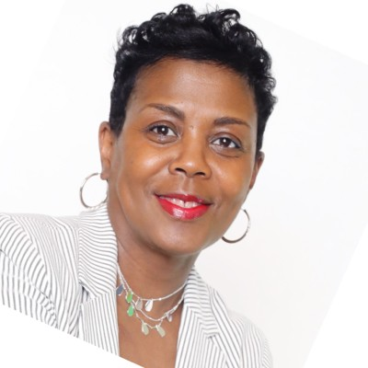
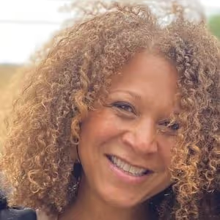
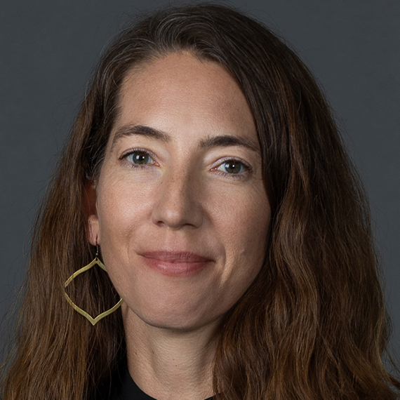
Introductions
Hope Paxson Jeanine C. Hatcher Mikeya Griffin Heidi Reijm
Central Ohio CLT Common Grounds CLT Rondo CLT FRB Chicago
Columbus, OH Detroit, MI St. Paul, MN Detroit, MI

Slide 4
Session Objectives
Learn about:
Community land trusts and how they work
Learn about different (and different types of) CLTs
Role of CLTs to promote affordable housing
Challenges and opportunities for CLTs
Whatever else you want to learn?

Slide 5
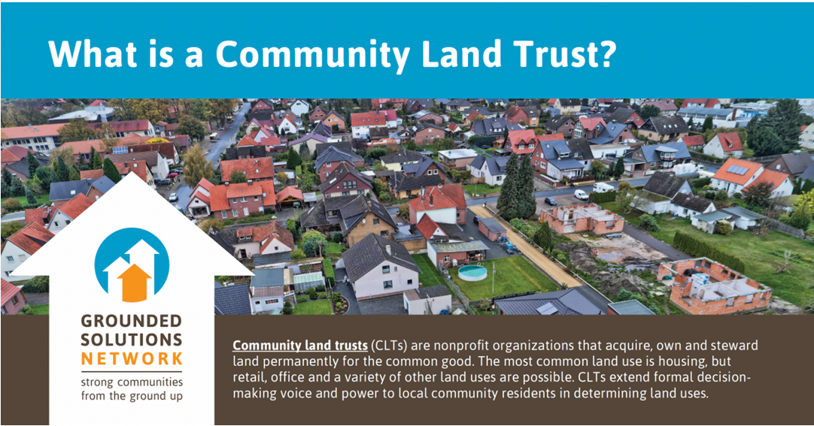

Slide 6
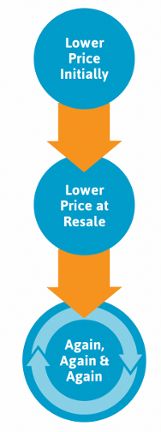
How a Community Land Trust Works
A typical community land trust for affordable housing works like this:
A family or individual purchases a house that sits on land owned by the community land trust.
The purchase price is more affordable because the homeowner is only buying the house, not the land.
The homeowners lease the land from the community land trust in a long-term (often 99-year), renewable lease.
The homeowners agree to sell the home at a restricted price to keep it affordable in perpetuity, but they may be able to realize appreciation from improvements they make while they live in the house.

Slide 7
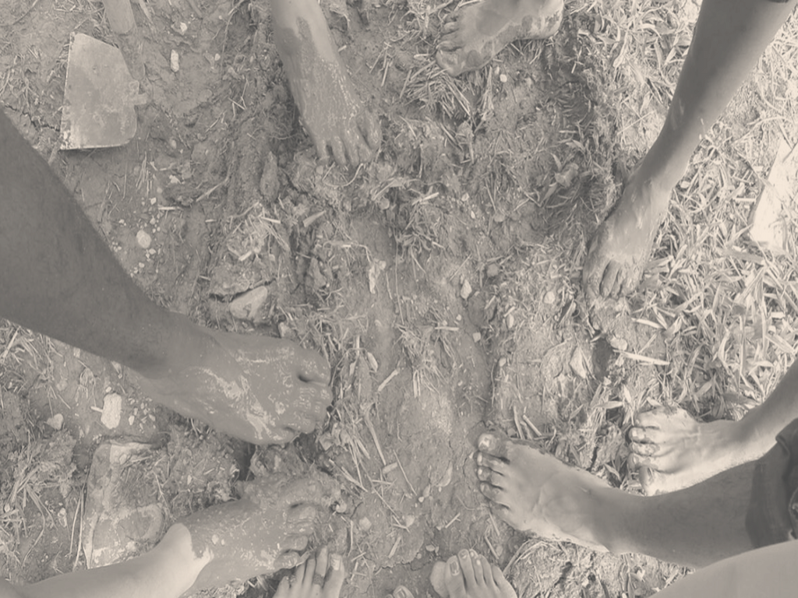

COMMON GROUNDS
UBUNTU
humanity to others

Slide 8

WHY?
COMMUNITY LAND TRUST
Notes:
Greetings,
There are lots of whys. Why? Why a CLT? Why Now? Why Detroit? Why these neighborhoods? And, a slew of other Whys.

Slide 9
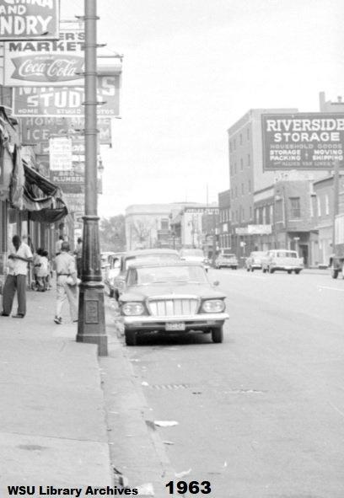
Mack Avenue
Detroit, MI
1963
Notes:
Growing up in the 60s, Mack Avenue was more than just a street; it was the lifeblood of our community, a bustling commercial corridor that beamed with life and energy. As a Black resident of Detroit, I remember how it served as a major transportation route connecting the neighborhoods of Pingree Park, Gratiot-Woods, and East Canfield to the north, and Islandview, Indian Village, and East Village to the south to downtown. The vibrancy of Mack was palpable, echoing the hopes and dreams of those who lived nearby.

Slide 10
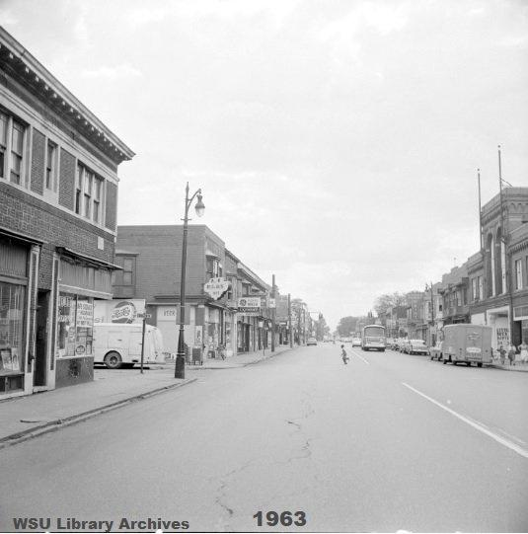
Mack Avenue
Detroit, MI
1963
Notes:
Back then, the avenue was lined with businesses, many were owned by Blacks—barbershops, grocery stores, and restaurants where the scent of home-cooked meals danced in the air. Each storefront was a testament to our resilience and entrepreneurial spirit, and it felt like there was a house on every lot, filled with families who mingled and mixed, regardless of their income. We shared everything: laughter, meals, and the occasional neighborly dispute. The social cohesion was strong; we were a tapestry woven together by shared experiences and dreams.

Slide 11
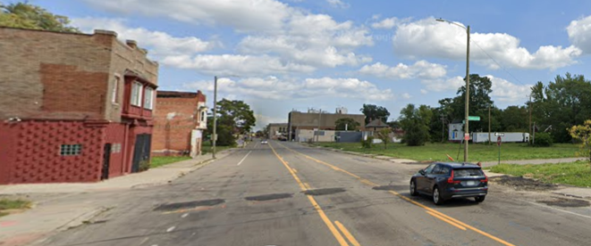
Mack Avenue
Detroit, MI
2024
Notes:
But fast forward 63 years, and the landscape of Mack Avenue has changed dramatically. What was once a thriving corridor is now marred by vacant lots and abandoned buildings, a stark reminder of the challenges our community faces. The vibrant energy I once knew has dimmed, and while Mack remains a popular transit route, it now serves as a dividing line rather than a unifying force.

Slide 12
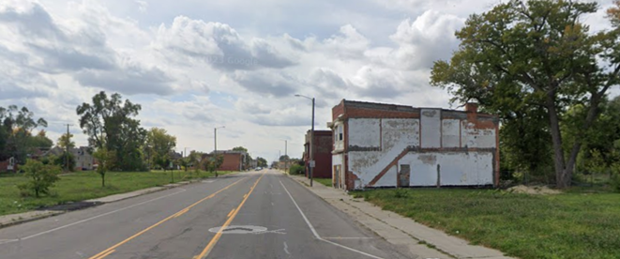
Mack Avenue
Detroit, MI
2024
Notes:
Yet, amidst this decline, something remarkable is happening. Residents from both sides of Mack Avenue, fueled by a collective sense of determination, are coming together to seize what many view as an opportunity to reshape our destiny. Two faith-based community development organizations have stepped up to lead the charge, rallying us around a vision of community ownership models for equitable economic development.

Slide 13

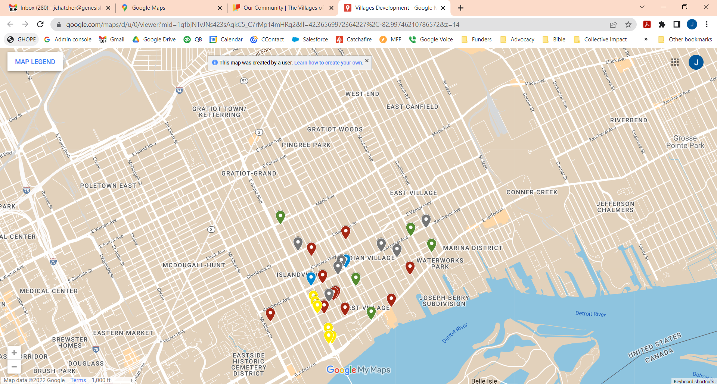




Economic
Development
Over 21 real estate development projects are in various stages and are concentrated south of Vernor adjacent to the Historic Indian Village, an affluent neighborhood.
Notes:
Since 2016, economic development has been rapidly occurring in one of the Mayor's first “strategic neighborhoods” - Islandview and the Greater Villages (Islandview, East Village, West Village, and Indian Village).
Gentrification is happening, too. People are being displaced as speculators and landlords seize an opportunity to make money. The neighborhood's economy has been stimulated and is continuing to do so.
The fear of displacement is real, the need for low and moderate-income, and affordable housing is real, and the loss of homeownership and Black wealth is real. So is our opportunity to do development differently in more equitable ways that honor those who are already here.

Slide 14
COMMON GROUNDS
INTRODUCTION
Notes:
We are forming Common Ground CLT, a community land trust that embodies the spirit of collaboration and unity. This initiative is about more than just reclaiming our streets; it’s about restoring our identity and empowering ourselves to build a better future. We are working together to create spaces that reflect our values, to establish businesses that serve our needs, and to foster a sense of belonging that had once flourished along Mack Avenue.
As I participate in these discussions and community gatherings, I feel a spark of hope igniting within me. The challenges are daunting, but the commitment of my neighbors reignites the flame of possibility. Together, we are not just dreaming of a revitalized Mack Avenue; we are taking action to make it a reality.
Mack Avenue may have changed, but the spirit of its people remains indomitable. With every step we take towards building a more equitable future, we are weaving a new narrative, one where our community thrives once again. This is our time to rise, to reclaim our place along Mack Avenue, and to ensure that its story continues to be written by those who call it home.

Slide 15
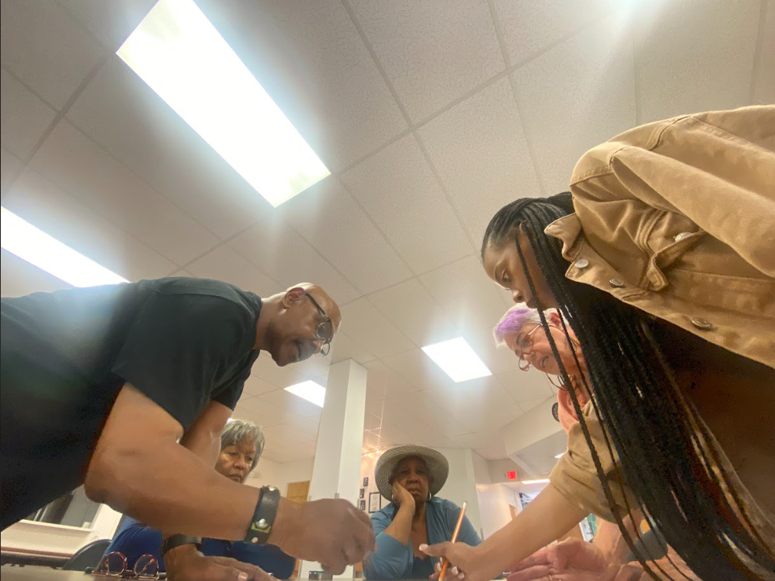
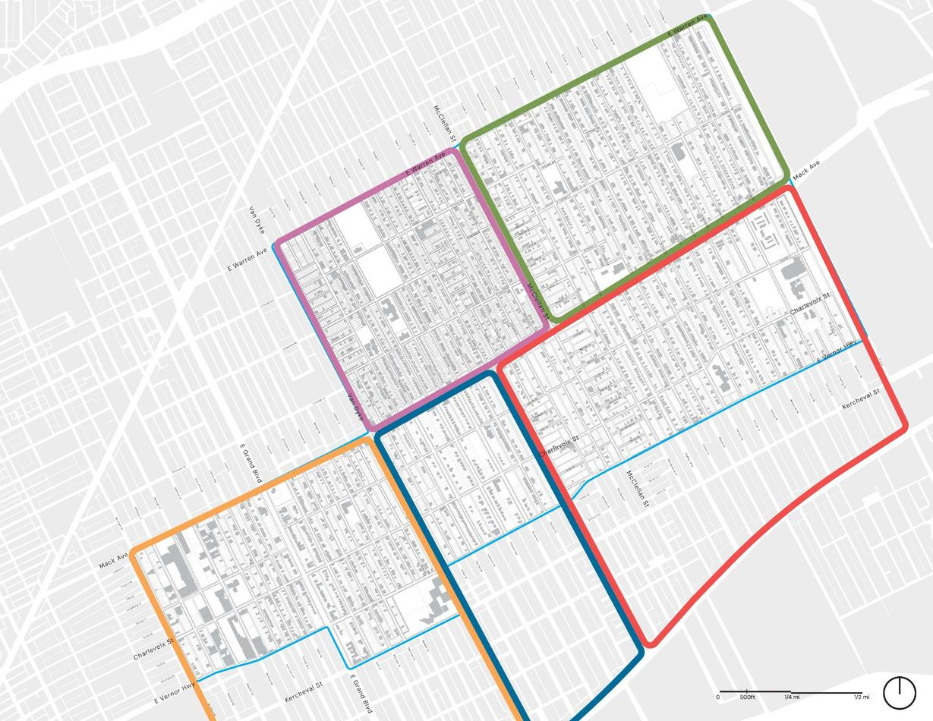

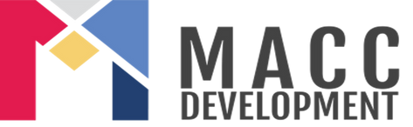







Our
Team
Resident Fellows & Advisory Board
Partners
Barb & Jourdin
Andrew & Jourdin
Consultants
Delores & Amy
Master Planning
Strategy &
Fund Development
CLT Formation and
Implementation Support
Land Acquisition
Marie
Community
Development
Strategies, LLC
Toyia
Notes:
Partners
The three organizing partners are the incorporators of Common Ground CLT.
Resident Fellows/
Advisory Board
The three organizing partners have engaged resident leaders to serve as Fellows to reach out to residents and educate neighbors.
The Fellows are the advisory board charged with designing the community land trust with the support and input of residents who are engaged in the process.
Consultants
The three organizing partners contracted with experts to support the residents with designing and implementing (a) a neighborhood plan, (b) a community land trust, and (c) a community investment fund.

Slide 16
“POWER is the ability to achieve a purpose. Whether or not it is good or bad depends upon the purpose.”
— Dr. Martin Luther King, Jr.
Notes:
We've built a team and are organizing residents to build power for community ownership models for equitable economic development and inclusive growth.

Slide 17
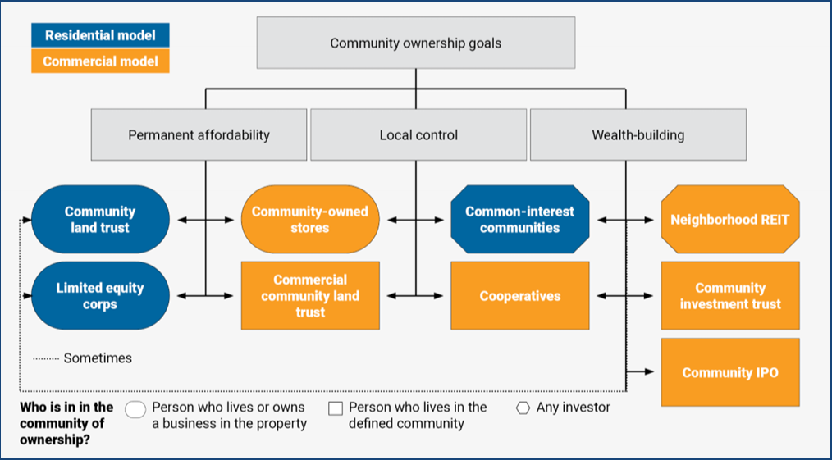

Our
Strategy
Notes:
For more than a decade, both GenesisHOPE CDC and MACC Development have served the Greater Villages neighborhoods, dedicated to supporting the residents and their priorities.
Through case studies like this excerpt from Brookings Institute's "Buy Back the Block", learning trips to NYC, New Orleans and Atlanta, resident surveying, community meetings, planning sessions, and other interactions with residents, GenesisHOPE CDC and MACC Development concluded that the community's path forward is a community ownership strategy that combines affordable homeownership with wealth generation

Slide 18


Our
Long Term Goals
In three years, prepare The Villages of Detroit, Pingree Park, Gratiot-Woods and East Canfield (Good Stock) communities, and the founding partner organizations, for a viable, community-governed, Community Land Trust with affordable housing options and commercial developments, for the sustainable future and common good of these neighborhoods. And a Community Investment Fund for residents to personally benefit by investing in the CLT’s development projects.
Solidarity
Notes:
Our goal is to prepare to launch a CLT and CIF, and I cannot emphasize enough the need for solidarity... the UNITY in Community!

Slide 19
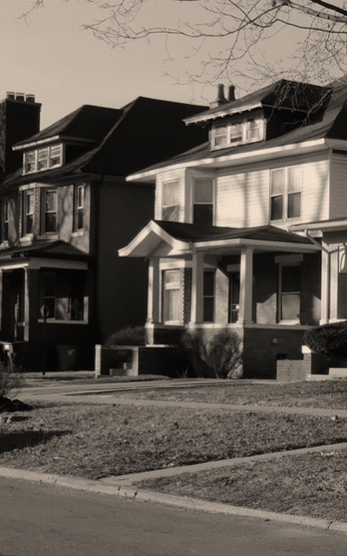

Our
Vision
The community controls large swaths of land, and with permanent land stewardship rights, provide pathways to homeownership, business development, and wealth creation for the common good of all members of the community.
SHARING
Our vision is based on a principle we all learned as children: SHARING!
Community Ownership Models (COMs) are based on SHARING equity for the common good of all.

Slide 20
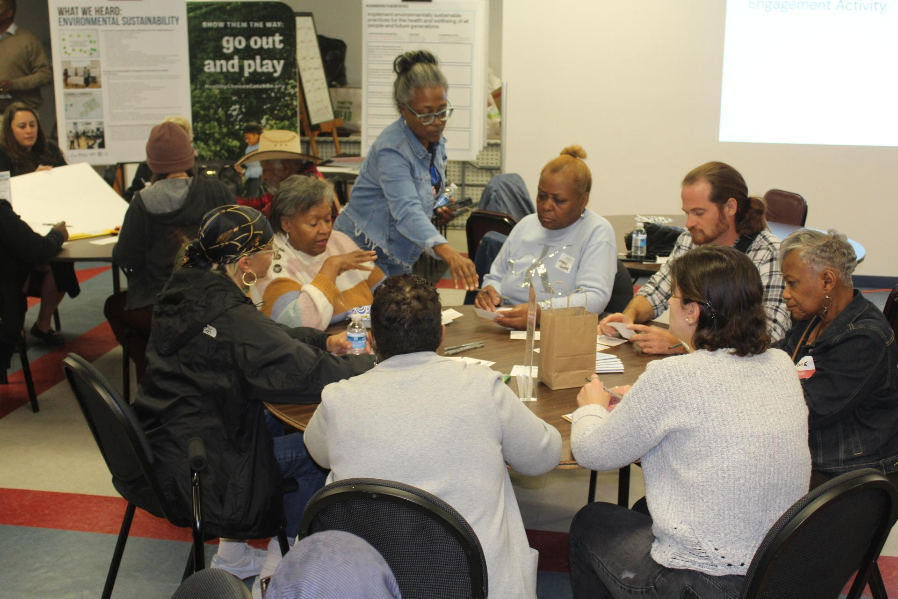
Our
Mission
Master Planning
How do you want to see development happen in our neighborhoods? What development do we, as residents, want?
POWER
Power Building
In gentrifying neighborhoods like Islandview, Greater Villages, and others, community ownership of land/property builds community power, provides affordable choices for homeownership, creates economically inclusive communities, and improves residents’ health and well-being overall.
Engaging, educating, and organizing to have ONE collective voice builds power to demand accountability.
Control, Choices & Stewardship
Owning land collectively equates to power to control what happens -- you can ensure families have choices.

Slide 21
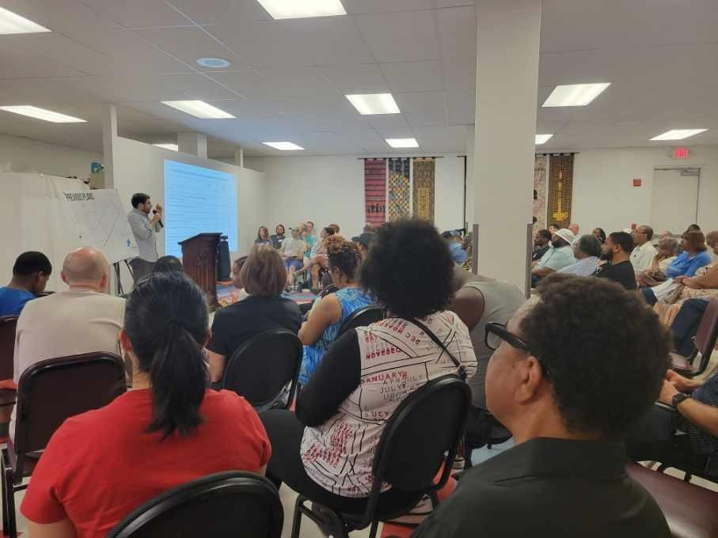
Our
Timeline
Offer to Purchase
2ⁿᵈ Bundle
17 Lots on McClellan
Development
09.2026
Option to Purchase
1ˢᵗ Bundle
10 Lots known as 3066 Beals
Pre-Development
HRD Plan
10 Lots on Beals
05.2025
08.2024
01.2021
10.2022
05.2024
06.2024
01.2025
CLT
Membership
Drive
(Ongoing)
Neighborhood Planning
(6-10 Months)
Land Acquisition
(On-Going)
Engagement,
Education &
Trust Building
(Ongoing)
Planning & Fundraising
(24-32 Months)
CLT
Planning
(6-10 Months)
Notes:
For a membership CLT with a tripartite board (the "Classic" CLT), allow ample amount of time for community engagement, education, and trust building.
Tripartite - The board of directors of the "classic" CLT is composed of three parts, each containing an equal number of seats. One third of the board represents the interests of people who lease land from the CLT (“leaseholder representatives”). One third represents the interests of residents from the surrounding “community” who do not lease CLT land (“general representatives”). One third is made up of public officials, local funders, nonprofit providers of housing or social services, and other individuals presumed to speak for the public interest ("public representatives"). Control of the CLT’s board is diffused and balanced to ensure that all interests are heard but no interest is predominant.

Slide 22
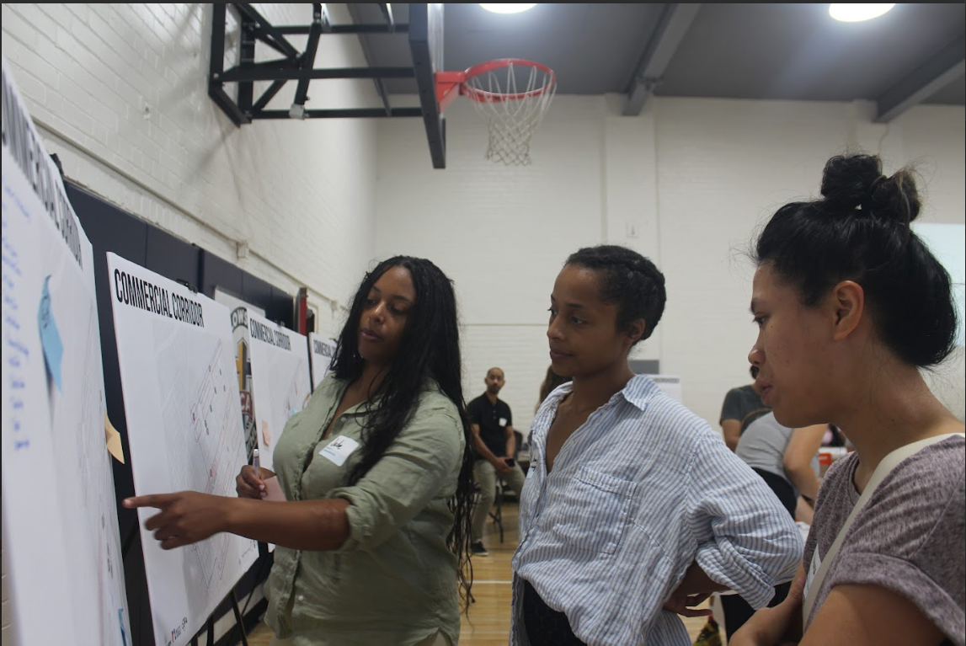
“You can’t have a community land trust without the community, land and the people trust the CLT will act on behalf of the common good for all the people.”
Community
A geographical place where people live, work, learn
and play.
Land
The ground upon which people walk and build places to live, work, learn and play.
Trust
Stewardship of land, in perpetuity,
for the
common good
of all the people.
Notes:
Our philosophical definition…

Slide 23
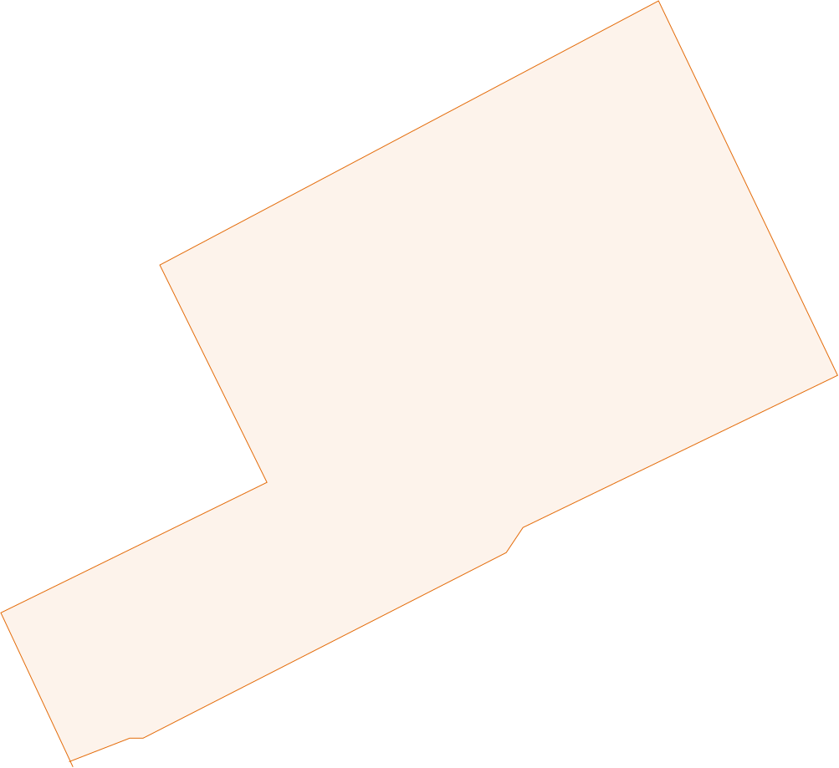
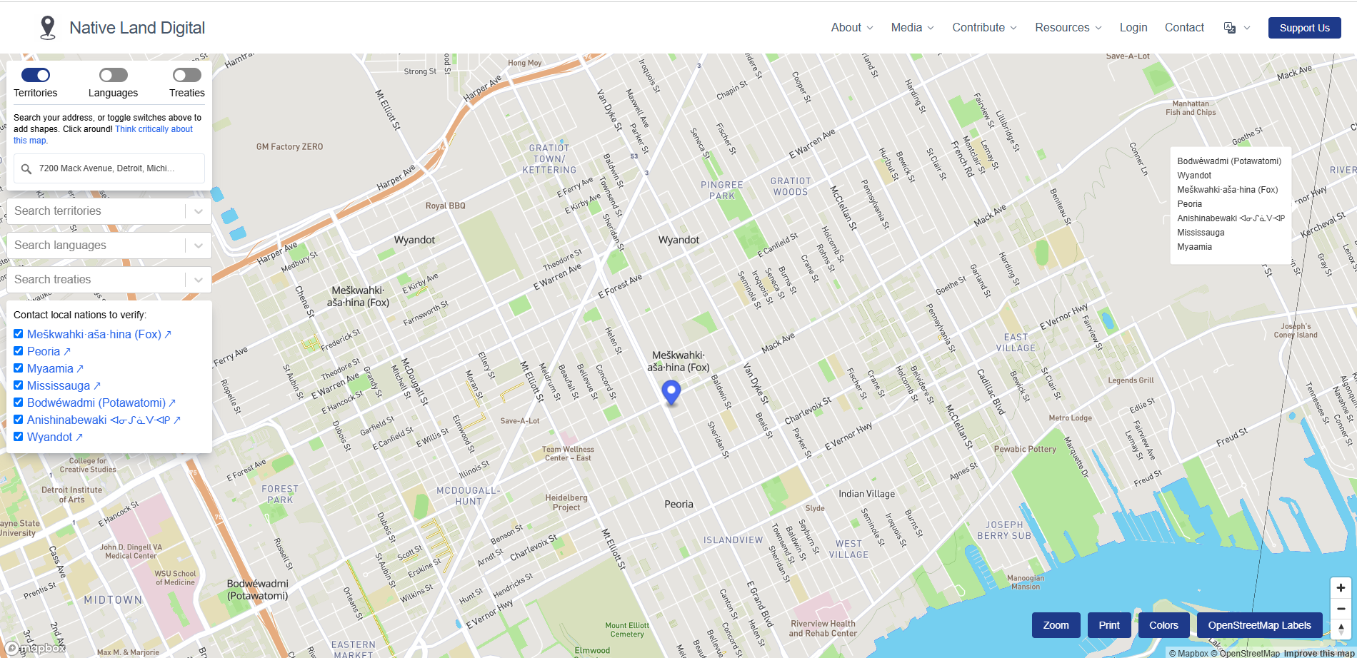
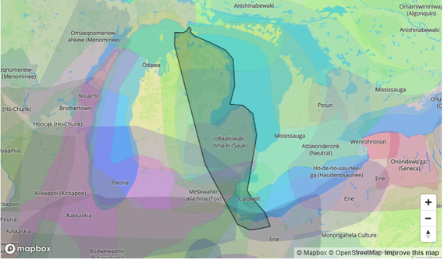
The Land
GenesisHOPE would like to acknowledge the land of the Meskwahki asa hina (Fox), Peoria and Wyandot territories. Detroit Treaty of 1807 was a treaty between the United States and the Ottawa, Chippewa, Wyandot and Potawatomi Native American nations. Signed November 17th, 1807, in Detroit, Michigan, the Potawatomi, Chippewa, Ottawa, and Wyandot nations ceded eight million acres to the U.S. Government for roughly 1.2 cents per acre, which is equivalent to 23 cents per acre in 2021 (Leatherbury, 1977, p. 20; $0.01 in 1807 → 2021 | Inflation Calculator, n.d.).
Wyandot of Anderson Territory
Wyandot: Indigenous people from the Neutral/Petun Nations; a people from a peninsula.
Sources: https://waseyabek.com/1807-treaty-of-detroit/#:~:text=Signed%20November%2017th%2C%201807%2C%20in,(Leatherbury%2C%201977%2C%20p. | https://native-land.ca/
Notes:
If we are going to talk about and advocate for what is equitable, then we must first begin by acknowledging that the land we are talking about belonged to indigenous people, the Fox Peoria and Wyandot territories ceded 8 million acres to the US government for $96,000
https://waseyabek.com/1807-treaty-of-detroit/#:~:text=Signed%20November%2017th%2C%201807%2C%20in,(Leatherbury%2C%201977%2C%20p
https://native-land.ca/
11

Slide 24
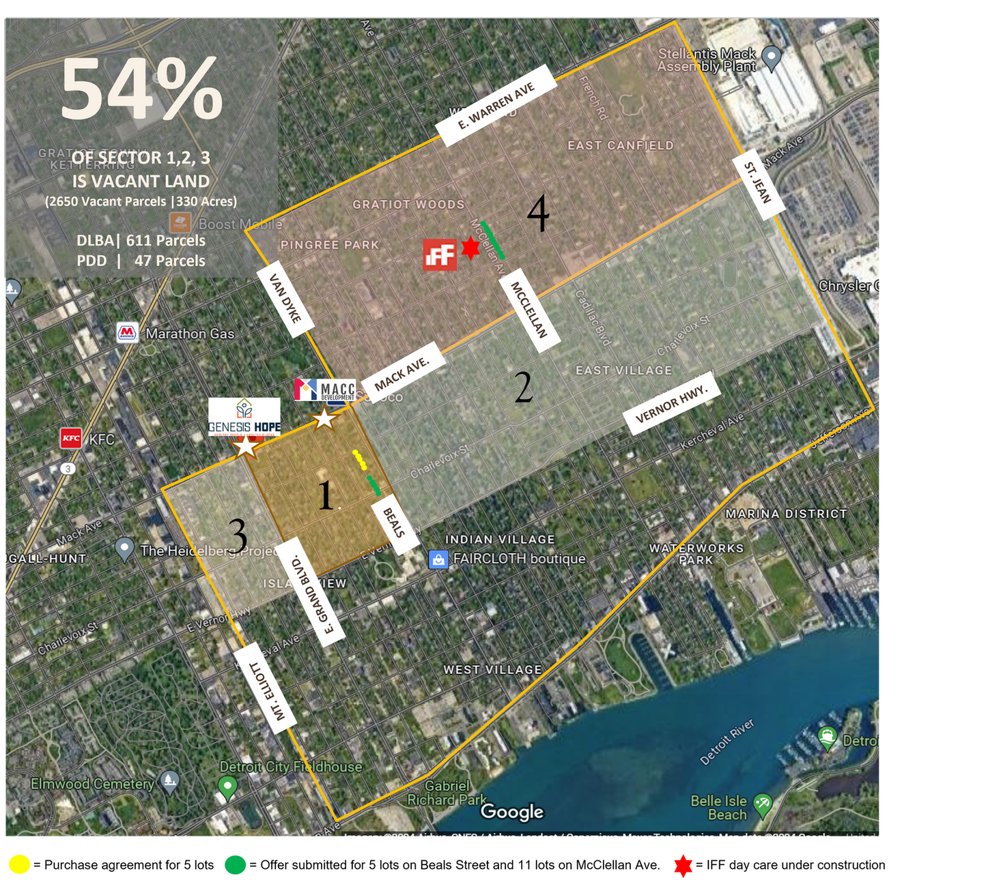
Our Land
Acquisition Strategy
    Initial Impact Area – Purchase vacant land on Beals Street to create density and impact adjacent to Mack Avenue, GenesisHOPE & MACC Development’s offices, and other new development projects.
    Eastern Section – Control and maintain while working with DLBA, private landholders, and potential partners.
    Western Section – hold and maintain for future use.
    Northern Section – Control/hold and maintain while developing Beals Street properties. DLBA has offered 11 lots near the new IFF daycare development project.
Notes:
54% of sectors 1-3 is vacant land. There's over 300 acres of vacant land. Of the 2,650 vacant parcels, the Detroit Land Bank Authority owns 611 (23%). Our initial goal is 150 parcels.

Slide 25
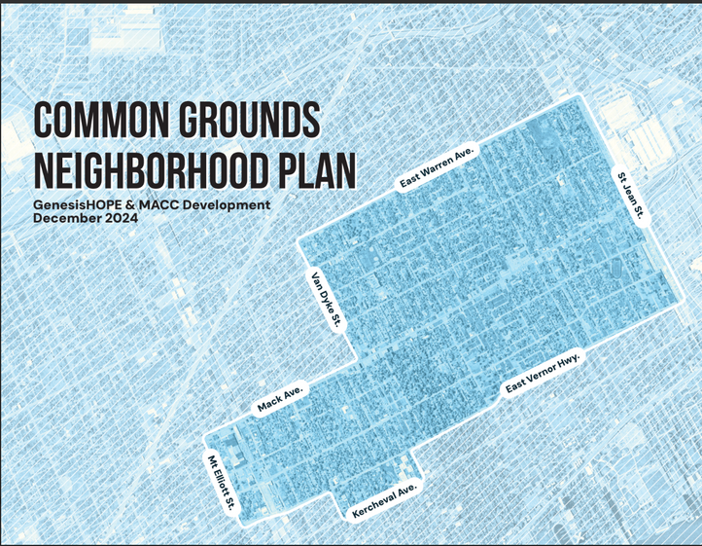
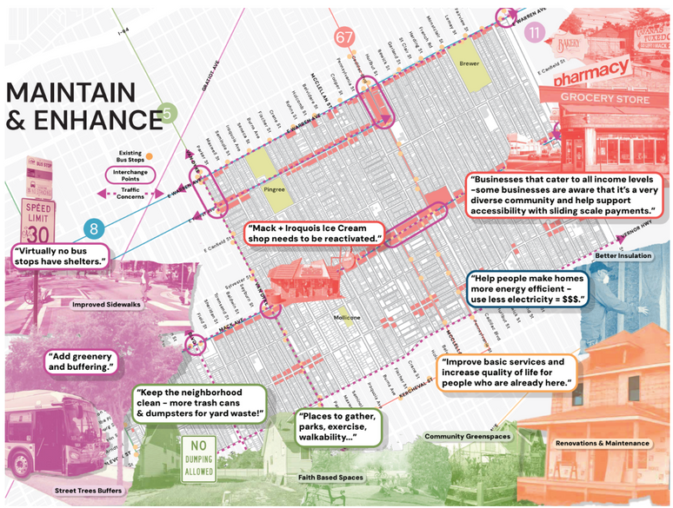
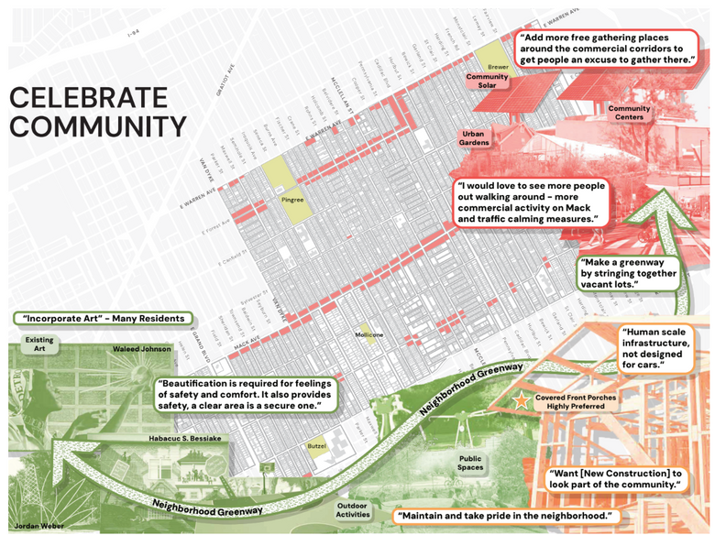
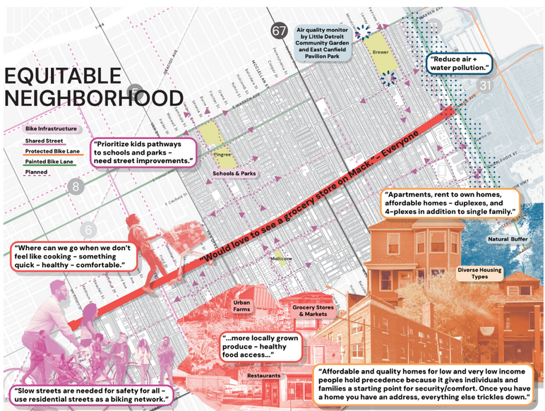
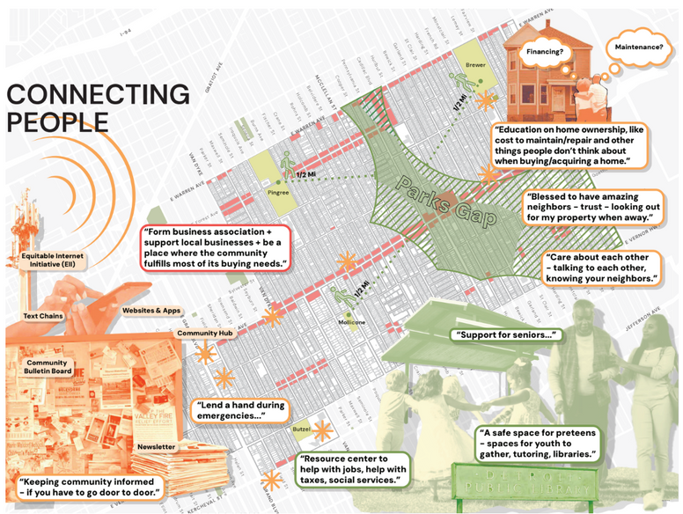
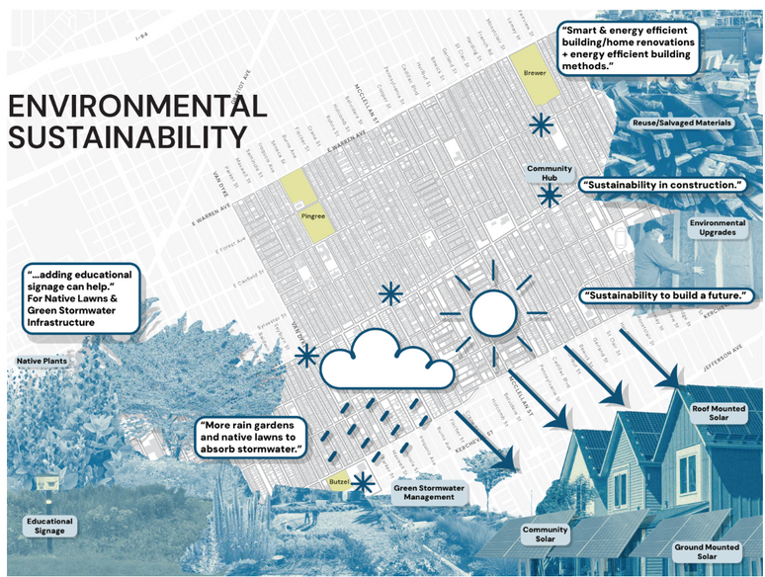
The Plan
Notes:
Neighborhood Plan serves as a guide for Common Grounds, AND OTHER DEVELOPERS. The flashing stars are some opportunities for our CLT to participate in the implementation of the community's plan like:
Renovating Homes and restoring the Old Ice Cream Shop to MAINTAIN & ENHANCE the community.
Ensure new construction projects look like they are part of the community to CELEBRATE COMMUNITY.
Affordable homeownership is the cornerstone of the modern CLT, but affordable rentals and commercial spaces like a grocery store can make NEIGHBORHOODS EQUITABLE, and according to the most recent Lincoln Institute Report, more and more CLTs are broadening their portfolios.
Protecting Green spaces that CONNECT PEOPLE are also ways CLTS can and should steward land for the common good of the neighborhood it serves.
CLTs must act responsibly and build places that are ENVIRONMENTALLY SUSTAINABLE.
https://www.lincolninst.edu/publications/policy-focus-reports/city-clt-partnership/

Slide 26


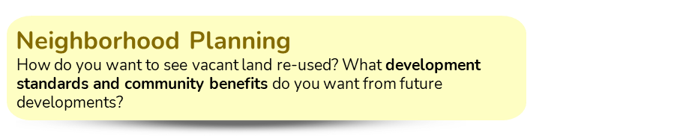
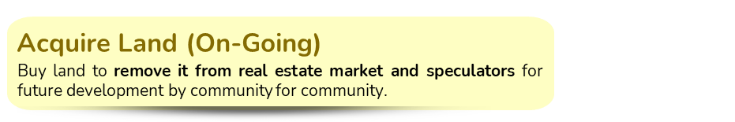
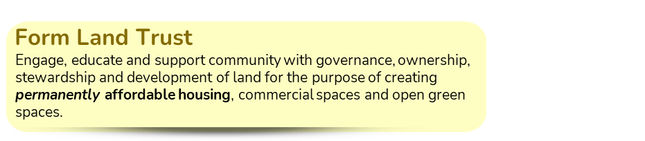
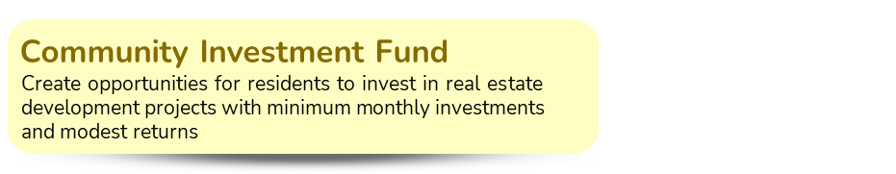
150
Permanently Affordable
Homes
Our Accomplishments
133
Residents
10
Lots
7
Fellows/
Advisory Board
13
Resident Advisors

Slide 27
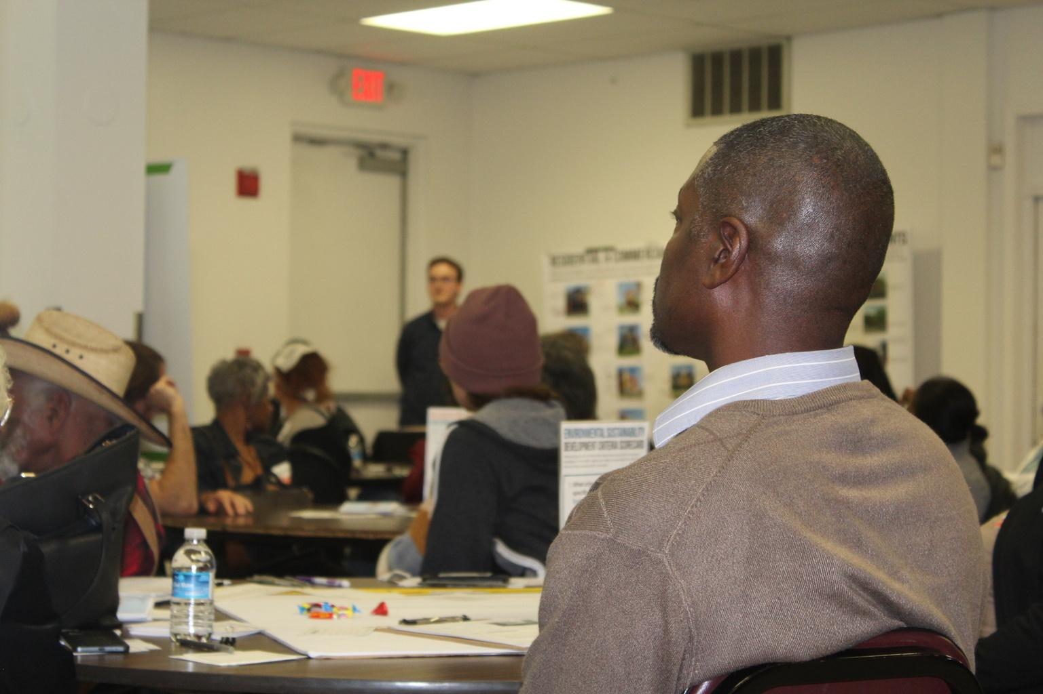
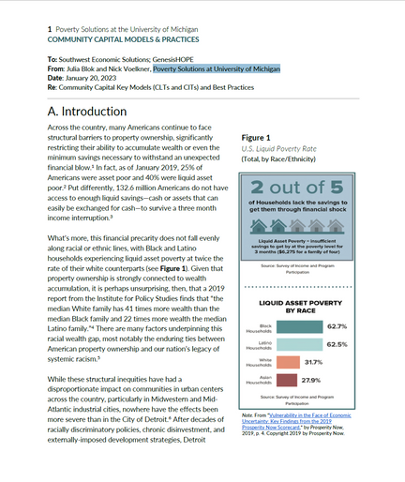
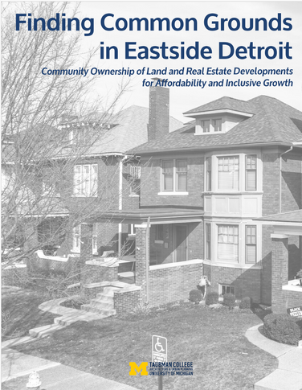
More Accomplishments
25
Stakeholders
Community Ownership Learning Table (COLT)
Convened the first funders’ briefing to introduce and socialize community ownership models that are now known as the COLT, co-led by Kresge and Detroit Federal Reserve Bank.
2
White Papers
CLT Recommendations for Detroit
The University of Michigan, Poverty Solutions, prepares best practices for COMs, and a Taubman College capstone makes recommendations for CLTs and CIVs specifically for Detroit.
Notes:
Capstone:
https://deepblue.lib.umich.edu/handle/2027.42/193529
Community Capital:
https://files.constantcontact.com/43983a0f001/d953b5d4-97f2-412b-a557-5dba39e669cc.pdf

Slide 28
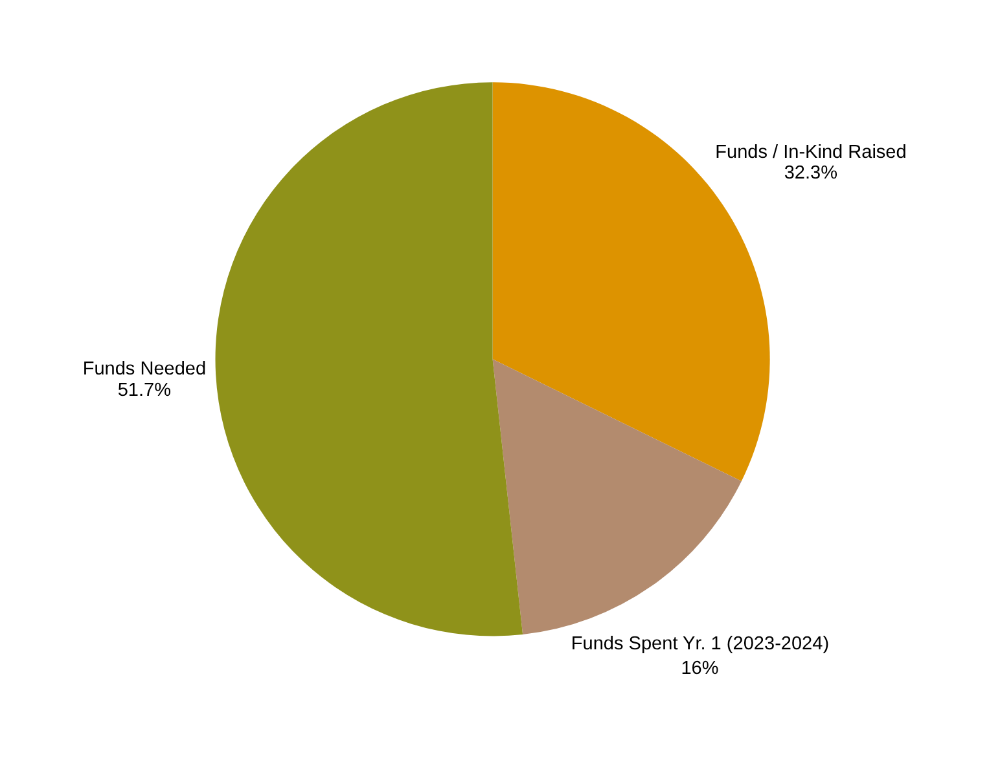
2023 – 2026 BUDGET* | $1.724MM
Our
Budget
Community Outreach,
Engagement & Education
Neighborhood Planning
CLT Formation
Acquisition
Pre-Development
* Does NOT include construction or
CIF Backstop costs
Notes:
$441,185.00 - Raised
$218,815.0 - Spent
------------------------
$660,000 Total raised

Slide 29
To SHIFT POWER from a capitalistic market-driven system to a community ownership system requires solidarity.
Solidarity

Slide 30
WE must execute a campaign that builds a movement for community ownership models like the CLT to drive permanent affordability: housing, commercial, and other assets, for the...
Common Good of Us All.

Slide 31
Collective Power
to create – or resist – change.
It is seeing where we are, where we want to go and how others can help us get there.

Slide 32
COMMON GROUNDS
UBUNTU
humanity to others
DETROIT
CLT COALITION

Slide 33
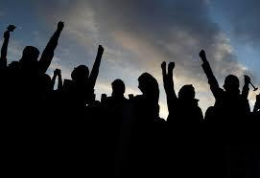
Why
Collective Power
FUND
DEVELOPMENT
MESSAGING
PEER
LEARNING
WORKING
TOGETHER
ADVOCACY
Notes:
32

Slide 34

Our
Policy Goals
The Roles
Collaborative NOT Competitive
Community Land Trust
(Goal: 150 Parcels)
OWN & STEWARD
LAND IN PERPETUITY
Detroit Land Bank Authority
(611+ Parcels)
HOLD
LAND TEMPORARILY

Slide 35
Our
Policy Goals
CLT Ordinance
Criteria for standard disposition of land by DLBA to CLTs across all neighborhoods, define CLT to protect authenticity, and set compliance guidelines that allows CLTs to steward land in perpetuity, and provides ample time to organize, educate and engage stakeholders, and raise capital and/or identify development partners.
Fair and Predictable Property Tax Assessments
Predictable and fair assessments of land and improvements held by CLTs, with a framework for PILOT and LIHTC.
Permanent Affordability Funding
State and local funding for permanent affordable housing and other CLT holdings.
CLT Capacity Building
State and local funding to build capacity for a CLT ecosystem, including capital for pre-development and gap financing, to support and preserve permanent affordability.

Slide 36
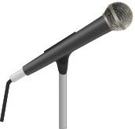
COMMON GROUNDS
Q&A

Slide 37
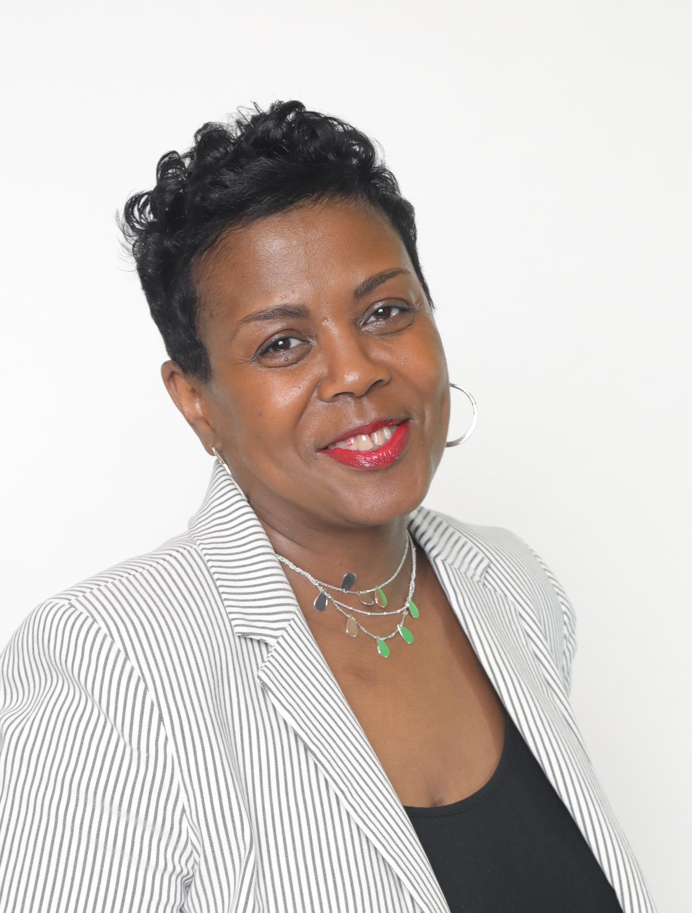

Jeanine C. Hatcher
Executive Director
Incorporator & Organizer
Website & E-mail
www.GenesisHOPE.org
Makaila Lucas, Project Manager
MLucas@GenesisHOPE.org
Office Address
7200 Mack Ave., Detroit, MI 48214
Phone
313.571.0937

Slide 38
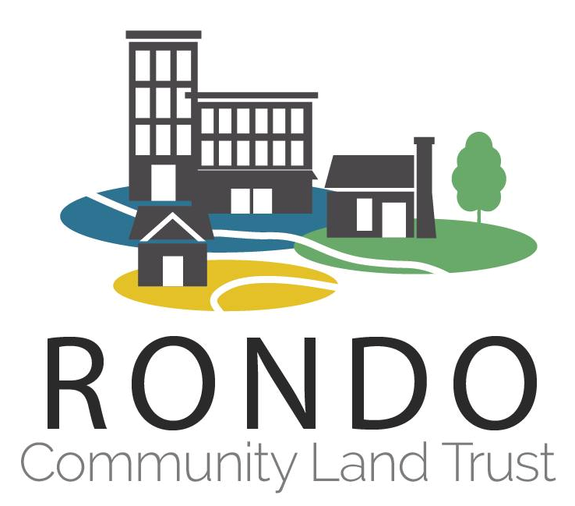
Building Permanent Affordability and Community Wealth
Mikeya Griffin
Executive Director
Rondo Community Land Trust
St. Paul, Minnesota

Slide 39
The Community Land Trust Model: Addressing Affordable Housing Needs
Founded in 1993, Rondo CLT spearheaded the community land trust movement in Minnesota, becoming the state's first residential and commercial (2017) land trust.
Our work is deeply connected to the Rondo neighborhood of Saint Paul, a community severely impacted by the construction of Interstate 94 in the 1950s and 60s, which displaced over 300 businesses and 700 homes. We set out every day to restore lost homes, businesses, and generational wealth in neighborhoods that have faced similar challenges.
Our mission is to use the land trust model to create permanently affordable home and business ownership opportunities that support long-term stability and strengthen neighborhoods in St. Paul and suburban Ramsey & Dakota Counties, providing a real pathway to the American Dream for low-to-moderate income families.

Slide 40
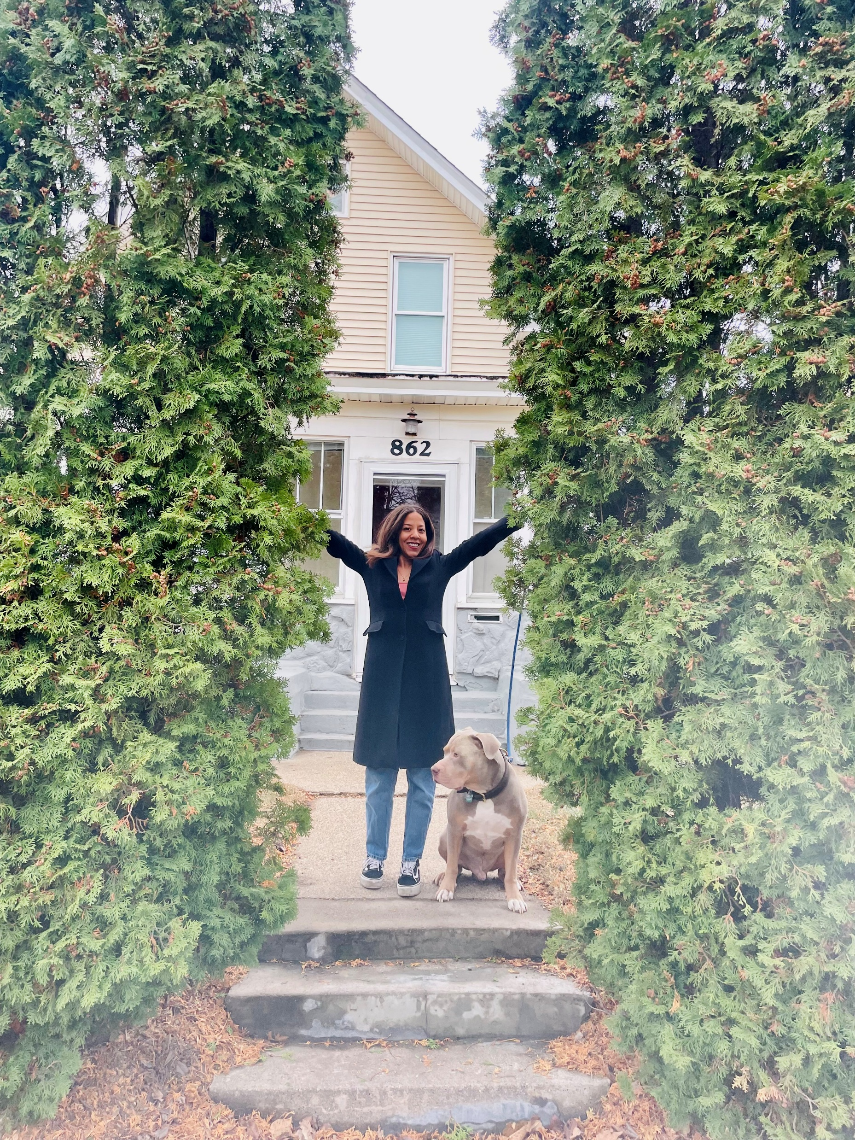
Generating Permanent Affordable Housing & Resident-Driven Investment
We serve low-to-moderate income families (earning 80% Area Median Income and below) across St. Paul and suburban Ramsey and Dakota Counties, ensuring housing and economic opportunities are within reach
Residential Programs
  Homebuyer Initiated Program
  Right to Return to Rondo Initiative
  City of St. Paul’s Inheritance Fund
  Pre-purchase and post-close stewardship: CLT education, financial literacy and wealth building tools, home rehabs, and continued support long after purchasing homes.

Slide 41
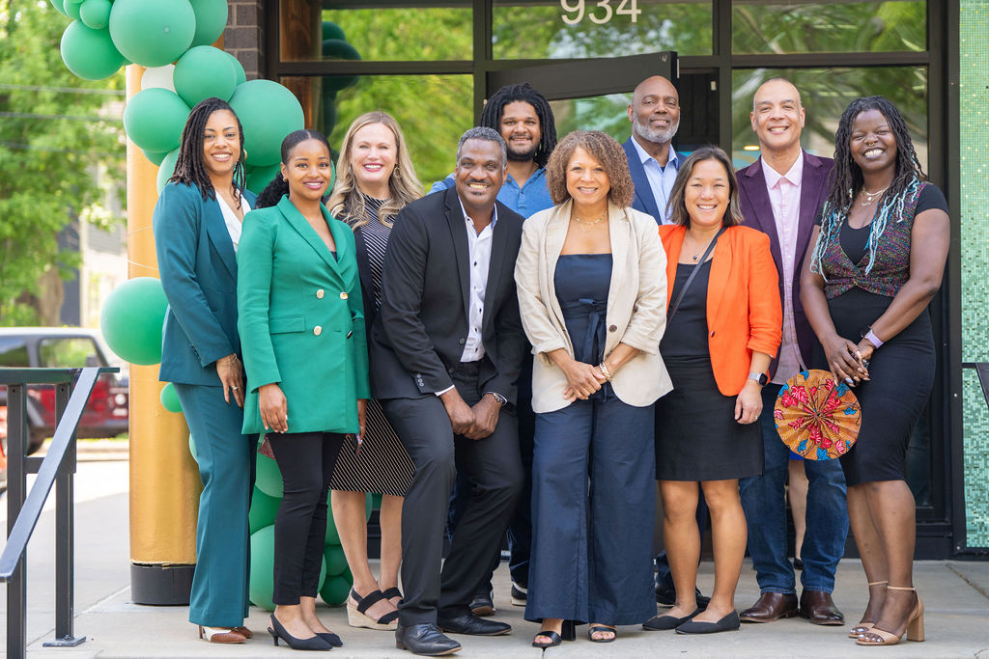

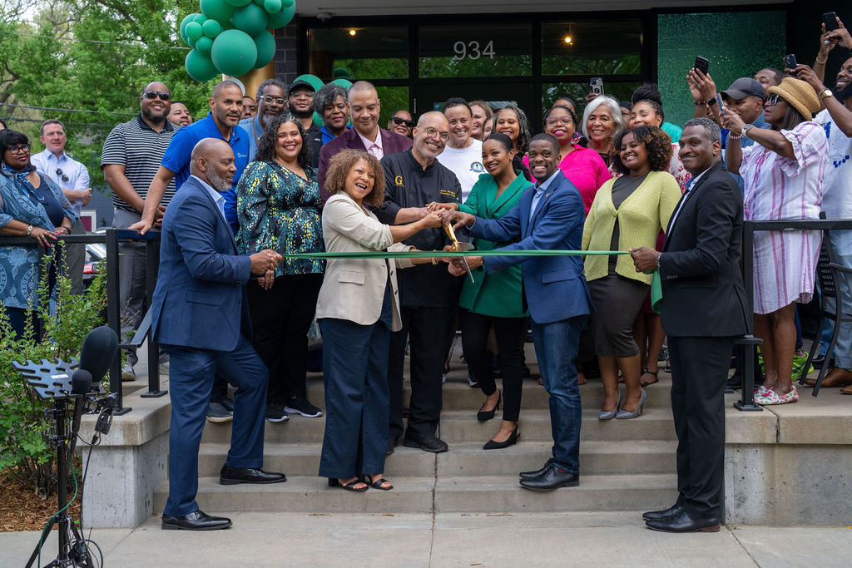
Commercial Opportunities for Redevelopment
Affordable Lease Rates
($7/sq ft) A fraction of market rates, giving local entrepreneurs a vital chance to grow and thrive.
Small Business Incubator & Golden Thyme Café and Restaurant
Resident-driven investment that revive community assets and create jobs, ensuring wealth circulates

Slide 42
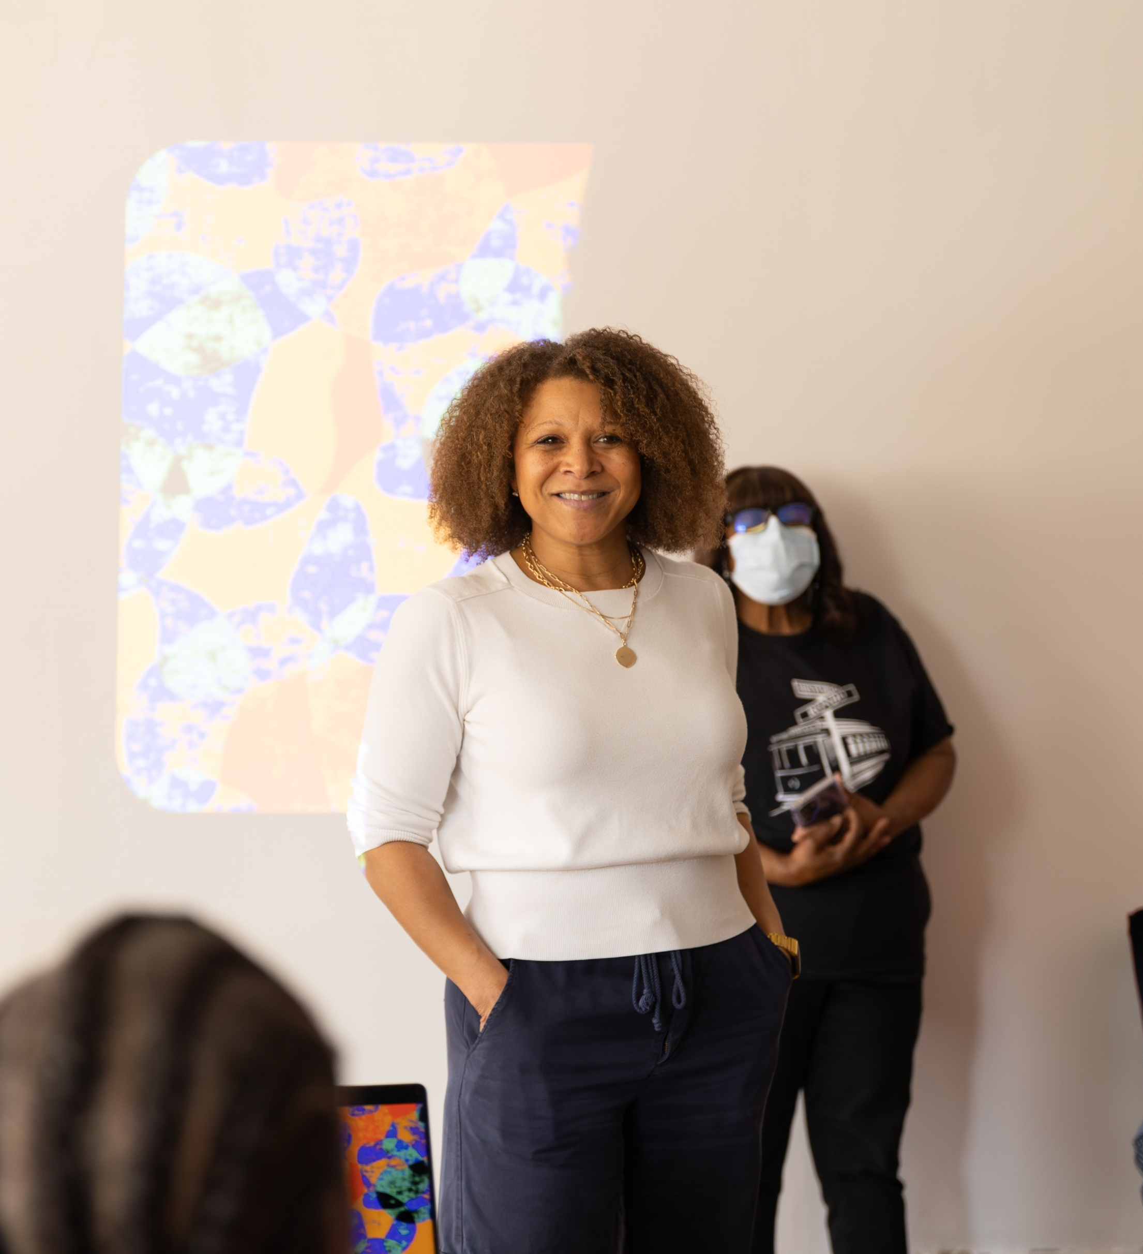
Core Impact
The Rondo Community Land Trust model emphasizes long-term affordability, sustainable economic opportunity, and local investment, fostering a whole-community view for residents, commerce, and culture.

Slide 43
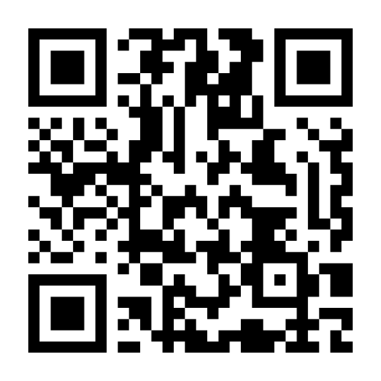
Thank you!
Mikeya Griffin
mikeya@rondoclt.org
Connect with me on LinkedIn!

Slide 44
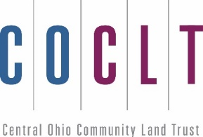

The Federal Reserve Bank of Cleveland Summit, Cleveland, Ohio
The Central Ohio Community Land Trust
Presented by: Hope Paxson, COCIC

Slide 45
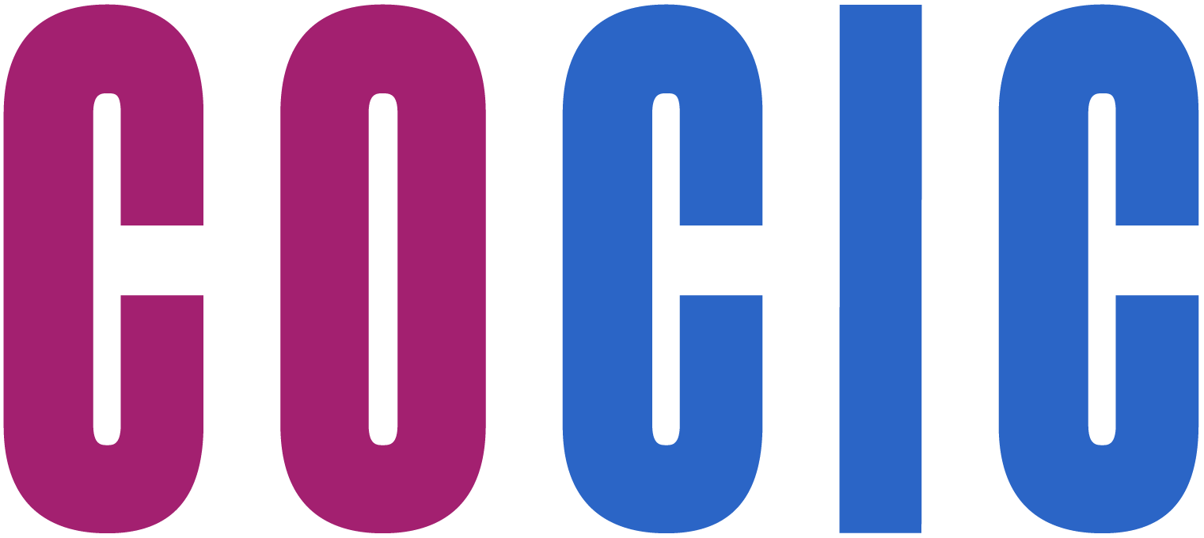
Serving on behalf of the Franklin County Commissioners, COCIC is a land reutilization corporation, (land bank) formed in 2012
COCIC’s initiatives deal with blighted, abandoned and stranded properties for re-use and restores them back to a productive property tax base for the county.

Slide 46

COCIC’S MISSION
REMOVING
REMOVING BARRIERS.
ACQUIRE PROPERTIES IN ORDER TO IMPROVE THE QUALITY OF NEIGHBORHOODS
REUSING
REUSING LAND.
INCREASE PROPERTY VALUES AND RETURN UNPRODUCTIVE PROPERTIES TO CONTRIBUTING, TAX-PAYING STATUS AND BEST RE-USE
REBUILDING
REBUILDING COMMUNITIES.
CREATE DIVERSE HOUSING AND BUSINESS OPPORTUNITIES

Slide 47
Designated Delinquent Tax Assessment Collection (DTAC) Funding
OHFA’s Neighborhood Initiative Program and the Ohio Attorney Generals’, Moving Ohio Forward Programs
COCIC, RECEIPIENT OF GRANTS FUNDS AWARDED TO COUNTY LAND BANKS FOR RESIDENTIAL DEMOLTIION
2014-2018 Funding Awards- $35.5 Million Dollars
Demolished over 3,500 units of blighted residential properties
COCIC, RECIPIENT OF DESIGNATED FUNDS FOR LAND BANK OPERATIONS AND INITATIVES
Approximately $3.5 Million Annually
The Ohio Department of Development Demolition and Site Reutilization Program
COCIC SERVING AS LEAD ENTITY AND APPLYS FOR DEMOLITON FUNDS FOR COMMERCIAL PROJECTS IN FRANKLIN COUNTY.
The Ohio Department of Development Brownfield Remediation Program
COCIC SERVING AS LEAD ENTITY AND APPLYS ON BEHALF OF PROJECTS SEEKING FUNDS FOR ENVIRONMENTAL HAZARD REMEDIATIONS AND ASSESSMENTS.
2023-2025 Funding Awards over 2 rounds - $28,409,000
2023-2024 Funding Award - $28,908,000
Second Round Still Pending – an additional ask of $11,000,000

Slide 48
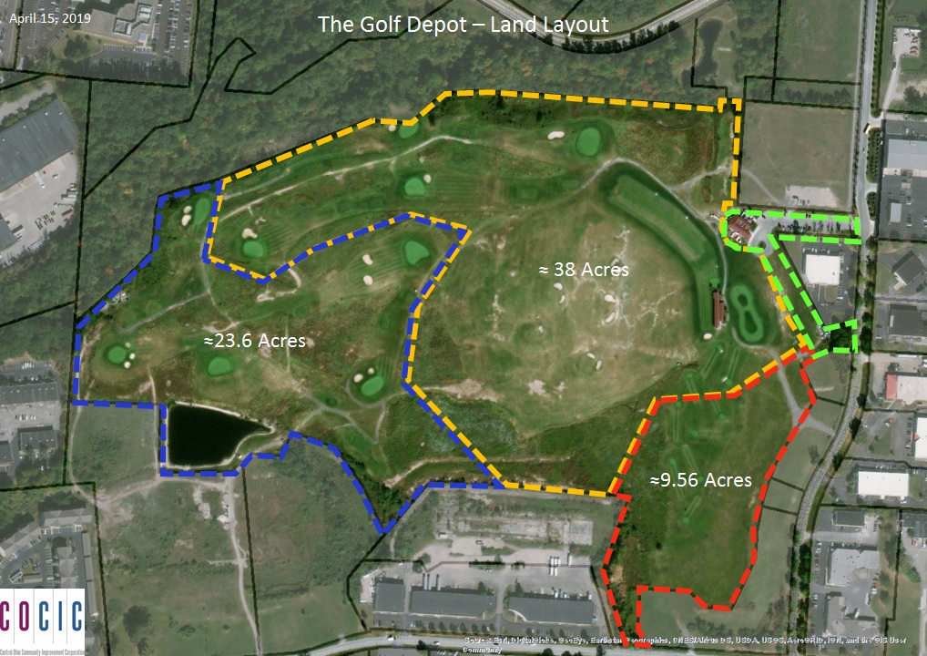
Bedford Landfill
Gahanna, ohio

Slide 49

The EDNA Project
Revitalization PROJECTS for community and economic
DEVELOPMENT

Slide 50

In 2018-Franklin County’s Land bank is ASKED TO ESTABLISH the CENTRAL OHIO community land trust
COCIC has county and city government partnerships
COCIC has relationships with nonprofit housing agencies for affordable housing projects
COCIC and the City of Columbus Land Bank have over 1,800 parcels of land
COCIC has capital to support a new 501 (c)(3)

Slide 51

-80,000 Central Ohioans severely burdened by housing costs.
(spending more than 50% of income on housing)
-Between 2009 and 2019, a single home was bult for every 2.5 jobs created in
Columbus.
-Since January 2013, Columbus added more than 150,000 jobs.
-Average Columbus home sale price in august 2023, $367K. With Median household income at $62,352.
-The Affordable Housing Alliance of Central Ohio, Finding Home in the heart of it all, October 24, 2023

Slide 52

A Community Land Trust (CLT) is a nonprofit, community-based organization committed to the permanent stewardship of land and the permanent affordability of housing and other buildings or uses located upon its land.

Slide 53


How
COCLT BUILDS HOMES
ON LAND BANK PARCELS AND SELLS THE STRUCTURE
TO A BUYER AT
A SALES PRICE
THAT IS AFFORDABLE
----------------------------------------------------------------------------------------
IF OWNER WANTS TO SELL
COCLT can purchase the property back or owner goes through the sale process outlined in the land lease.
Owner recoups original investment and shares in the gained equity based on a shared appreciation model.
New income-qualified owner can purchase the property at a price below current market rate cost.
LAND REMAINS IN THE OWNERSHIP OF THE COCLT IN PERETUITY AS A COMMUNITY INVESTMENT
COCLT STILL OWNS THE LAND, PROVIDES A
99 YEAR LEASE TO BUYER
Income qualified buyer
Future income qualified buyer

Slide 54
Re-sale formula
Achieve an equitable and sustainable balance between preserving affordability and building wealth
----------------------------------------------------------------------------------------
If the preservation of affordability allows no wealth build-up for present homeowners, there is no balance.
If the build-up of individual wealth allows no affordability for future homebuyers, there is no balance.
Present Homebuyer
Future Homebuyer

Slide 55
A dual approach
TO DEVELOPMENT
COCLT BUILDS HOMES ON LAND BANK LOTS
COCLT is the developer and works with general contractors to build homes or
COCLT hires a developer for larger scale projects to provide capital for the project
COCIC purchases the property and sells the homes to eligible buyers.

Slide 56



Slide 57




Slide 58


Slide 59


Slide 60


Thank You
Hope Paxson
https://cocic.org
hpaxson@cocic.org
https://coclt.org

