Slide 1
Builders Wanted
Investing in the Construction Workforce to Boost Affordable Housing Supply
Policy Summit 2025
Cleveland, OH
June 26, 2025

Slide 2
Disclaimer
The opinions and thoughts expressed in this presentation are solely those of the presenters and not endorsed by the Federal Reserve Bank of Kansas City or Federal Reserve System

Slide 3
Today’s Session
Housekeeping
Panelist Introductions
Research Overview
Teach Nebraska Trades Program
A Builder’s Perspective
Moderated and Audience Questions
Conclusion

Slide 4
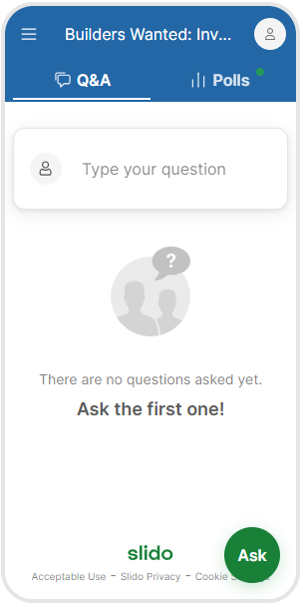

Housekeeping
Use the QR Code to pose questions to panelists or
Join at Slido.com
#4334 952
Questions will go through moderation
Up-vote questions from other attendees that you want answered
Toggle between the Q&A and Polling Tabs throughout today’s session

Slide 5
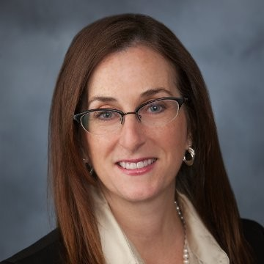

Panelists
Shannon Harner
Executive Director
Nebraska Investment Finance Authority
George Davis, III
Founder and President
ProBuilt Homes

Slide 6
Relevant Research
Sophie Huang, Joint Center for Housing Studies, Harvard University: “Rebuilding the Construction Trades Workforce,” June 5, 2024.
  Construction trades workforce remains significantly smaller than the mid-2000s housing boom
  Labor shortage factors: difficulty in attracting and retaining young people and women and decline in new immigrant trades workers who have historically filled labor gaps (avg. 45,000 annually from 2010-19 compared to 88,000 annually from 2003-2009).
The Home Builders Institute Construction Labor Market Report, Fall 2024.
  8.3M payroll construction workers in the U.S.; 3.4 M in residential construction
  Estimated required amount of annual construction worker hiring is approximately 723,000
  Average hourly wages increase 4.3% in past year
  Women make up a growing share of construction employment, reaching 10.8% in 2023 compared to 9.1% in 2017

Slide 7
Increasing Workforce to Address Housing
Teaching Nebraska Trades (TNT)
June 26, 2025

Slide 9
Reframing Housing as Economic Development
Beds are where our jobs sleep at night

Slide 10
Reframing Housing as Economic Development
Businesses cannot expand, sustain or relocate when housing is unavailable.
If we don’t ensure enough affordable and attainable housing Nebraska will not only lose billions of dollars; it will lose the people that call it home.

Slide 11
Nebraska’s Housing Landscape

Slide 12
Time for a Quiz

Slide 13



Please download and install the Slido app on all computers you use
What is the population of Nebraska?
ⓘ Start presenting to display the poll results on this slide.

Slide 14
Please download and install the Slido app on all computers you use
What percentage of Nebraska's population live in rural areas?
ⓘ Start presenting to display the poll results on this slide.

Slide 15
Please download and install the Slido app on all computers you use
How many people live in the least populated county in Nebraska?
ⓘ Start presenting to display the poll results on this slide.

Slide 16
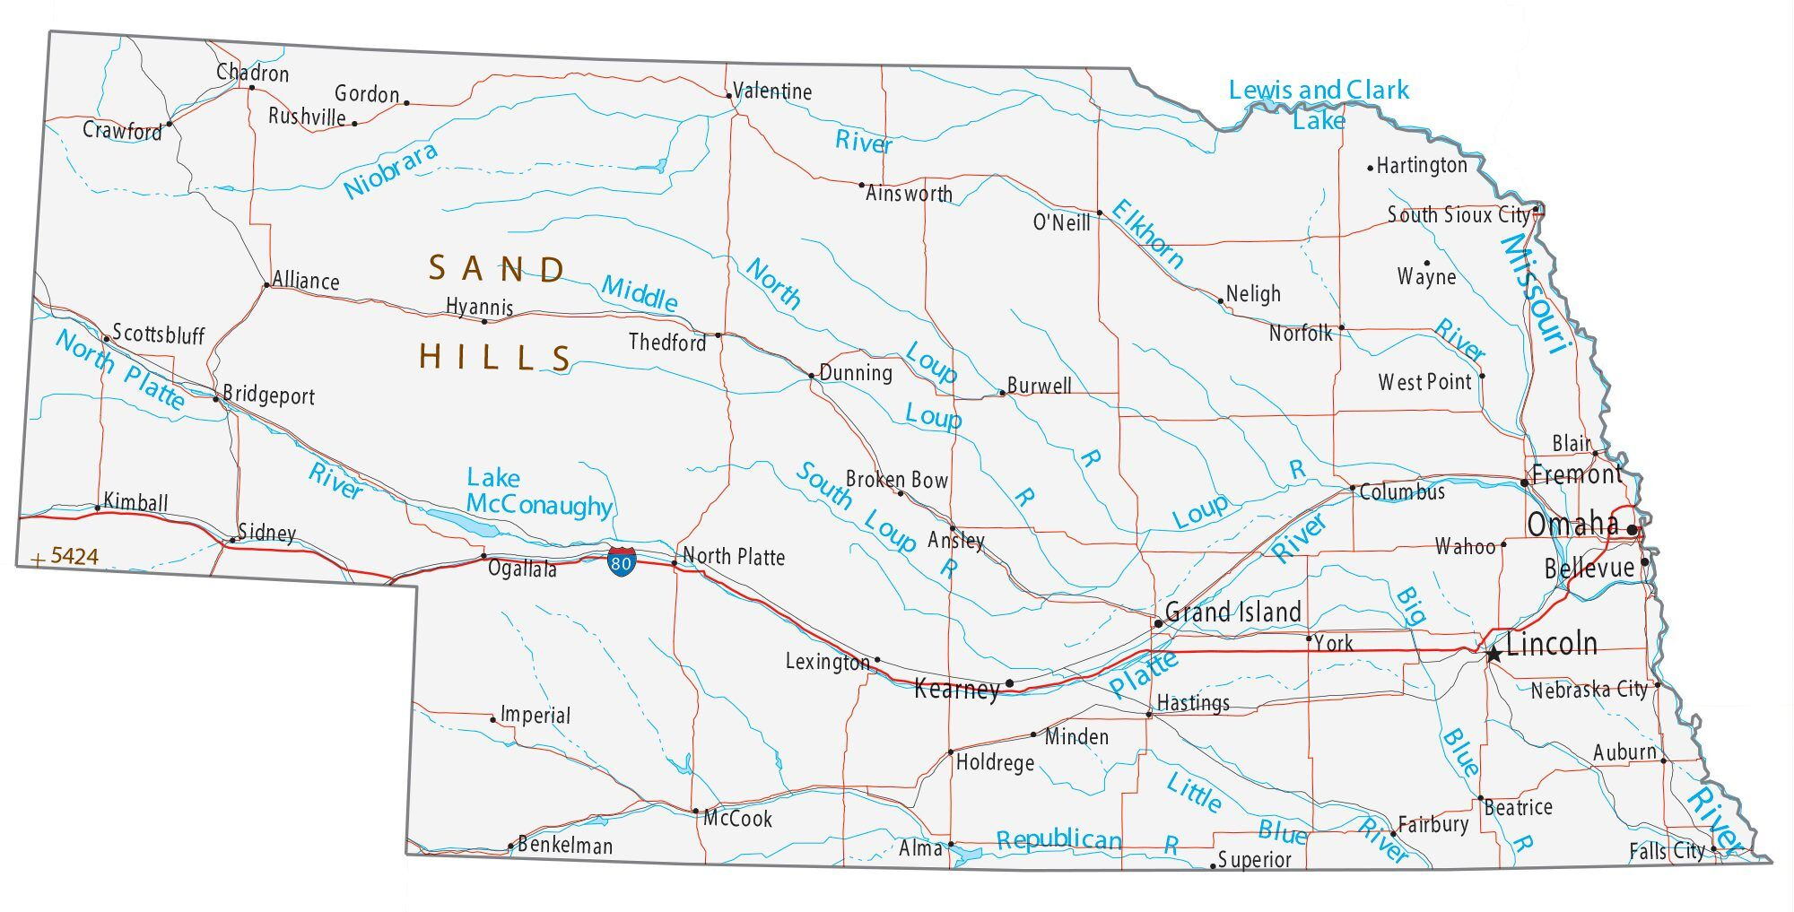
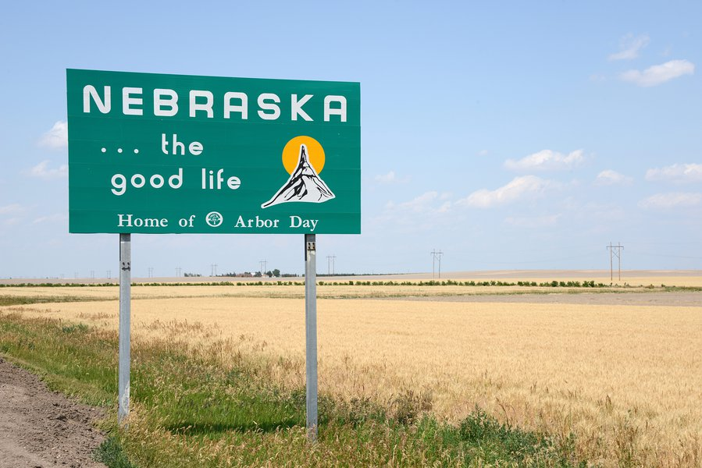

Quick Facts
Nebraska Population: 1,965,926
Number of Households: 786,885
Median Household Size: 2.4 People
51.14% of Nebraska's population live in Lincoln and Omaha Metro Areas.
Geographics:
  The Only Triple-Landlocked State in the U.S.
  430 Miles East to West
  210 Miles North to South
  93 Counties
  Most populated county: Douglas (248,692)
  Least populated county: Arthur (230)

Slide 17
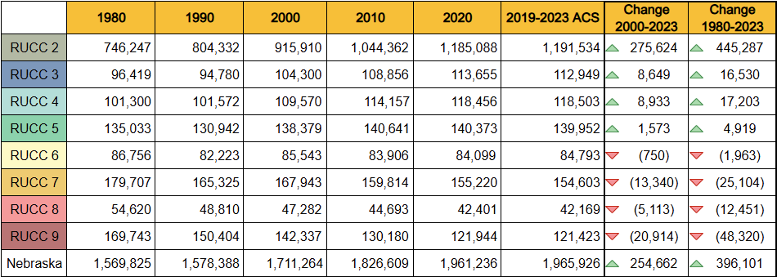
Population Trends
Between 2020 and 2023, Nebraska has seen a net gain of about 5,000 people centered predominately in Metro and Nonmetro areas with populations of 20,000 or more (RUCCs 2 - 5).
  Unofficial estimates saw Nebraska's population crest 2 million early this year.
RUCCs 6-9 saw a decrease in population.
RUCC 7 experienced the greatest decrease of population (617 people) since 2020.
Source: U.S. Census Bureau, American Community Survey 2019-2023

Slide 18
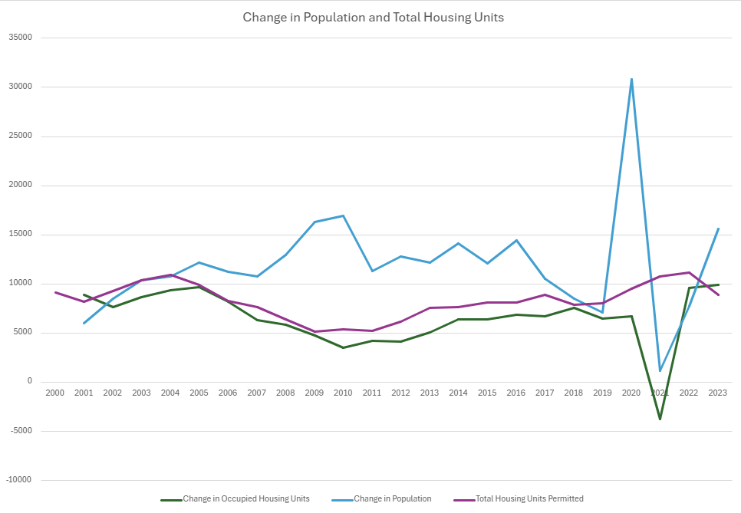
Change in Population and Total Housing Units
Change in Occupied Housing Units
Change in Population
Total Housing Units Permitted
Source: U.S. Census Bureau, American Community Survey 2019-2023

Slide 19
Time for a Quiz

Slide 20
What is a Rural Urban Continuum Code?
ⓘ Start presenting to display the poll results on this slide.

Slide 21
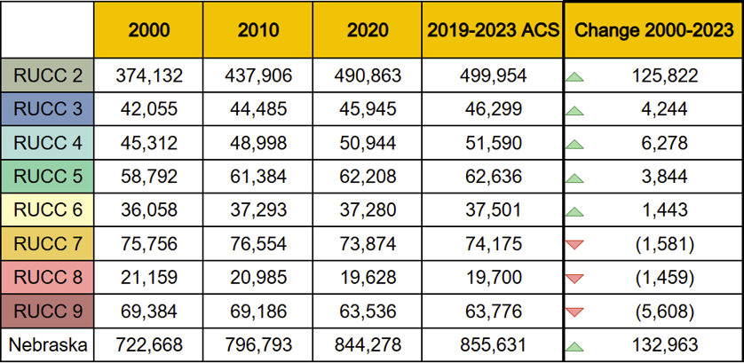
Housing Availability
Since 2000, the total number of housing units has increased by 132,963 across the state, largely supported by RUCCs 2, 3, 4, 5, and 6.
While all RUCCs saw an increase in the number of housing units since 2020, the number of total units for RUCCs 7, 8, and 9 have decreased by about 8.6k total units.
Estimates gauge Nebraska's housing shortage between 100,000 and 120,000 units across the owner-occupied and renter-occupied markets.
Source: U.S. Census Bureau, American Community Survey 2019-2023

Slide 22
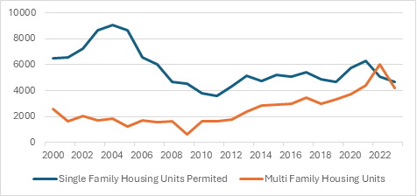
Permit Rates by Type
Until 2022, single family housing far outpaced the permitting of multi-family housing.
Permitting rates have been increasing, but still trail rates seen in the first decade of the millennium.
A dip in permitting was seen in 2023, further data will be needed to confirm whether this is an outlier or a trend.
Source: U.S. Census Bureau, American Community Survey 2019-2023 and National Association of Homebuilders

Slide 23
Planning for Success

Slide 24
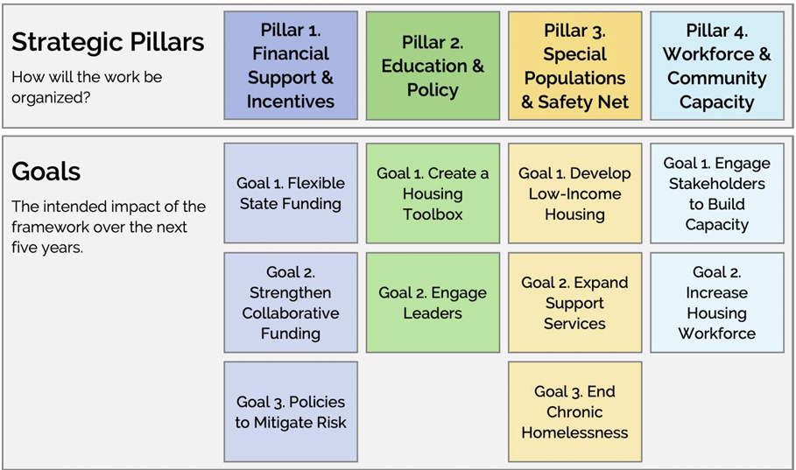

Slide 25
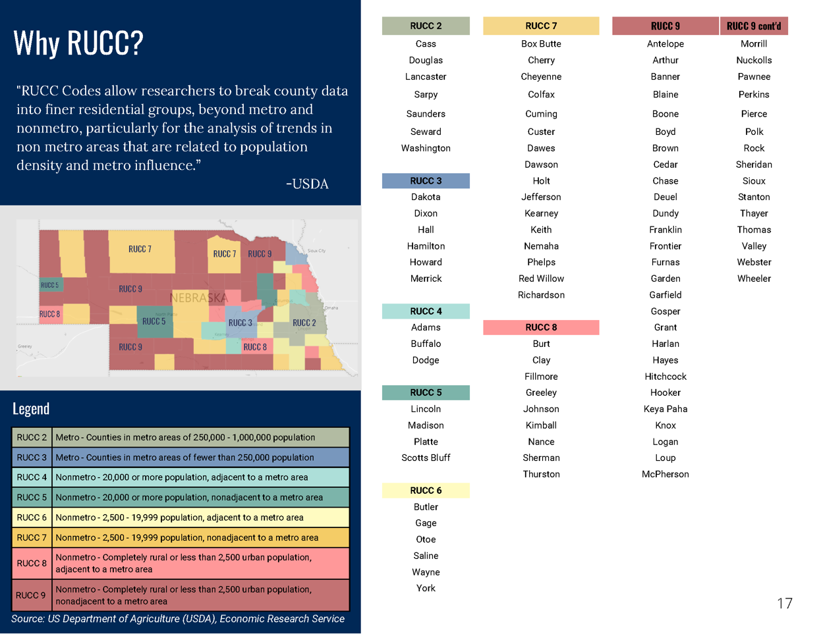
Analysis and Solution Sets

Slide 26
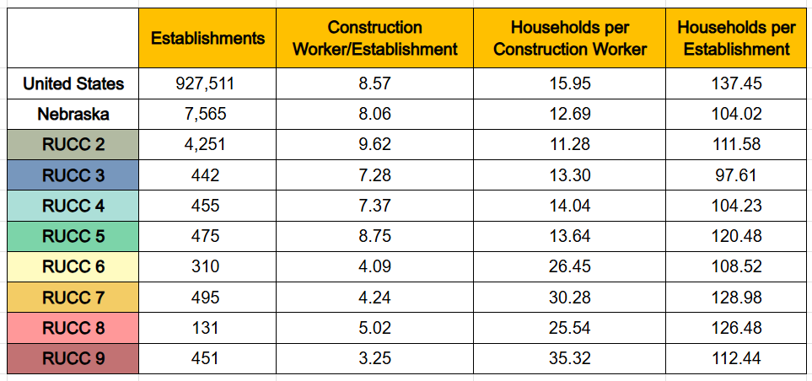
Construction Capacity
Nebraska has a lower average ratio of households per construction worker and households per construction establishment (business).
RUCCs in rural areas have almost two to three times fewer workers per establishment than RUCCs in urban areas.
When comparing to the development rates in these RUCCs, largely as the ratio of households per worker increases, the number of housing units created since 2020 decreases.
Source: U.S. Census Bureau American Community Survey, 2019-2023

Slide 27
Pillar 4
Workforce Pipeline
  Develop a home building academy that supports and expands existing efforts to increase those being educated in the construction trades.
  Redevelop and fund education and training pathways throughout the state, including K-12, higher education, and non-formal education, to prioritize construction and complementary trades.
Manufactured Housing
  Incentivize manufactured housing to support affordable and attainable housing in rural Nebraska to alleviate workforce challenges.
  Create incentives to ensure more manufactured housing produced in Nebraska stays within the state.

Slide 28
Workforce Solutions

Slide 29
TNT Program Specifics – Requires 1 to 1 match
Supply Side
Partnership with community colleges to create and recruit for instructor positions
Funding to increase teacher salaries to increase retention
Partnership with Builders Foundation to train Industrial Tech teachers in construction trades
Teacher summer stipends
Demand Side
Support for Builders Foundation efforts to expand their model of teaching construction trades to high school students
Funding to expand the number of high schools included in the program

Slide 30



TNT Program History
2019
Concept germination at NIFA’s Innovation and Ideation Retreat
2020
Initial request for ‘Train the Trainer’ funded through NIFA’s Rural Renaissance Program
2021
TNT Partnership Pilot Program funded for five (5) years
Notes:
The germination of the Teach Nebraska Trades Program was NIFA’s Innovation and Ideation Retreat in 2019. The Builder Foundation’s high school build program called Builders of the Future has been teaching trades in the schools and had seen a need in high schools where teachers were being thrown in trade instruction when that wasn't their specialty. They reached out to NIFA looking for assistance in supporting its “Train the Trainer” program to recruit and retain quality instructors in the trades. This initial request was funded through NIFA’s Rural Renaissance Program.
In conversation with the Nebraska Community Foundation and with community colleges, Shannon identified recruitment and retention of trade instructors was also an issue at a collegiate level. NIFA facilitated discussions with the groups and created the TNT Partnership Program, aimed at supporting both the Supply and Demand Side of this issue.

Slide 31
TNT Program Goals
To stabilize construction trade programs in both the Supply Side and Demand Side Partners
To increase the number of Demand Side Partner schools being served
To increase the number of students enrolled in (Demand Side) and graduating from (Supply Side) these programs, creating additional workforce in the local areas served by the TNT Partners
To create a sustainable plan to continue funding the Programs post pilot

Slide 32
Program Impact
Matt Gotschall, College President of Central Community College, emphasized the impact of TNT:
“…these retention earnings should keep an instructor engaged over the first critical years of instruction when they are learning to teach the curriculum and managing a build with regularly changing student workers (which) is the most challenging to master.
From a donor side, it makes sense to invest in the instructor(s) as that one investment can make a positive difference in over twenty students each year, vs trying to scholarship twenty students a year, while risking the quality and commitment of the single instructor.”

Slide 33
TNT Program Partner Actions
Engage with area contractors to determine areas of highest need.
Create opportunities for real world student experiences such as summer internships, apprenticeships.
Work with area non-profits, schools, businesses, and governments to develop area and community specific plans.
Obtain match funding for the Program from community or private foundations, trade organizations such as Homebuilders and Realtors and other governmental programs.

Slide 34
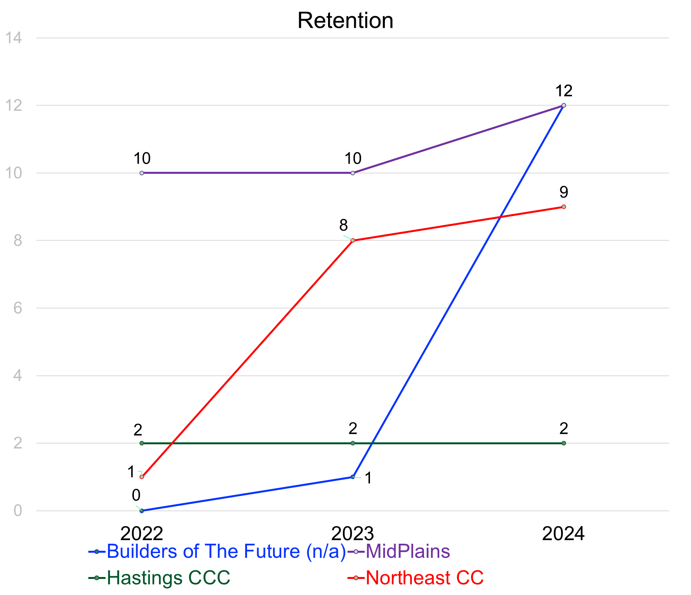
Goal 1: To stabilize construction trade programs in both the Supply Side and Demand Side Partners
Community College Professor Retention
  Data shows that retention for a minimum of three years for a position significantly increases likelihood individuals will stay with the college

Slide 35
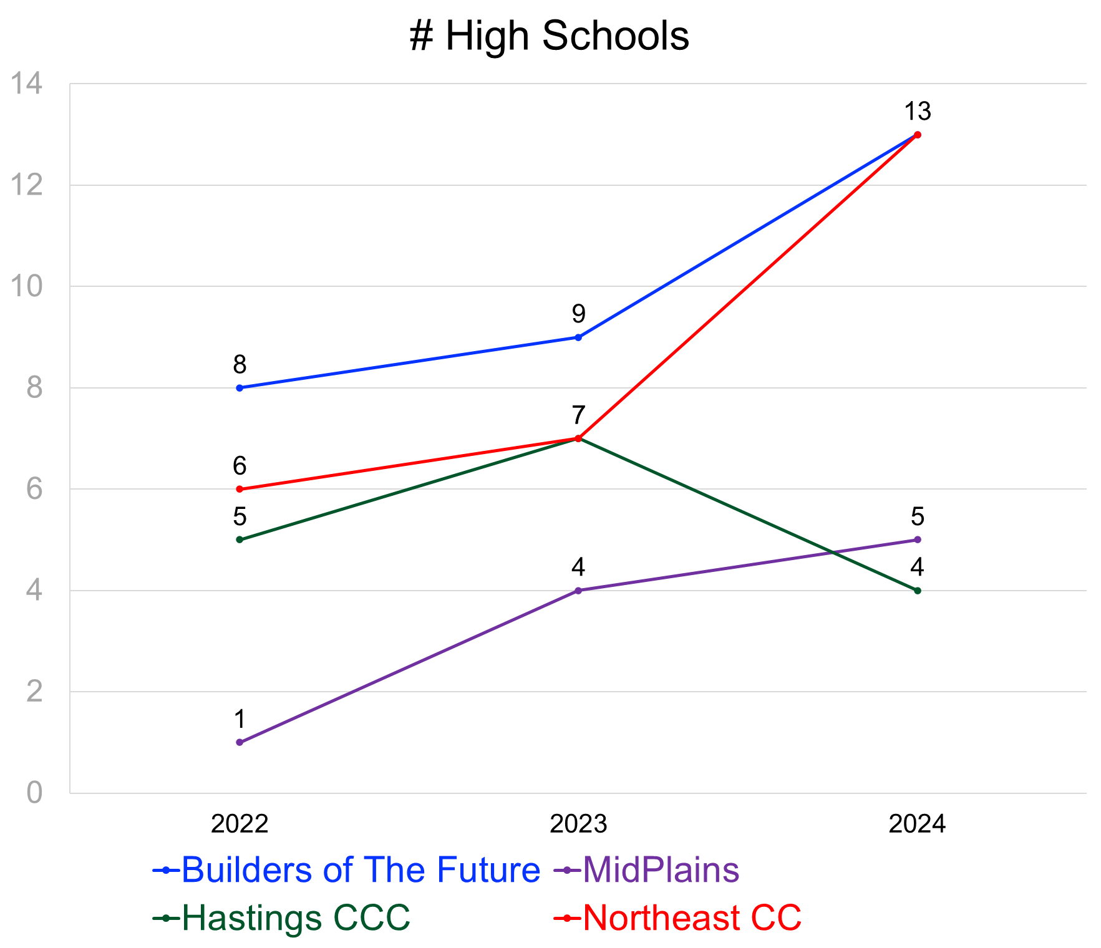
Goal 2: To increase the number of Demand Side Partner schools being served
From 20 high school programs in 2022 to 34 in 2024
  Increase of 70%
  BOF direct work with high schools
  CC professors working in area high schools in coordination with BOF

Slide 36
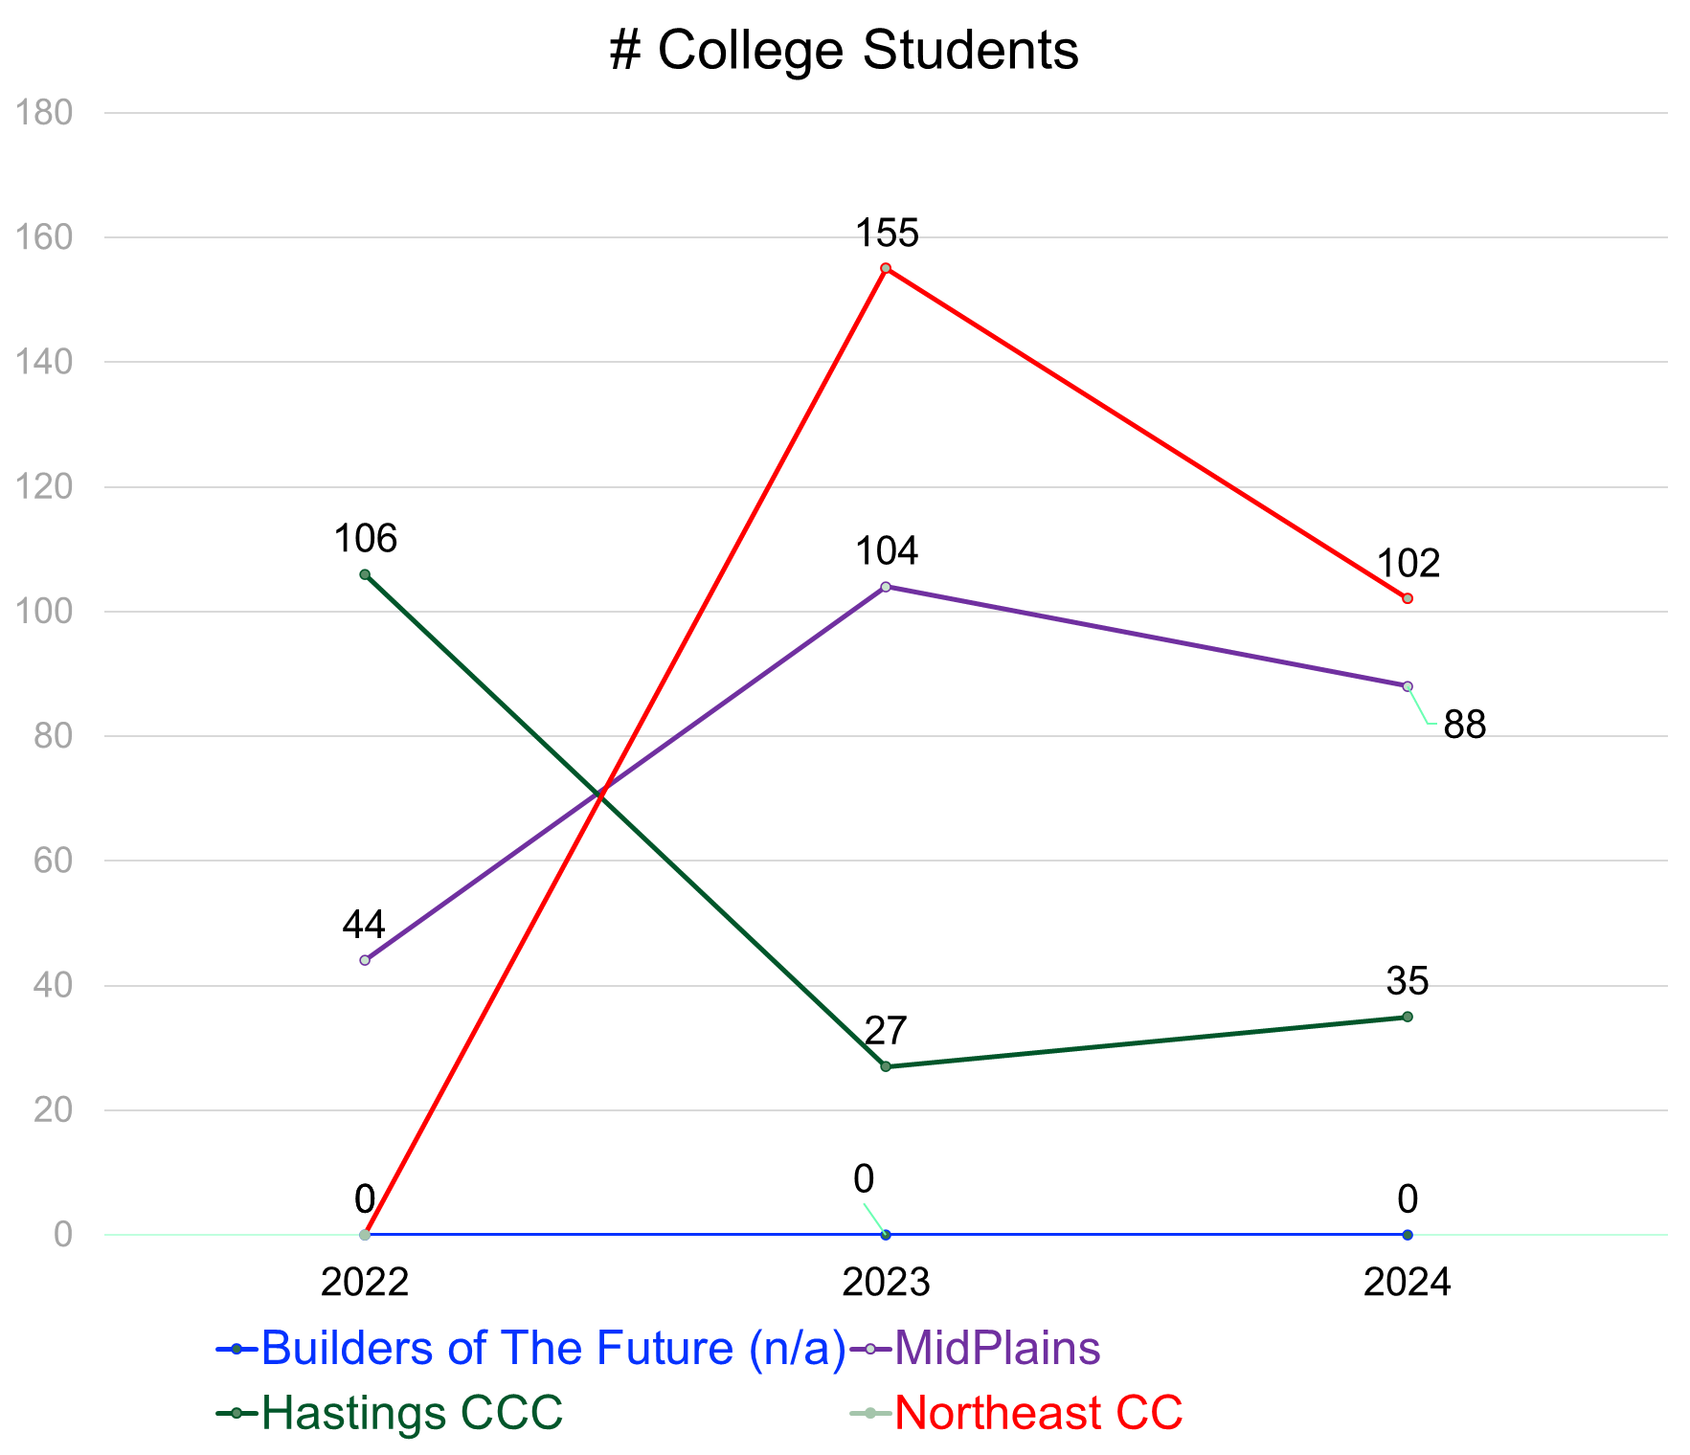
Goal 3: To increase the number of students enrolled in (Demand Side) and graduating from (Supply Side) these programs, creating additional workforce in the local areas served by the TNT Partners
Majority of community college graduates stay within the college's service area
This work support the Six Regions One Nebraska program, which is based on regionalizing goals and effort using community college regions across the state

Slide 37
Goal 4: To create a sustainable plan to continue funding the Programs post pilot
TNT 2
  Concept of loaning a school up to $250,000 to build a home and then selling that home to a teacher or first responder
  Money revolves into the next project, reducing principal needed
    After 5 or 6 builds school will have self sustaining fund
  Interest off loan – Split between BOF and NIFA
Continue to broaden scope of programs
State Dept of Labor and Builders of the Future
  Discussing statewide collaboration (Using Workforce Development Cash Fund)
  Ramp up program to train HS Industrial Tech Teachers
Workforce Pipeline (Pillar 4)

Slide 38
Success Stories
100% placement rate in construction trades from program graduates
94% of students remain in the community (Central Community College)
Programming consistently has a waitlist of applicants

Slide 39
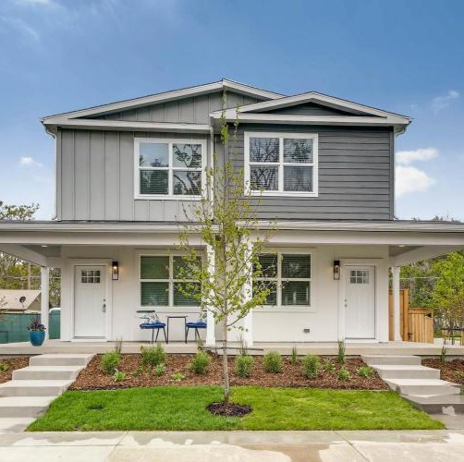
Coming Soon
Statewide modular ordering facility
  Using design standards and approved plans from multiple manufacturers
  Templated Planned Unit Developments (PUDs) to increase density and simplify development
  Best practice and example plats
  Leveraging community colleges to ensure sufficient, trained installation teams available for regional installation

Slide 40
Thank you
Shannon R. Harner, Executive Director
Shannon.Harner@nifa.org

Slide 41




Slide 42
ProBuilt Homes:
32 home plans
Average cost to build is up 38.6% since Covid

Slide 43
Labor Today’s Focus
+ Materials
+ Soft Costs
= Total new home cost

Slide 44


Slide 45
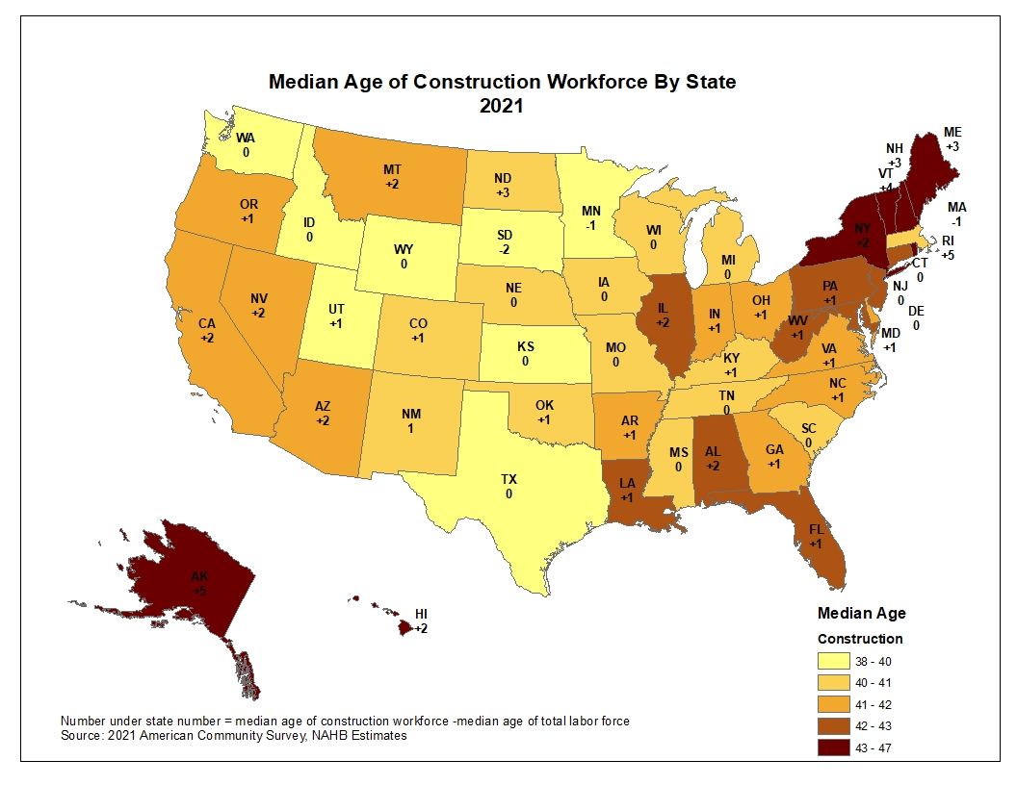

Slide 46
Construction Workforce Shortage
How we got here:
Societal Norms
    Go to college
    Remove shop classes from high schools
    Women in Construction
Covid 19
    Enhanced unemployment
    Back fill out of industry
Immigration Patterns
    H2B Visas

Slide 47





Slide 48
Mayfield Schools
Program approved in 2021
2 years ago, there were 6 students enrolled
This year there are 26 students enrolled
100% PLACEMENT

Slide 49
Schools Expanding Their Programs
2025-2026
Eastlake North
Willoughby South
Westlake
2026-2027
Benedictine
Notes:
Note: Colorado – 130 High Schools in 5 years

Slide 50

Colorado started PACT 5 years ago and is now in 130 high schools.

Slide 51
To Ponder:
Workforce housing for the housing workforce OR
Housing workforce for workforce housing?

Slide 52
Audience Questions
Use the QR Code to pose questions to panelists or
Join at Slido.com
#4334 952
Questions will go through moderation
Up-vote questions from other attendees that you want answered

Slide 53

Thank You!
Rachael Surmick
Community Development Advisor
Federal Reserve Bank of Kansas City
Rachael.Surmick@kc.frb.org
816-634-8483

