Slide 1
DISCUSSION OF “CYBERATTACKS AND FINANCIAL STABILITY: A NATURAL EXPERIMENT” by Kotidis & Schreft & “BANK FUNDING RISK, REFERENCE RATES, AND CREDIT SUPPLY” by Cooperman, Duffie, Luck, Wang & Yang
Peter Zimmerman, Federal Reserve Bank of Cleveland
The views expressed here are my own and not necessarily those of the Federal Reserve Bank of Cleveland or the Board of Governors of the Federal Reserve System.

Slide 2
Summary of Kotidis & Schreft
Event study examining the effect on bank liquidity of a cyberattack affecting the payment system. Their techniques could be used to examine any kind of operational outage.
Banks were unable to access Fedwire and had to rely on contingency plans.
Payment flows were disrupted, but bank were able to access liquidity so knock-on impacts were minimal.
Notes:
This paper examines the effect of a cyberattack on the Fedwire payments system. The attack caused an operational outage at a technology service provider, meaning that client banks couldn’t process payments.
This outage affected payment flows by users of the affected entity, but ultimately banks were able to rely on contingency plans and alternative sources of liquidity, so that their counterparties were not disrupted.

Slide 3
How cyberattack affects payments
Fedwire
TSP 1
TSP 2
TSP 3
TSP 2
Bank B
Bank C
Bank D
Bank A
Bank B
Notes:
In this illustration, four banks access Fedwire, and may use technology service providers to do so.
An outage at TSP 2 affects its clients’ ability to access Fedwire. Bank B now has no access. Banks A and C have contingency plans. Bank A can use TSP 1, while bank C can access Fedwire directly. Bank D is not affected directly. But all banks might find that payment flows are disrupted.

Slide 4
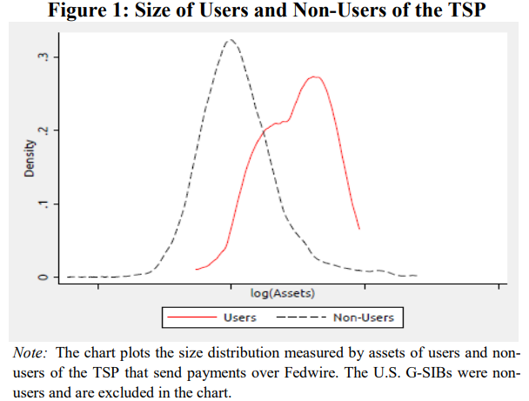
Parallel trends assumption
Authors show no significant difference between users and non-users in payments pre-attack.
But I still worry users and non-users have different characteristics that could affect their behaviour.
For example, if attack coincides with market turmoil, users and non-users might respond to that turmoil differently, confounding the results.
Can we use other bank characteristics as controls?
Notes:
One challenge to the identification in the paper is the assumption of parallel trends. The authors compare users of the afflicted TSP to non-users. They check for parallel trends by comparing growth in payments in the period prior to the cyber attack, and show there is no significant difference. That is helpful, but I still worry users and non-users are different in nature. This chart from the paper compares the balance sheets of the two groups, and they are clearly quite different. Users are larger banks than non-users. Suppose, for example, that the cyberattack causes market turmoil, and that users and non-users respond differently, perhaps because their access to contingent payment methods or alternative sources of liquidity differ. This could confound the results. The authors could consider using other bank characteristics as controls, to ensure we’re comparing like with like.

Slide 5
Fed funds loan data
Identify interbank loans using the Furfine algorithm:
On day t, bank A sends bank B a payment X, where X is a round number.
On day t+1, bank B sends payment Y to bank A.
If $\frac{X}{Y}−1$ is a plausible interest rate, we say (X,Y) is an overnight loan.
Armantier & Copeland (2015) show this method is very unreliable: it misses 23% of actual fed funds txns, and 81% of identified txns are not in fact fed funds txns!
Authors check validity of algorithm using FR 2420 (daily bank liability disclosures) and 10K filings of FHLBs. I guess these give aggregates for each party? It seems like it will be hard to reconcile these data.
Notes:
The authors identify interbank loans using the Furfine algorithm. This is an algorithm designed to identify interbank loans from payments data. Conceptually, the algorithm works as follows. Suppose, on day t, bank A pays bank B some payment X, where X is a round number. The following day, bank B sends Y back to A, where X/Y-1 is a plausible interest rate. Then the algorithm matches X and Y and calls it an overnight loan. You can do it for term loans too. But Armantier & Copeland show this method is highly unreliable, and produces both type I and type II errors.
The authors mention they check the results of this algorithm against forms FR 2420, in which banks file their liquidity disclosures (incidentally, this helps date the incident, since these forms have only existed since 2014). And 10K filings of FHLBs. I guess these regulatory forms only tell you total assets or liabilities for the filer, without a granular breakdown by counterparty. How well, then, do these forms match the Furfine data? How do you reconcile any differences?

Slide 6
Summary of CDLW&Y
When times are bad, banks have two problems:
Corporate borrowers draw on pre-committed credit lines [asset side]
Funding costs rise [liability side]
If lines are linked to a risk-free rate, the two risks are poorly matched. This makes bank shareholders reluctant to offer credit lines ex ante.
Transition away from LIBOR to risk-free rates could mean less credit extended.
Notes:
Let me go on to the second paper. This paper explores a mismatch problem that banks face. When times are bad, corporate borrowers draw on pre-committed lines. At the same time, the banks’ funding costs go up. When the rate on the credit lines is linked to stressed market conditions – for example, using LIBOR as a reference rate, then the two risks are matched. But if we transition to a risk-free reference rate, then the mismatch worsens and banks rationally prefer to offer smaller lines ex ante. This means less credit is extended.

Slide 7
Contracting friction
The bank commits to a line L and a spread s(L) ex ante. The borrower then observes market stress and chooses to borrow q ≤ L.
Simple solution to mismatch problem: make spread contingent on bank’s own borrowing costs. That’s even better than using LIBOR! No disclosure if use bond price.
Why, given L, is the spread fixed? Why can’t the bank make the spread contingent on q?
Notes:
The model features a contracting friction which is never explicitly spelled out, so I will attempt to do so now. The bank commits ex ante to providing a credit line L at a spread s(L) to a borrower. Having obtained the committed line, the borrower then observes the state of the market and chooses to draw an amount q on that line at a rate s.
But why must the spread depend on L? The bank would do better, for example, to make the spread contingent on its own borrowing costs. That would hedge the rate risk even better than using LIBOR. And the bank needn’t disclose any private information if it uses a public price, like its bond or CDS premium. Obviously, banks don’t do this in real life, so there must be some friction or missing part to the model.
Even if that’s not possible, why does the spread need to depend on L? Why can’t the bank make the spread contingent on q? Then, if the borrower draws more, he pays a higher rate. That would also help the bank manage the mismatch problem.

Slide 8
Welfare considerations
As the authors discuss, the issue is essentially whether the bank or the borrower should take interest rate risk.
If bank takes rate risk, it lends less, which is assumed to reduce welfare. (This is the only contribution to welfare considered.)
But isn’t it possible the firm borrows too much under a risk-free reference rate? It may take on more risky projects than is socially optimal.

Slide 9
Both papers are about banks’ liquidity resilience
In K&S, the operational outage is a shock to liquidity.
In CDLW&Y, the transition to risk-free reference rates exacerbates liquidity mismatch risk.

Slide 10
Ample liquidity mitigates the risks
In K&S, there is no significant knock-on effect to payment delays at banks indirectly affected by the cyberattack.
In CDLW&Y, transition from LIBOR increases cost of credit lines by 5.6 bps in normal times.
If central bank reserves are limited or more expensive, would the liquidity risks associated with cyberattacks and LIBOR transition rise?

