Slide 1


Newly discovered risks in financial markets
2021 Financial Stability Conference: Planning for Surprises, Learning from Crises
Zhiguo He (何治国)
Fuji bank and heller Professor of Finance
Director of Becker Friedman Institute China
University of Chicago, Booth School of Business; and NBER

Slide 2

Three excellent papers
Liquidity Provision and Co-insurance in Bank Syndicates
  Kevin Kiernan, Vladimir Yankov, Filip Zikes
  Network structure in syndicated loan market, linking to banks’ liquidity holdings and LCR regulation. Dealscan data
(In)ecient repo markets
  Tobias Dieler, Loriano Mancini, Norman Schurhoff
  Theory on interbank market trading
  The interaction between anonymity and clearing scheme
Hedge Funds and the Treasury Cash-Futures Disconnect
  Daniel Barth and Jay Karn
  Broader financial market where financial constraints limits the arbitrage opportunity
  Hedge funds during Treasury market disruption

Slide 3
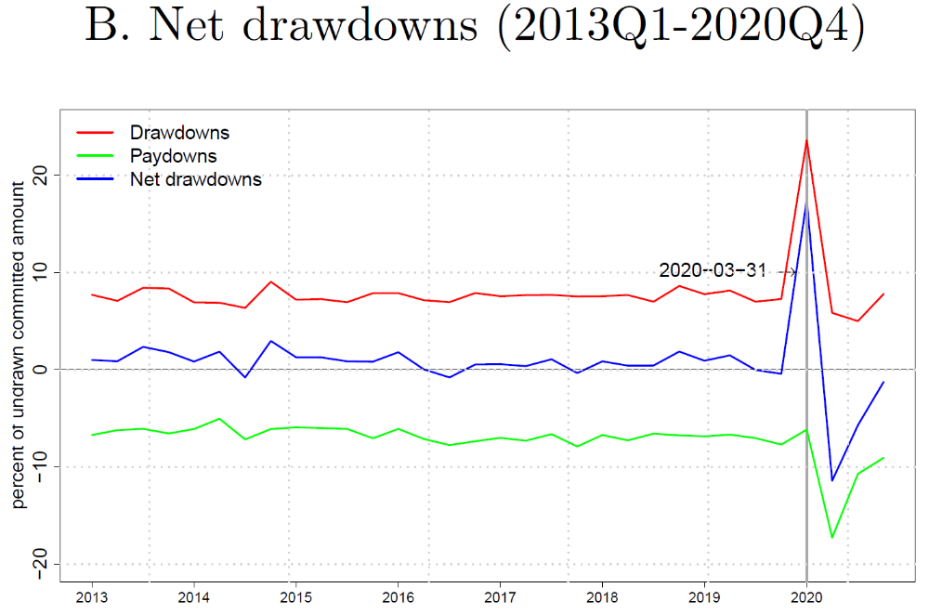
Liquidity banking network

Slide 4
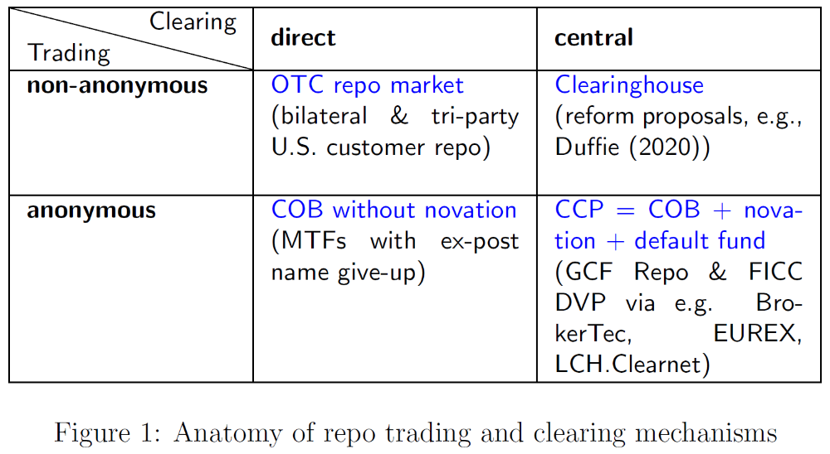
Repo markets
In the model, firms with Good/Bad project quality rolling over their interim debt
Non-anonymity, no information asymmetry during trading (not necessarily good as ex post risk sharing is useful)
Central clearing helps weed out bad firms in clearing
Propose a solution to achieve the efficient allocation

Slide 5
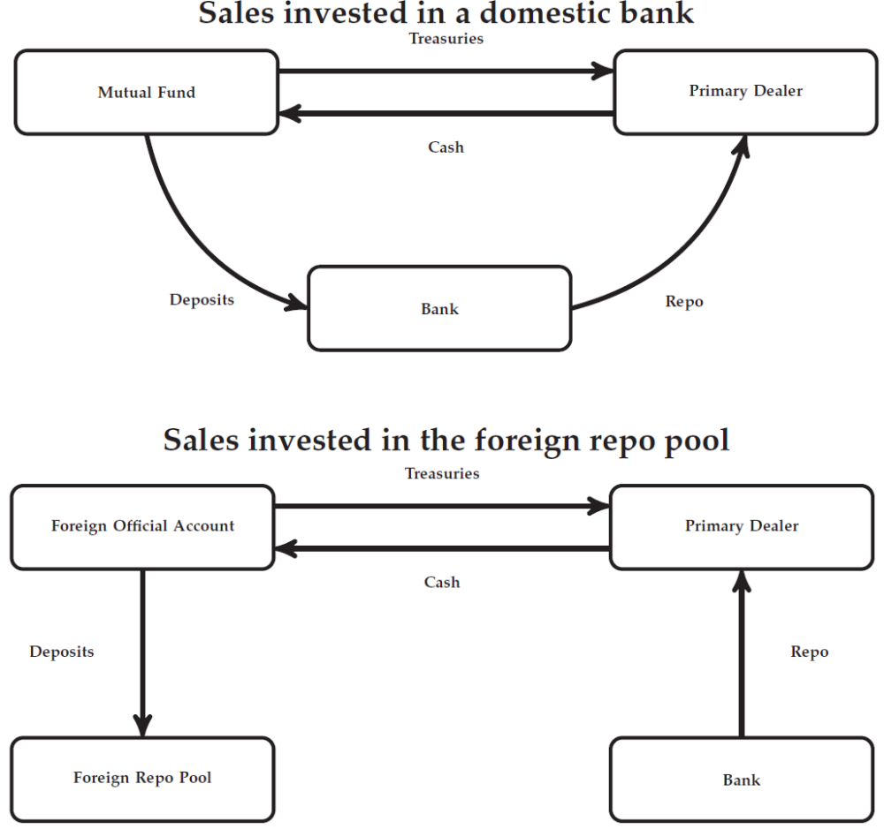
Treasury cash-future
How does foreign repo pool work? Eventually needs to park in some US-related bank accounts?

Slide 6
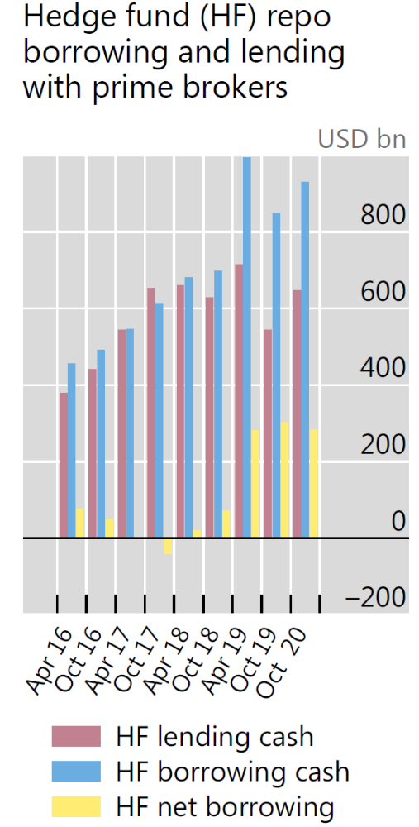
Treasury cash-future
Egemen Eren and Philip Wooldridge, BIS report, 2021
Emphasizing
  Treasury turmoil was not only US phenomenon
  The role of NBFIs

Slide 7
Conclusion
New risk in the old financial system is always young and vibrant
As we still knows little
New financial system?

