Slide 1
The Unequal Burden of Inflation
November 14, 2023
Tara M. Sinclair, Deputy Assistant Secretary for Macroeconomics
Office of Economic Policy, U.S. Department of the Treasury
Notes:
https://www.clevelandfed.org/events/conversations-on-central-banking. The other two panelists are: Alberto Cavallo (Harvard Business School) and Christoffer Weissert (Danish National Bank).

Slide 2
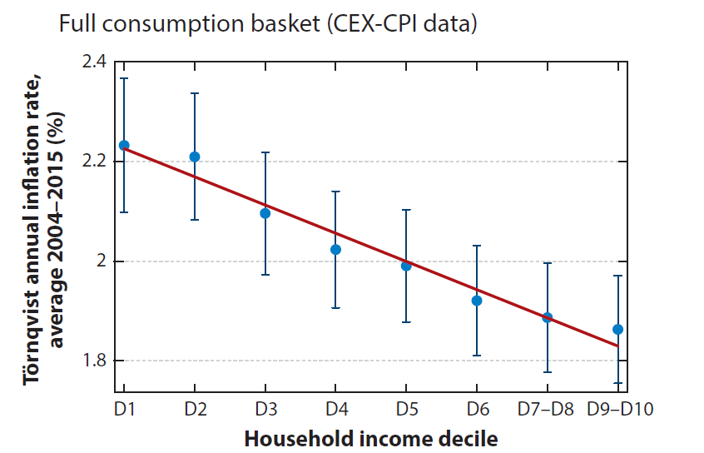
Unequal Experience of Inflation
Poorer households tend to see faster price growth (Jaravel, 2021)
Firms innovate more on goods purchased by richer households, reducing their quality-adjusted prices (Jaravel, 2019)
Choice set for wealthier households is larger so it is easier to shift expenditures in response to price changes (Argente and Lee, 2020)
Wealthier households engage in more sophisticated saving and investment behavior that protects them from inflation (Doepke and Schneider, 2006)
Source: Jaravel (2021)
Notes:
Kaplan and Schulhofer-Wohl (2017) show that the distribution of household-level inflation rates rises with the aggregate price index. This doesn’t necessarily imply that inflation gaps between the poor and rich widen, but it is suggestive given the other evidence they provide.
Argente and Lee (2020) argue instead that inflation inequality rises during recessions due to substitution behavior.
Munseob Lee (2022) finds that Black households face somewhat higher and significantly more volatile inflation in consumer goods from 2004-2020.
More graphs: https://www.bls.gov/spotlight/2022/inflation-experiences-for-lower-and-higher-income-households/home.htm

Slide 3
Inflation in Context
The distributional effects of inflation do not occur in a vacuum
There are also distributional effects from a weak economic recovery: more child poverty, more hunger, more housing instability, poorer labor market outcomes
We had a remarkably strong recovery from the COVID recession with compression in the real wage distribution, even after accounting for price growth differentials between lowest and highest earners
Source: Autor, Dube, and McGrew (2023), Jaravel (2021), and author’s calculations
Notes:
Autor, Dube, McGrew estimate that between Jan 2020 and Sept 2022, real hourly wages grew by 6.4% for the 10th percentile of wage-earners, and fell by 6.7% for the 90th. If we adjust for inflation inequality, the 10th percentile instead experience 4.8% wage growth. Assumes the CPI is inflated by 0.6% for the 10th percentile and deflated by 0.4% for the 90th percentile.

Slide 4
Equitable Recovery
Labor Markets: The gaps between Black/white and Hispanic/white unemployment rates have closed substantially, dropping to near their historic lows in 2023.
Income: Median real hourly wages have risen substantially for low-wage workers (Autor, Dube, and McGrew 2023).
Wealth: Household net worth has risen faster for poorer households during the recovery from the pandemic recession. This is rare, historically.
Source: Federal Reserve Board
Notes:
U.S. Treasury Department Releases Report on the Historically Equitable Economic Recovery From the Pandemic | U.S. Department of the Treasury

Slide 5
Conclusion
Distributional effects are complicated, and we need to be careful of “Innocent Bystanders” (Coibion et al., 2017)
It’s important to remember that we’ve had an equitable recovery in real terms, meaning accounting for inflation
We still need further research on the causes of the recent inflationary episode and on how to assess the broader distributional issues
Policy in the face of unequal burdens of inflation is a challenge
For example, redistribution to offset the unequal impacts of inflation might fan the flames of inflation by redistributing toward households with a higher marginal propensity to consume
Notes:
Is inflation more of a symptom? Maybe the symptom of several different underlying issues so we need to identify the source to understand the effects.
Innocent Bystanders? Monetary policy and inequality – ScienceDirect https://www.sciencedirect.com/science/article/abs/pii/S0304393217300466

