Slide 1

Conversations on Central banking
May 17 2022
Julia Coronado
MacroPolicy Perspectives LLC is an economic research consulting firm. The information presented represent the views of the author and is not intended to be, and should not be considered, investment, tax, or legal advice.

Slide 2
The Structure of Inflation has been Transformed by Globalization and Technology Disruption

Slide 3
Goods Inflation has been the Most Disrupted by the Pandemic, Services Looks More Macro

Slide 4
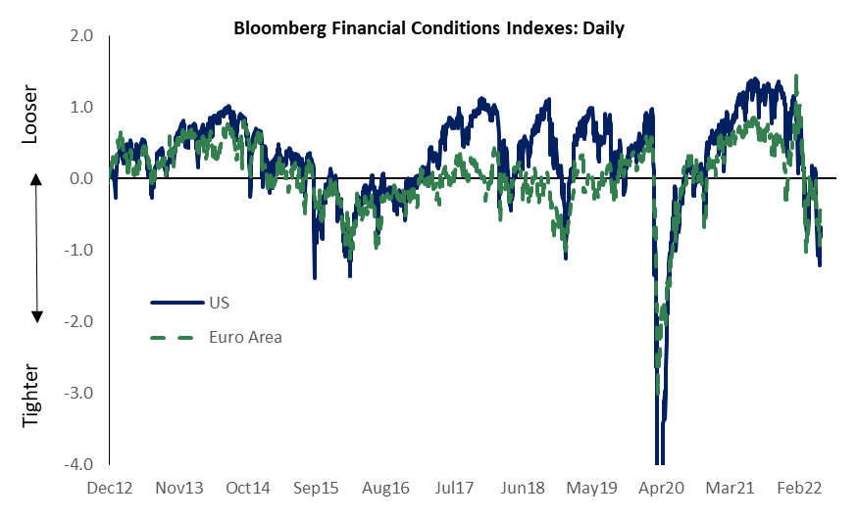
Firms are Investing in Business Transformation The Fed is Tightening Policy

