Slide 1


Monetary Policy Committee
Observations on Inflation:
External vs Domestic Dynamics
Outcomes vs. Expectations
All slides from: https://www.bankofengland.co.uk/monetary-policy-report/2022/february-2022

Slide 2
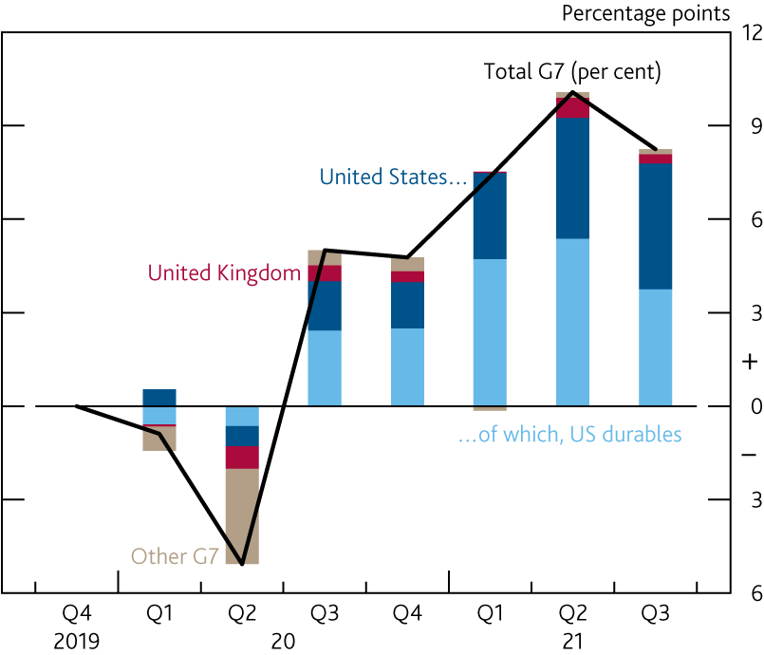
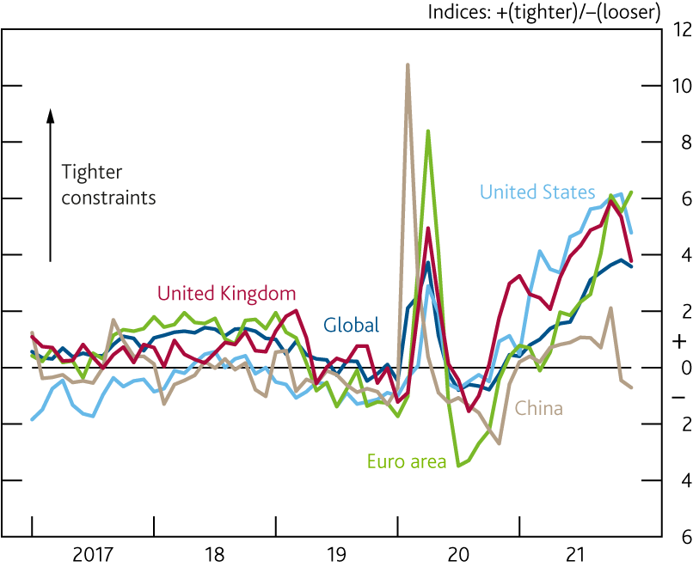
Demand and Supply Imbalances
Implications for Global Goods Prices and Domestic Prices
Contributions to change in G7 goods consumption
since 2019 Q4
Indicators of supply constraints
Section 2, Box B, Chart A and B in the Monetary Policy Report, February

Slide 3
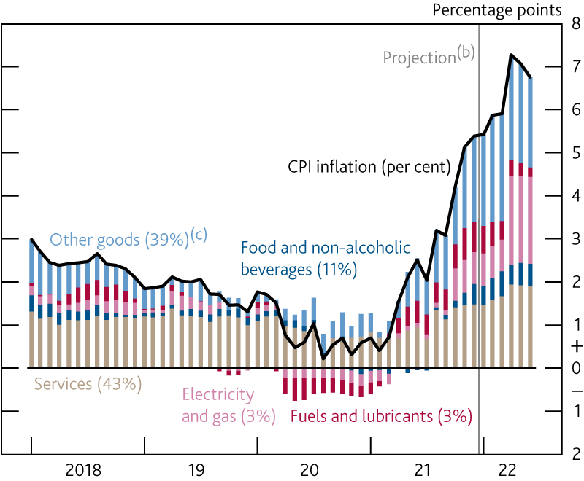
  Macro Outcome and Projection
  CPI inflation was 5.4% in December and is expected ~~ 7¼% in April
    Contributions to CPI inflation^{(a)}
Chart 2.19 in the Monetary Policy Report, February

Slide 4
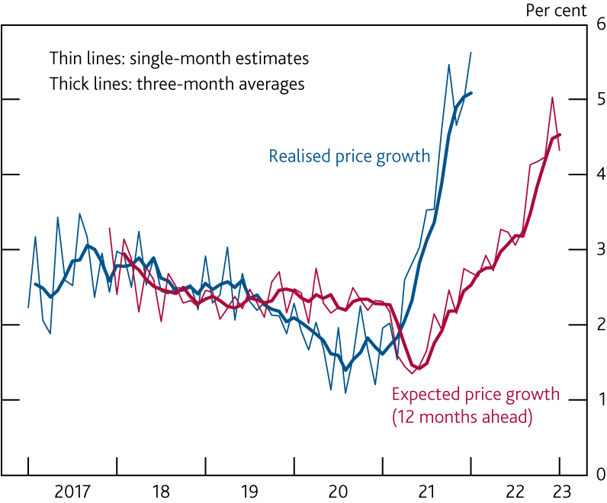
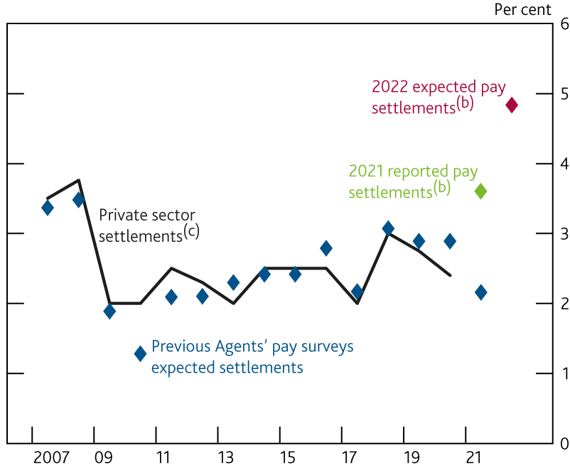
  Micro Underpinnings and Expectations
  Firms and Workers both expect prices and wages ~~ 5% in 2022
Firm-level price growth, realised and expected: DMP Survey Pay settlements: reported and expected: Agents Survey
Chart 2.23 and Chart 3.9 in the Monetary Policy Report, February

Slide 5
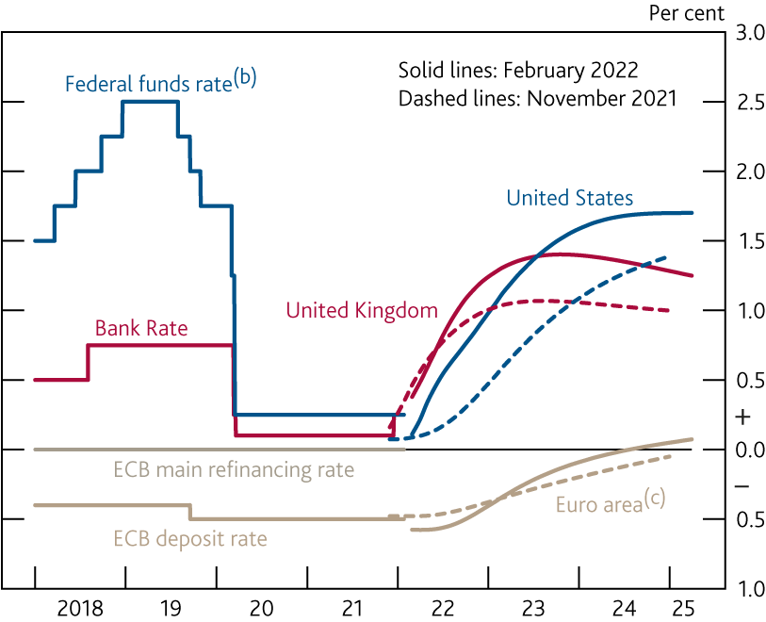
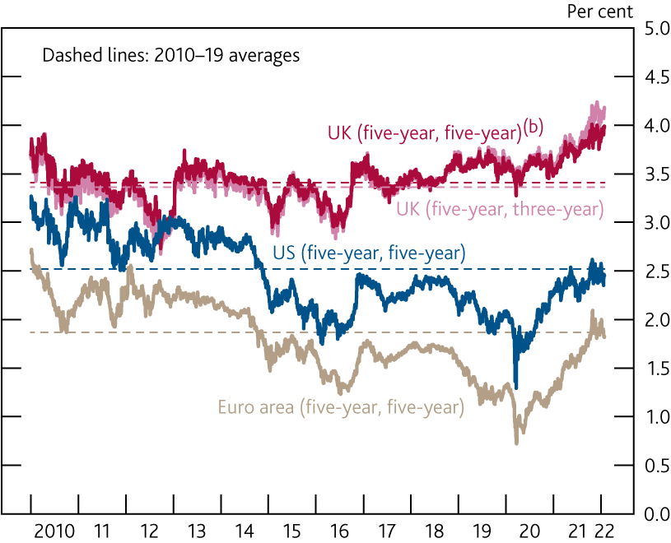
  Policy Strategy and Expectations
  Market participants expect policy rates to increase
    International forward interest rates
Financial market measures of inflation compensation
Chart 2.25 and 2.26 in the Monetary Policy Report, February

