Slide 1
Quantum Prices
Diego Aparicio
Roberto Rigobon

Slide 2
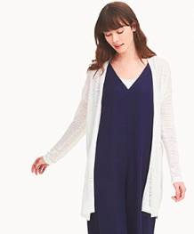


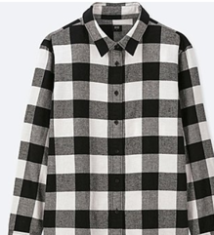
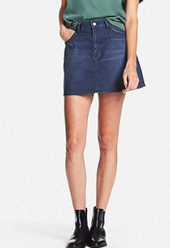

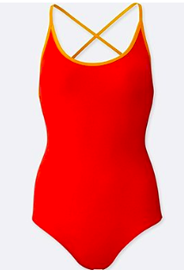

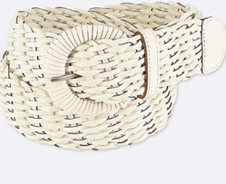
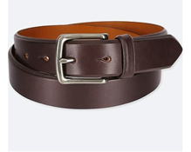
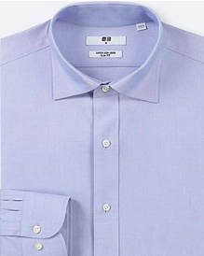
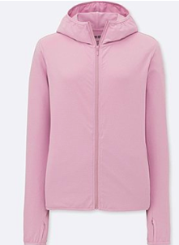

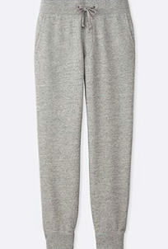
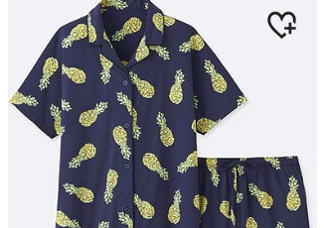
UNIQLO
$29
$29
$29
$29
$29
$29
$29
$29
$29
$29
$29
$29
$29
$29
$29

Slide 3






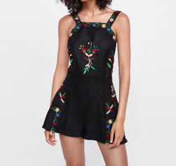

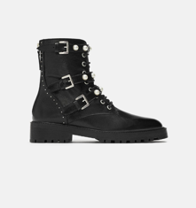


ZARA
$69
$69
$69
$69
$69
$69
$69
$69
$69
$69
$69
$69
$69
$69
$69

Slide 4







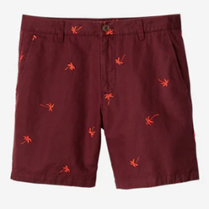
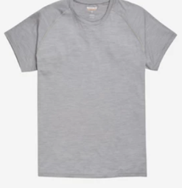
BONOBOS
$88
$88
$88
$88
$88
$88
$88
$88
$88
$88
$88
$88
$88
$88
$88

Slide 5



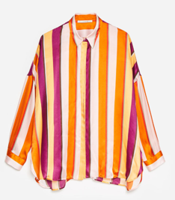
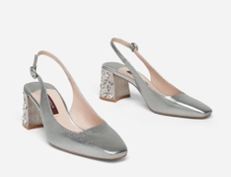


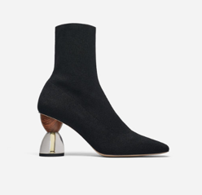


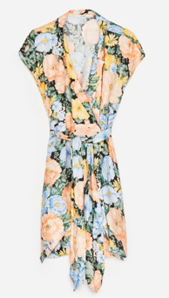




UTERQUE
£120
£120
£120
£120
£120
£120
£120
£120
£120
£120
£120
£120
£120
£120
£120
£120

Slide 6
Online Pricing Strategies
1
Robo-pricing
Amazon, Walmart, etc.
Prices decided by pure demand optimization
Almost every price can be observed
Profits come from the implied information in the network
2
Quantum Prices
Zara, H&M, etc.
Prices choice set is sparse
Very few prices relative to items
Profits come from the clustering of the demand

Slide 7
Our Paper
1
Document price clustering in fashion retail
Informal definition:
Same handful of prices for diverse assortment
Prices are meaningfully separated
Rare price increases
2
Potential explanations to clustering as an optimal pricing strategy
3
Model predictions and empirical evidence
4
Macro implications

Slide 8
Data — Collection
1
Fashion retailers in the US and the UK
Industry: $380 billion sales in the US
Second largest market, after China
Inditex $32B; Louis Vuitton $20B;
Walmart $30B; Nike: $34B
Data availability
Collect online data

Slide 9
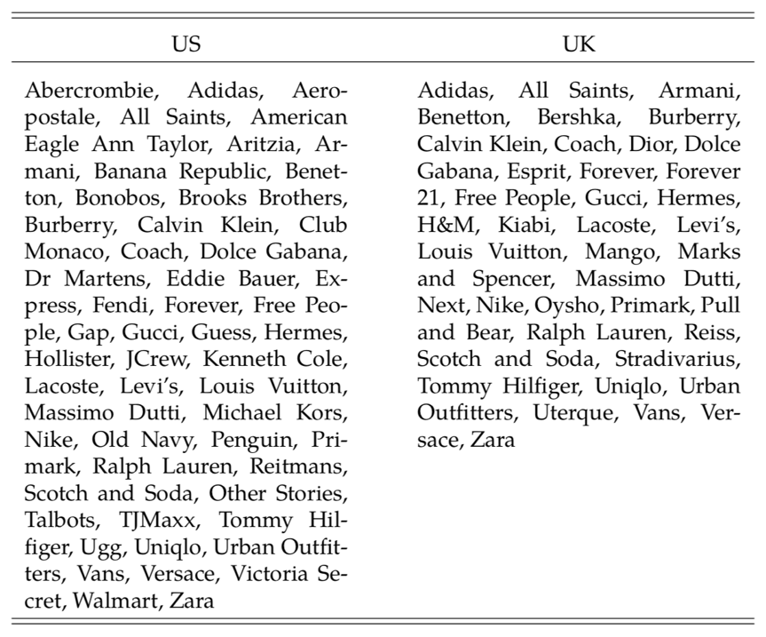
Collection
Data
1
What types of retailers?

Slide 10
Collection
Data
1
Scripts that read HTML code of retailer website
SKU
product description
price
sale price
.
.
Scraped data is unlabeled
(uncategorized, inconsistent across retailers)
We need to classify items into categories

Slide 11
Classification
Data
1
Semi-supervised classifier: decision trees
Categorize items reading words in HTML code
Hierarchy
“blue” “denim” “jacket”
Bottoms

Slide 12
Classification
Data
1
Semi-supervised classifier: decision trees
Categorize items reading words in HTML code
Hierarchy
“blue” “denim” “jacket”
Outerwear

Slide 13
Classification
Data
1
Semi-supervised classifier: decision trees
 | US
Observations (#) | 505,522
Categories per retailer (#) | 11.5
Products per category (%)
Accessories | 7.3
Bags | 6.1
Bottoms | 15.4
Dresses | 7.5
Jewelry | 4.1
Outerwear | 7.1
Shoes | 10.8
Sports | 3.9
Suits | 2.3
Tees | 13.7
Tops | 16.9
Underwear | 2.9
Unclassified | 2.2
12 categories consistent across time and across retailers
Miss-classifications reduce price clustering

Slide 14
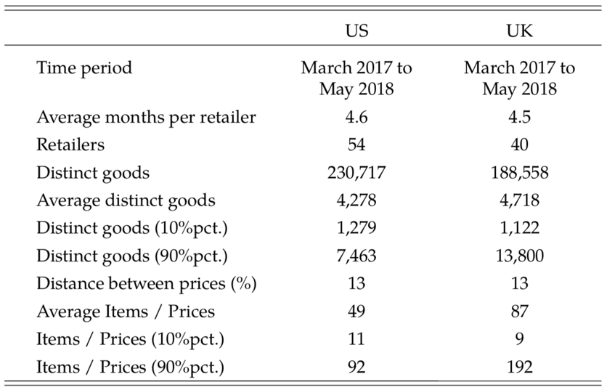
Summary Statistics
Data
1
Cross-section of unique products
Remove products duplicated in terms of time, color, sizes

Slide 15
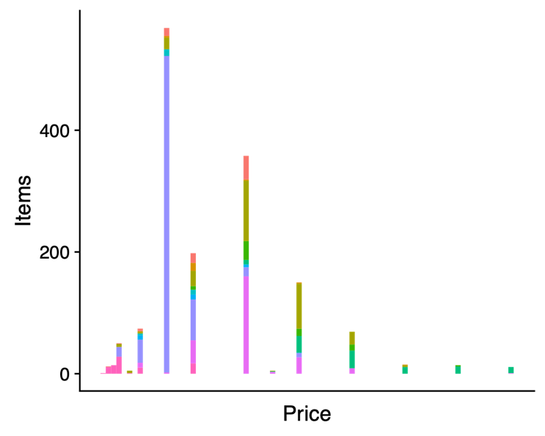
Price Clustering — Example
2
Clustering as a probability
How frequent different products have the same price
Categories in different colors
Measure clustering at three levels:
within a retailer-category
within-retailer, across-categories
within-category, across-retailers

Slide 16
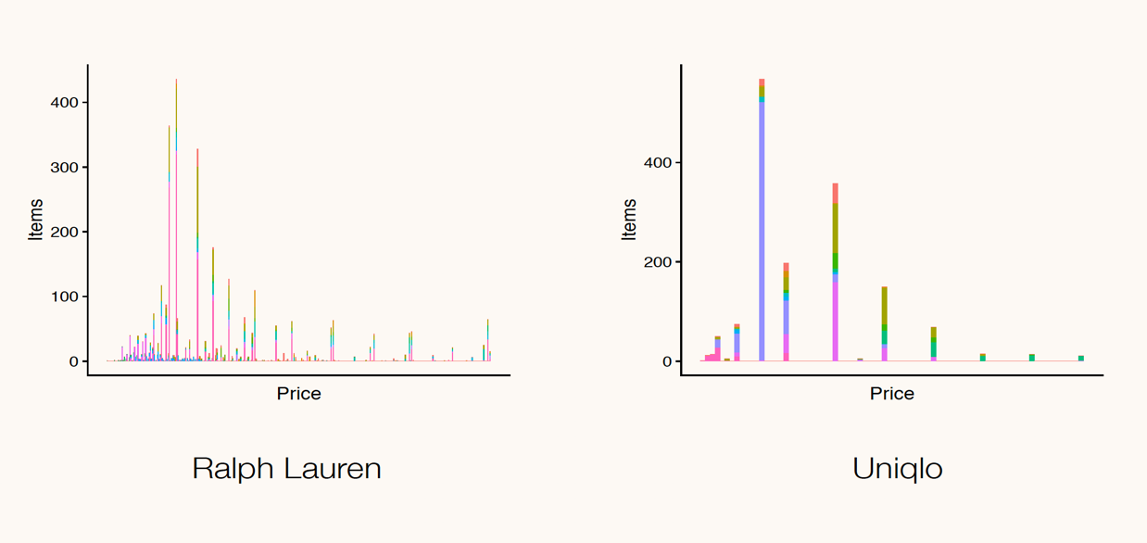
Massive Price Clustering
2

Slide 17
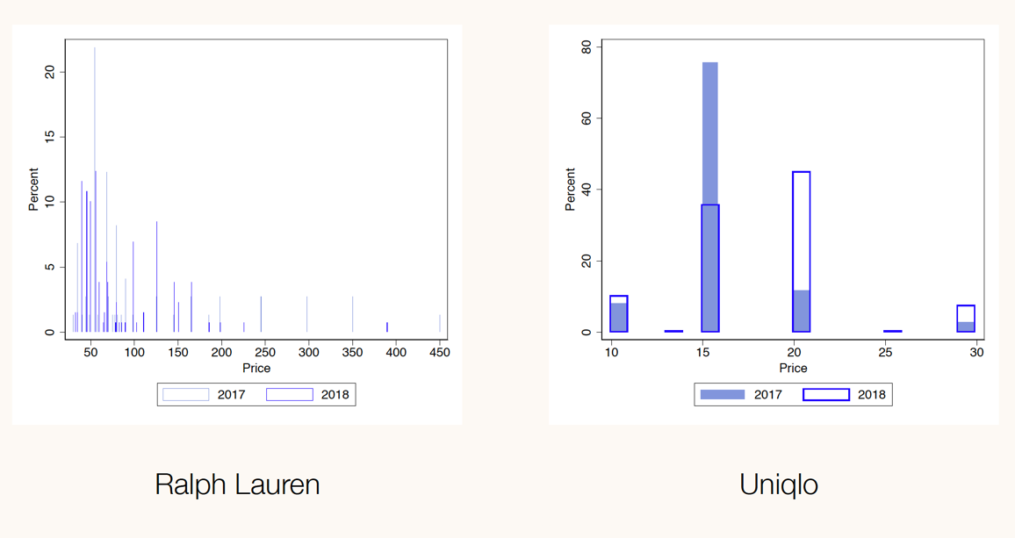
Inflation Dynamics
2

Slide 18
Scope of Clustering
Price Clustering
2
within-retailer
across-category
within-retailer
within-category
across-retailers
within-category

Slide 19
Potential Explanations
3
Explanations that could account for some clustering
Contrast the model predictions with the evidence
Cost mark-up rules, convenient prices
1
2
Demand uncertainty
3
Salience and price sensitivity
4
Advertising effectiveness

Slide 20
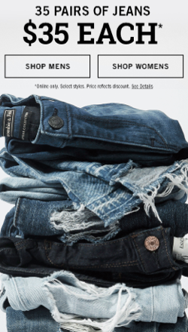
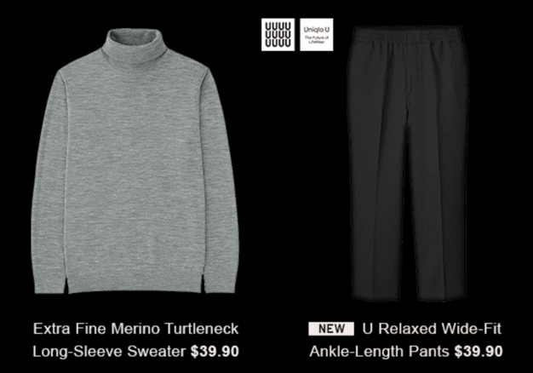
1. Price Advertising
Evidence
4
  A prediction of the model is that retailers that price advertise should exhibit more clustering
  This is testable
  Example

Slide 21
1. Price Advertising
Evidence
4
  A prediction of the model is that retailers that price advertise should exhibit more clustering
  Generalize to all retailers
  Enroll in e-mail newsletters
  Landing page
  Over several months keep track if ads include prices or not: 36% of retailers

Slide 22
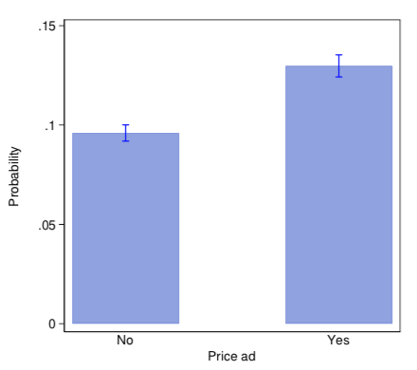
1. Price Advertising
Evidence
4
  A prediction of the model is that retailers that price advertise should exhibit more clustering
  Generalize to all retailers
  Enroll in e-mail newsletters
  Landing page
  Over several months keep track if ads include prices or not: 36% of retailers
  Price advertisers have significantly larger price clustering

Slide 23
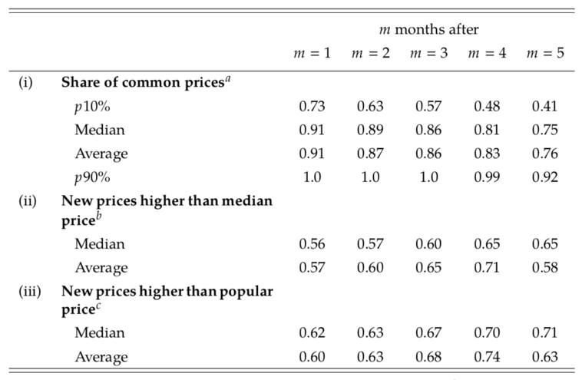
3. Price Stickiness — New Prices
Evidence
4
  There is a lot of seasonality in apparel
  But the “distinct” prices observed over time are very stable
  Share of common prices 1-5 months later (relative to the first month)
  After 5 months, on average 76% of the prices are old
  The new prices tend to be larger than the median price (and the most popular price)

Slide 24
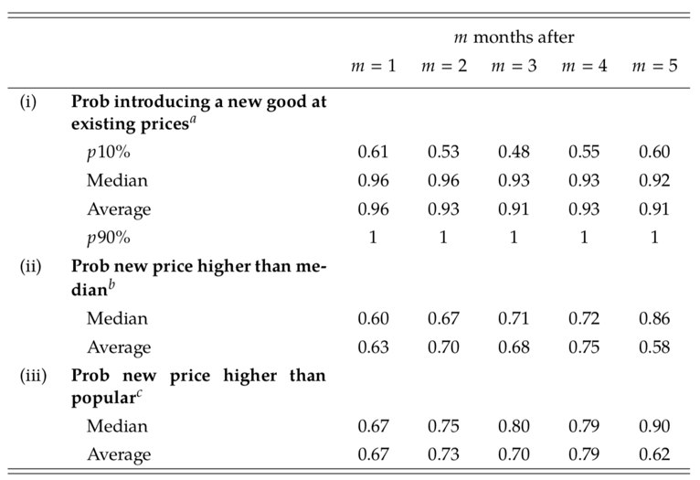
3. Price Stickiness — Introductions
Evidence
4
  Same analysis but only for product introductions
  New products are in general priced using old prices
  The average probability 5 months later is 91%
  And there are retailer-categories which are only using old prices

Slide 25
3. Price Stickiness — Adjustments
Evidence
4
Consider a case study
Price obfuscation
No price signs
No price advertising
Wide price distribution
Easy to introduce a new price
Price advertising
Signage costs
Clustered prices
Costly to introduce a new price

Slide 26
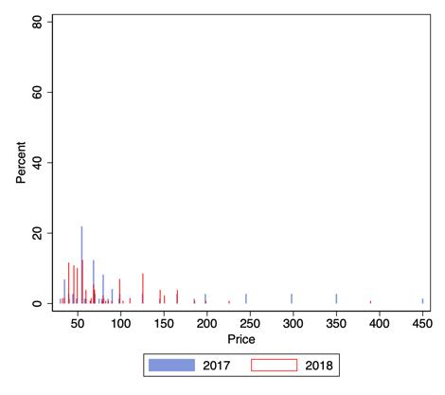
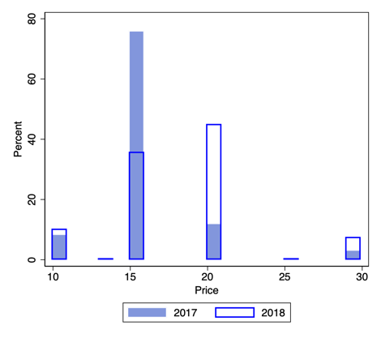
3. Price Stickiness — Adjustments
Evidence
4
1 year data
Compare the same category over two consecutive years
Prices all over the place
Products introduced at new prices
and at old prices
Ralph Lauren
Products introduced at the same prices
But the shares of products are changing
Large share shifted to the $20 price bucket
Over 90% of the price distribution changes through same prices
Uniqlo

Slide 27
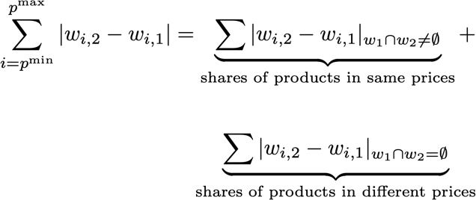
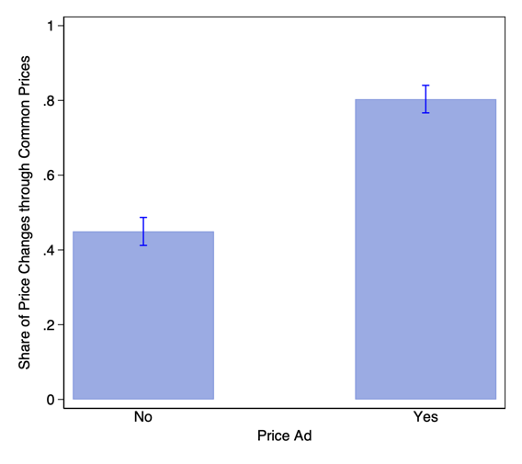
3. Price Stickiness — Adjustments
Evidence
4
Decompose the price distribution
wi,2 and wi,1 are the shares of products at price i (no rounding) in time 1 and 2
The median fraction is 0.60 (through same prices)
Significantly higher for advertisers
A fraction of retailers adjust prices through product shares in old prices
Suggests a “menu cost to a new price”
☑︎

Slide 28
Macro Implications
5
Macro literature: behavioral, marketing, managerial inattention to explain pricing frictions
This research suggests the role of advertising in price stickiness
Focus on one macro implication
Sticky introductions can predict deviations from the law of one price (LOP)

Slide 29
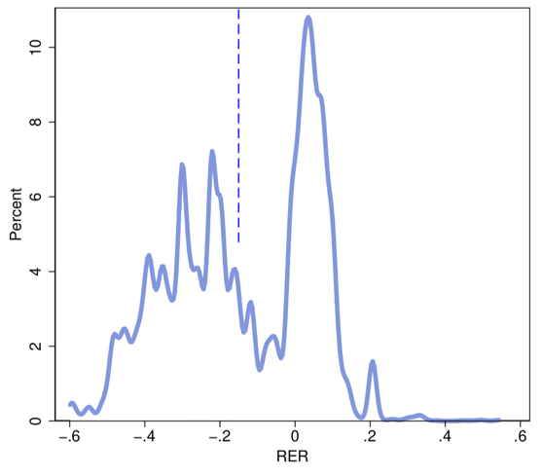
Law of One Price
Macro Implications
5
Match +30,000 distinct products between the US and the UK
Compute good-level RER
Exchange rate at the time of product introduction
RER above or below 0
are deviations to LOP
Large deviations.
Consistent with literature using good-level data: Gopinath and Rigobon (2008);
Cavallo, Neiman, and Rigobon (2014); Gorodnichenko and Talavera (2017)

Slide 30
Simulation
6
Deterministic wage shock (from 1 to 1.3)
Time dependent stickiness + Quantum prices (prices separated by 30%)
Optimal pricing decision of firms assuming a standard CES aggregator. We have 10k products
Evaluate the biases from the indexes and also the biases due to sampling

Slide 31
Simulation
6

Slide 32
Simulation
6

Slide 33
Simulation
6

Slide 34
Simulation
6

Slide 35
Areas of Future Research
1
Sampling implications for measuring inflation. Why?
Explore other sectors
2
Study non-linear price adjustments using cost data
Conlon and Rao (2016);
Ellison, Snyder, and Zhang (2018)
3
Behavioral mechanism through which clusters of prices affect consumer decision
Prelec and Loewenstein (1998);
Bordalo, Gennaioli, and Shleifer (2017)

Slide 36
Paradigm organizing data
Start of Surveys?
  1400 BC Egypt middle kingdom
    The Egyptians first used it to accurately divide land into plots for the purpose of taxation.
  120 BC
    Greeks standardized procedures for conducting surveys.
  1 AC
    Herod survey in Judea – First evil and questionably manipulated survey of population
Paradigm
  Geography
  Socio-Economic Conditions

Slide 37



Netflix?
Instead of approximating preferences, lets measure preferences
People that like these movies might be very different in terms of geography and economic conditions
+
+

Slide 38










Change in preferences
+
+
+
+
+
+
+
+
+

Slide 39
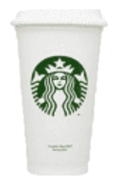




Bundle Products
Sell the Soda to whom?
Price
Sell Information
Sell Information

Slide 40
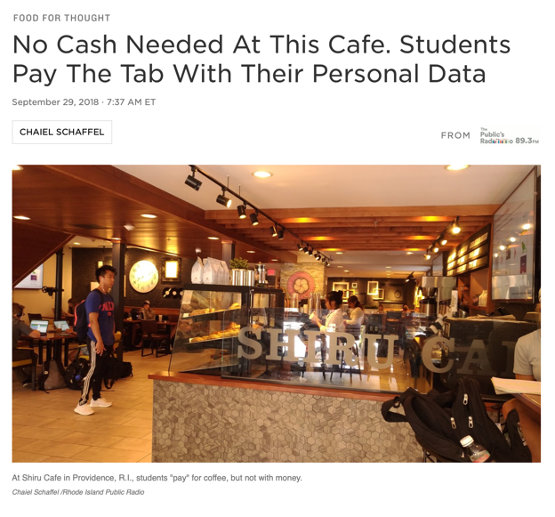
All goods are affected
Inflation?
GDP?
Productivity?

Slide 41
Conclusion
1
Evidence of an unexplored form of pricing: quantum price
Large heterogeneity in pricing
20% of retailers with substantial clustering; not explained by digit endings, price levels, popular prices, assortment size
Clustering w/ and a/ categories, but not across retailers
Stickiness in product introductions
2
Theories to price clustering
3 models that could predict some clustering
Short product duration, greater need to inform consumers about assortments
Clustering as an optimal pricing to increase advertising effectiveness
3
Beyond the puzzle
Managerial implications (product design)
Implications for macro literature on price frictions

