Slide 1
Digital Money, Monetary Sovereignty, and Financial Stability
Markus K. Brunnermeier
Based on joint work with Harold James, Jean-Pierre Landau, Dirk Niepelt, Jonathan Payne
Federal Reserve Bank of Cleveland
2020-11-20

Slide 2
Rethinking Money in the Digital Age
Ubiquitous digital money, M-Pesa, Alipay, Libra
So far: digital inside money (liability of issuer)
Now: digital outside money/ “currencies”
Questions:
Will private digital money drive out cash?
Will central banks lose their grip on monetary policy?
Will platforms “steal” the seigniorage benefits of governments and private banks?
Digital Dollarization and Digital Currency Areas
Will CBDC be the answer?
Should BigTechs be forced to be “narrow banks” and platforms to be interoperable?

Slide 3
Roadmap
Technological trends
New currency competition
Monetary Sovereignty
International Monetary System & Digital Currency Areas

Slide 4
Technological Trends
Smart phone
Digital platforms/ecosystems - “digital lifestyle” (COVID)
Big data, AI, deep learning, recommender systems
Smart contracts and value chains:
contingent payments to minimize credit risk
Internet of things: payments from machine to machine
Token (instead of account-based) – DLT
Micropayments
impacts money

Slide 5
Tech Trends: Inversion of Power - “Inverse Selection”
Information advantage for customer
Borrower
Insurance client, …
Customer knows her multiple attributes, but platform only platform can connect them
Traditional example:
I like a red car
Insurance companies knows (from big data) that drivers of red cars are more accident prone
Soon, for seller/platform
Lender (platform) “will know more about me
Insurance company than I know about myself”
Asset managers, … Privacy regulation
From Adverse Selection to “Inverse Selection”
(with Segura-Rodriguez and Lamba)

Slide 6
Tech Trends: Big Data, AI, Machine/Deep Learning
Economies of “Bigger is better” Scope
Unstructured data, textual data
Social media data PLATFORMS
Payment system data (transforms IO of finance)
Diversity
Scale
Diminishing returns to scale? SIZE
More
customers
Self-rein- forcing
Bigger
data
Better
Recommender
system

Slide 7
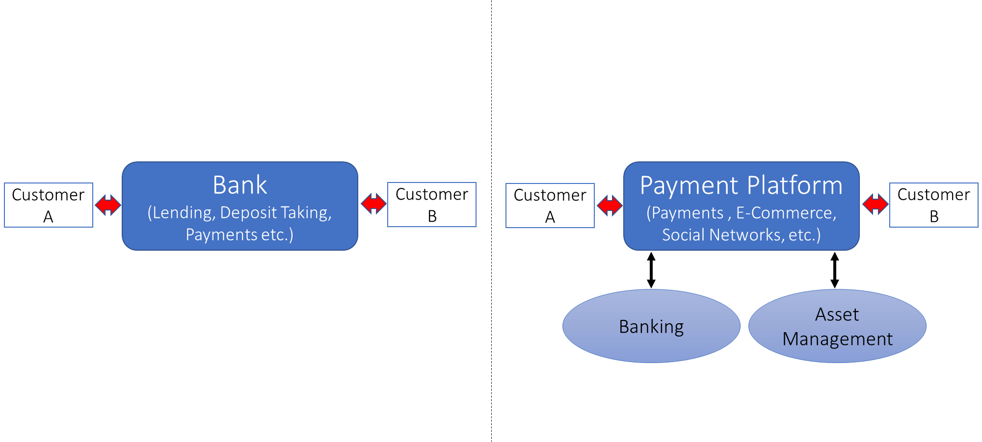
Technological Trends
Digital platforms/ecosystems - “digital lifestyle”
Data advantage – who controls the data?
Change of IO of financial activities
Bank-centric Payment-centric

Slide 8
Roadmap
Technological trends
New currency competition
Monetary Sovereignty
International Monetary System & Digital Currency Areas

Slide 9
Currency competition
Hayek (1976)
Bundling reduces competition
Unbundling the 3 roles of money
Unit of account
Store of value
Medium of exchange
Convertibility, Gresham’s law (gold vs. silver)
Declining switching costs $⇒$declining network externality
Language analogy (speech translation software)
Re-bundling with platform/ecosystem
Discounts on digital eco-system
Smart contracts, recommender system
“Money product differentiation” (e.g. “privacy currency”)
Closed ecosystem (incl. payment instruments)

Slide 10
Private platform/currency competition
Platforms have greater “control” over digital currencies (better able to monitor, restrict or punish usage)
New IO perspective on Money from “environment friction” to “strategic choices by platforms”
Platform strategy/design:
Entry costs/subsidy
Using costs/subsidy, i.e. trading mark-ups, privacy (possible negative)
Exit costs (“Berlin wall”)
Growth rate of money/token supply
Platform/currency competition
With public money (no digital convenience, no exit cost, MoPo based on macro shocks,…)
Digital dollarization (is public money at a disadvantage?)
Across private platforms/currencies
Regulation: interoperability (like EPI), convertibility, narrow banks approach
Behavioral biases of customers
With Jonathan Payne
“lure you in, lock you in, and inflate value away” (Hotel California)

Slide 11
“Digital Dollarization”
Loss of “unit of account” role of money
Via medium of exchange (invoicing) vs. store of value (reserves)
Sudden and highly non-linear (Chang&Velasco 2006)
Vulnerable countries: small, socially open
Small, open economy, large informal sector (traditional dollarization)
Inefficient electronic payment system
No own social media presence
Defense lines:
LOLR and taxing power + taxes in local currency
CBDC since, (Public) Cash is poor substitute for private digital money
Private “stable coins” via 100% narrow bank (whole sale CBDC)
Regulation of private platforms: convertibility, interoperability, …
Let private platforms explore and invent and government appropriates later
Nepal suspended AliPay and WeChat pay
May 2019
Notes:
https://asia.nikkei.com/Business/Companies/Nepal-bans-China-s-Alipay-and-WeChat-Pay

Slide 12
Roadmap
Technological trends
New currency competition
Monetary Sovereignty
International Monetary System & Digital Currency Areas

Slide 13
Monetary Sovereignty
Seigniorage rents from money creation
Store of value role of money
Financial repression
Control of monetary policy to manage macro economy/business cycle Should Facebook’s MoPo manage the macroeconomy?
Unit of account role of money
Intratemporal behavioral
Intertemporal due to MoPo’s redistributive and risk-shifting effects
New Keynesian: Stickiness in private/public money (invoicing)
Financial Frictions: Denomination of nominal debt MoPo redistributive & risk transfer “The I Theory of Money”
Power to bail out and to provide liquidity LOLR
Connected to taxing power, fiscal space, governance
Power to exclude from monetary system
Weaponizing US dollar
With Harold James and Jean-Pierre Landau

Slide 14
Public versus Private Money
Current arrangement: 2 tier system
Government outside-money/unit of account/settlement among banks
Private banks inside money
Future arrangement
Example: India Stack, PBC imposing narrow bank model
Government
Banks
BigTech

Slide 15
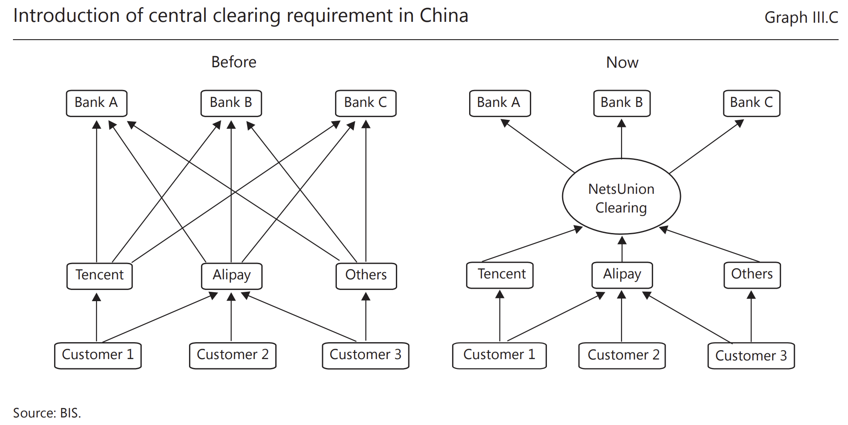
BigTech and Regulation (China example)
BigTech capturing Payment
New regulation in China (July 2018)
Official clearing system for all payments
100% backing of deposits with reserve holdings
Notes:
https://qz.com/1791778/ant-financials-yue-bao-is-no-longer-the-worlds-biggest-money-market-fund/
https://www.ft.com/video/a331c838-8bd7-4e79-8966-eb9f012743aa

Slide 16
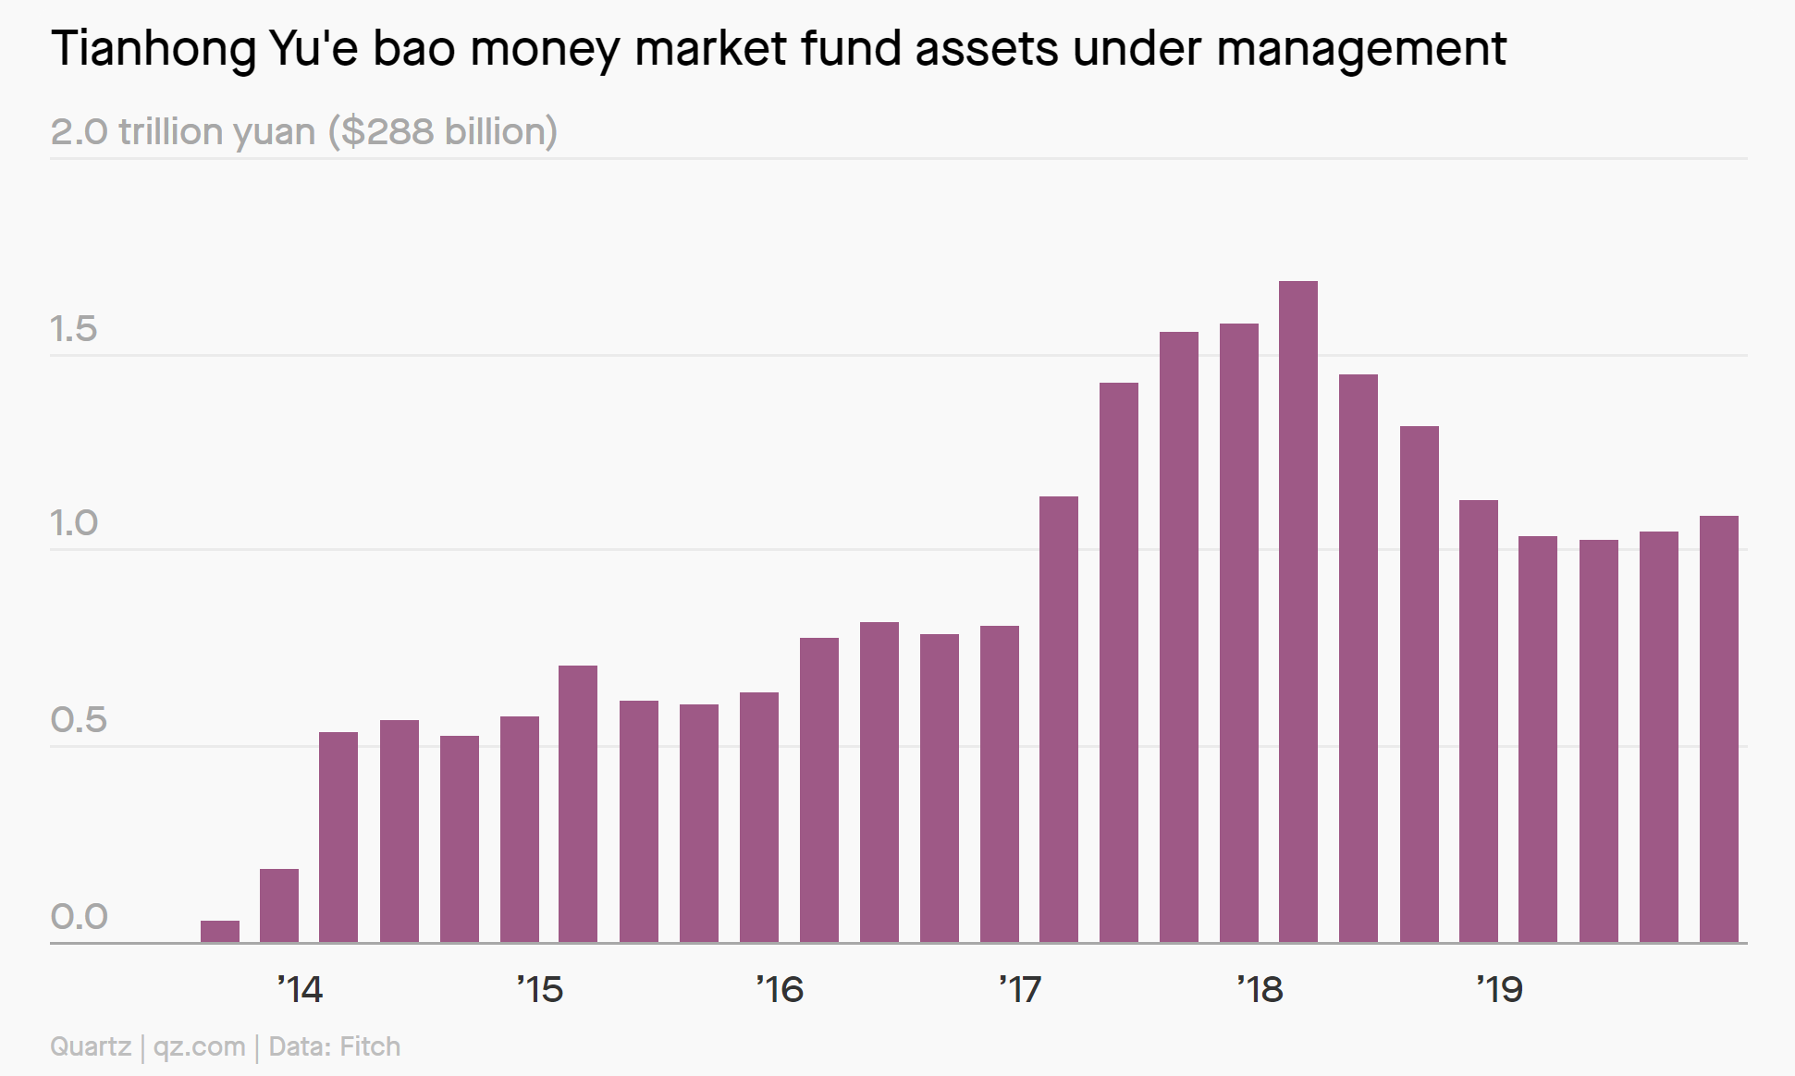
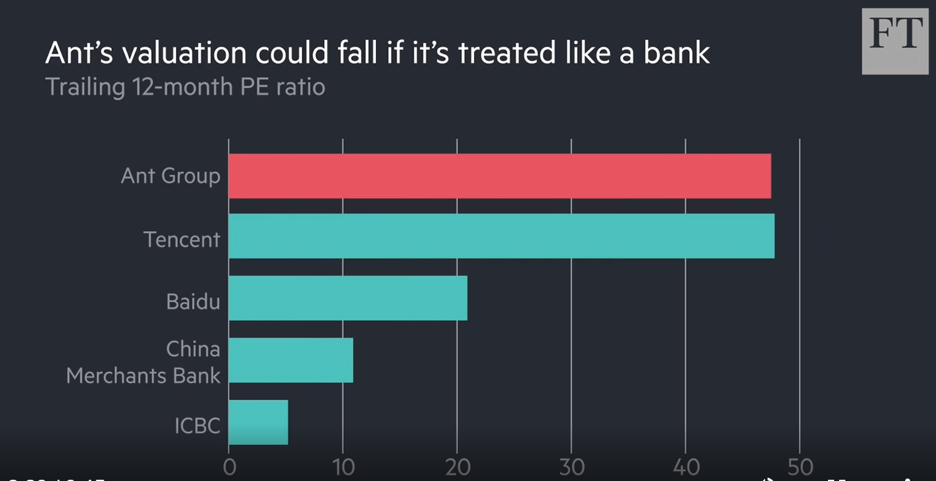
BigTech and Regulation (China example)
BigTech capturing Payment
New regulation in China (July 2018)
Official clearing system for all payments
100% backing of deposits with reserve holdings
BigTech capturing Lending and Deposit taking
Raise e-deposit funds and park in money market fund
WeChat currently pays 2.32% on RMB-deposits
27 MMFs (wealth management)
Maturity and liquidity mismatch
Like a bank - Financial stability concerns?
New regulation in China (Nov 2020)
Capital requirements + move loans onto books
Lending limit per individual
Price/Earnings Multiples:
BigTech: 48 (Ant’s planed IPO)
Banks: 10
Notes:
https://qz.com/1791778/ant-financials-yue-bao-is-no-longer-the-worlds-biggest-money-market-fund/
https://www.ft.com/video/a331c838-8bd7-4e79-8966-eb9f012743aa

Slide 17
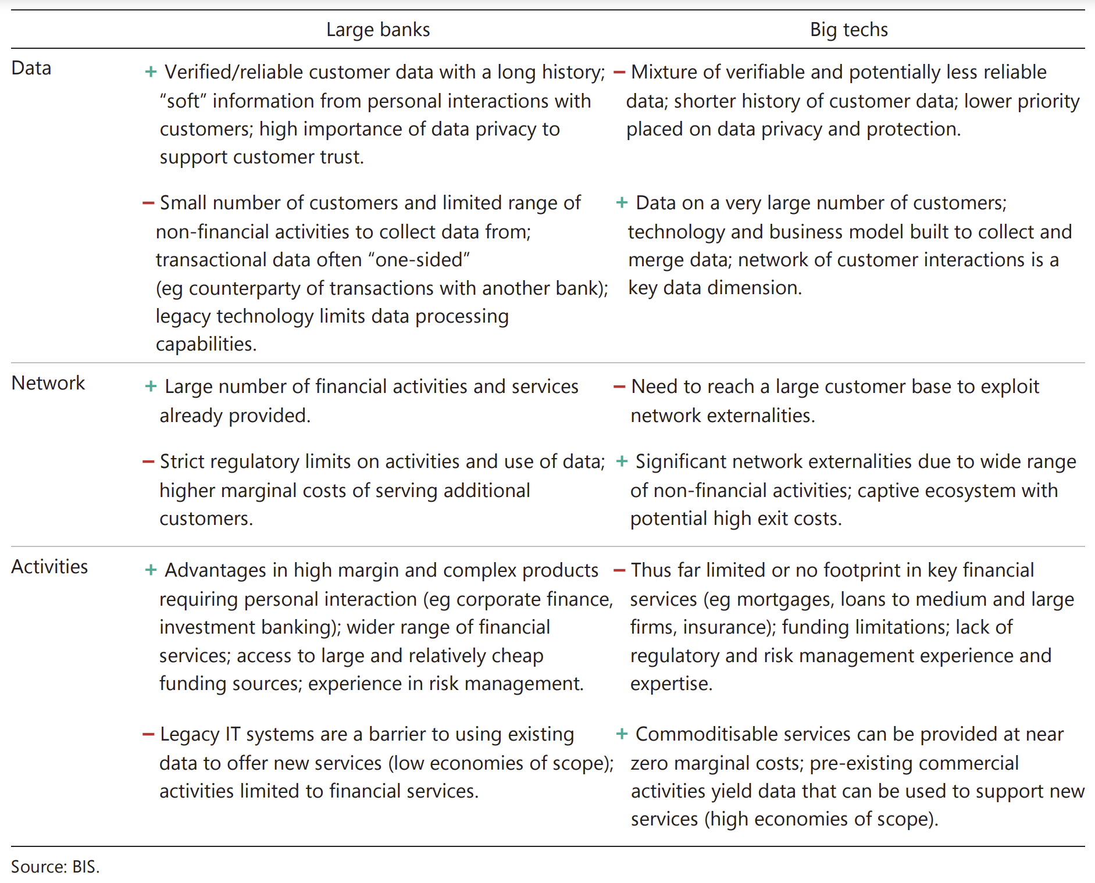

Slide 18
Seigniorage Rents from Money Creation
$\max{U(x)}$ subject to Brunnermeier-Niepelt (2019)
Budget constraint $ℬ=0$
Liquidity constraint $ℒ≤0$ Lagrange multiplier $λ$
Cash in advance, MIU, shopping time, New monetarism
Any asset price
$$p_{t}^{j}=E_{t}[SDF_{t,t+1}\underset{≔Λ_{t,t+1}≥1}{\underbrace{\frac{1}{1−λ_{t}\frac{∂ℒ}{∂a^{j}}}}}\left(z_{t+1}^{j}+p_{t+1}^{j}\right)]$$
$$p_{t}^{j}=E_{t}\left[\sum_{s=1}^{∞}{SDF_{t,t+s}Λ_{t,t+s}}z_{t+s}^{j}\right]+Bubble$$
= Fundamental value + liquidity value + bubble

Slide 19
Seigniorage Rents from Money Creation: Public or Private
Extreme form: issue bubbly liquid asset
No (social) resource costs Friedman ‘69
More general: hold illiquid asset with high cash flow
issue liquid asset with low cash flow
Rents:
“free lunch”
Competition
Pass on rents to borrowers, but
Curse excessive supply, ICOs $⇒$ inflation
A
L
High fundamental
value
Low fundamental
High liquidity value
Bubble

Slide 20
Equivalence: CBDC vs. Deposits
A
Gov. & CB
L
A
Households
L
Gov.
Bonds
PV Primary Surplus
Gov.
Bonds
PV Primary Surplus
A
Firms
L
A
Banks
L
Implicit G-Equity
Implicit G-Equity
Physical Capital
Firm Loans
Firm Loans
B-Debt
B-Debt
Money
Money
Net- worth
Deposits
Deposits
B-Equity
B-Equity
Firm
Equity
Firm
Equity

Slide 21
Equivalence: CBDC vs. Deposits
A
Gov. & CB
L
A
Households
L
Gov.
Bonds
PV Primary Surplus
Gov.
Bonds
PV Primary Surplus
A
Firms
L
A
Banks
L
Implicit G-Equity
Implicit G-Equity
Physical Capital
Firm Loans
Firm Loans
B-Debt
B-Debt
Money
Money
Net- worth
Deposits
Deposits
Deposits
B-Equity
B-Equity
Firm
Equity
Firm
Equity

Slide 22
Equivalence: CBDC vs. Deposits
A
Gov. & CB
L
Key insight: Central bank “passes through” funding
If banks are non-competitive, Central Bank’s supply function has to be such that banks set the same deposit rates
A
Households
L
Gov.
Bonds
PV Primary Surplus
Gov.
Bonds
PV Primary Surplus
A
Firms
L
A
Banks
L
Implicit G-Equity
Implicit G-Equity
Physical Capital
Firm Loans
Firm Loans
B-Debt
B-Debt
Money
Money
Net- worth
Deposits
Deposits
Deposits
B-Equity
B-Equity
Firm
Equity
Firm
Equity

Slide 23
Roadmap
Technological trends
New currency competition
Monetary Sovereignty
International Monetary System & Digital Currency Areas

Slide 24
What defines a (separate) currency?
Same unit of account
Convertibility
Convertibility
Maintain value
Uniformity of money (“singleness”)
Account-based
Approval of payments
Verification of account owner
Backing of a currency
Currency board
Stable coin
Token-based
Finality of payment

Slide 25
International monetary system
Digital Currency Areas
Def.: own unit of account or payment instrument only inside
Complementarity with digital platform (not geographic)
Price discounts, price discovery, transparency within
Digital Synthetic World Currency
Symmetric supply of a safe asset (to avoid that flight to safety capital flows become cross border) (Brunnermeier & Huang)

Slide 26
… to sum up
Digital platforms/eco-system, smartphone, tokens
Inversion of IO of financial activity
New currency/platform competition – digital dollarization
Unbundling enhances currency competition
Re-bundling reduces
Interoperability, convertibility, limit product differentiation
“Monetary Sovereignty” to manage macroeconomy
Private vs. Public Money – important role of CBDC/LOLR
International monetary system – digital currency areas
Is Bitcoin/Libra is like Napster
for the music industry?

Slide 27
Based on
The Digitalization of Money
With Harold James and Jean-Pierre Landau
On the Equivalence of Private and Public Money
With Dirk Niepelt
Digital Tokens and Platforms
With Jonathan Payne
Inverse Selection
With Rohit Lamba and Carlos Segura-Rodriguez

