Slide 1
CBDC and fintech
Some thoughts on their financial stability implications
November 18, 2020
James Chapman
Deputy Managing Director for Economic and Financial Research at the Bank of Canada

Slide 2
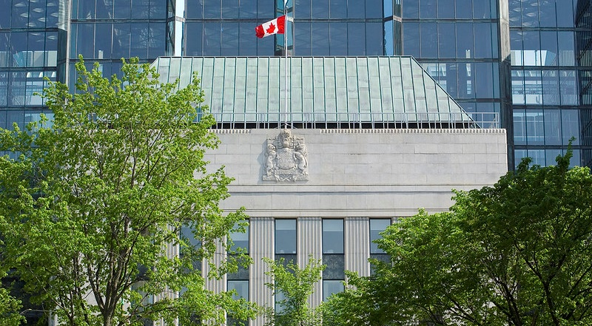
Disclaimer
The views expressed are those of the discussant and may differ from official Bank of Canada views

Slide 3
FINTECH
Integration of information technology into financial services offerings
What is it? (Examples)
Chatbots (Rodoadvisors)
P2P lending
Distributed ledger technology
Mostly (disruptive) but standard technological change

Slide 4
Digital currencies are a Innovative
What is a CBDC?
  A digital payment instrument, denominated in the national unit of account, that is a direct liability of the central bank – Joint Report (2020)
Still lots of design decisions to work out: (to simplify)
  Account or token
  Retail or interbank
  Privacy
  Security
  Resilience
  Interoperability (domestic and cross-border)

Slide 5
The FS and MP Implications come from a CBDCs role as money
Economic Roles
FS (and MP) Policy considerations
Means of payment
  Cash currently acts as the outside option for different payment schemes and supports the efficiency of payments
Store of value
  The risk-free store of (domestic) value and foundation of the term structure of interest rates
Means of payment
  The fundamental role and basis of monetary policy
What is the deposit effect of a CBDC?
What is the investment effect of a CBDC?
What is the monetary policy effect of a CBDC?
  Interactions?

Slide 6
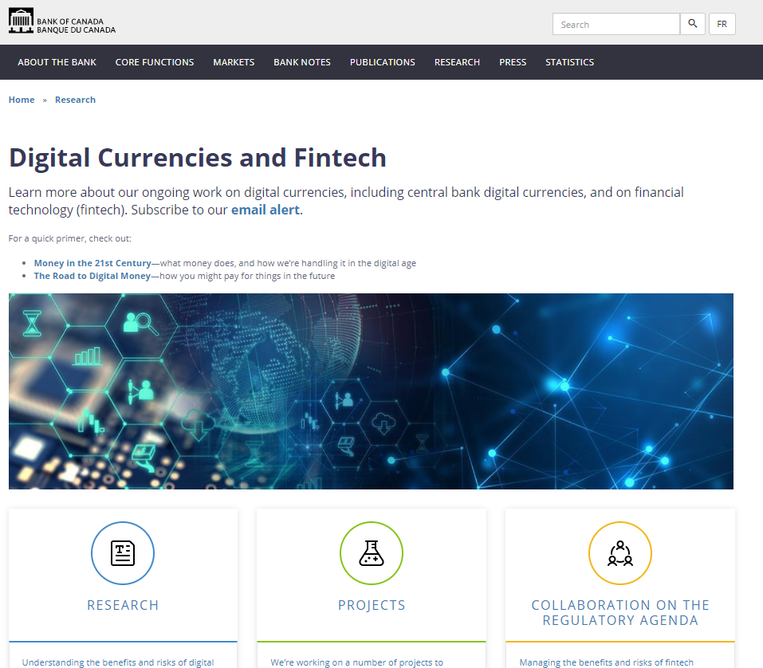
Read this and other CBDC and fintech work on the Bank of Canada website.
https://www.bankofcanada.ca/research/digital-currencies-and-fintech/

