Slide 1
WILKINSBURG BOROUGH

Slide 2
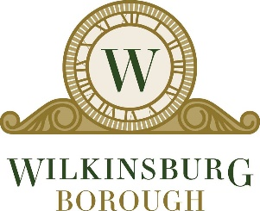
WILKINSBURG: AT A GLANCE
Population:15,930 residents
2.2 square miles – borders City of Pittsburgh, Penn Hills, Swissvale, Edgewood, Forest Hills, Churchill
Wilkinsburg was known as the City of Churches. The borough has a high concentration of churches, and was known at certain points in its history as “The Holy City.” Bars and taverns have been prohibited in Wilkinsburg since 1870, except during the years 1933 to 1935. *Ban on liquor sales were lifted in 2015
Wilkinsburg is a major transportation hub, with 2 East Busway stations located in the Borough along with easy access to the Parkway.

Slide 3
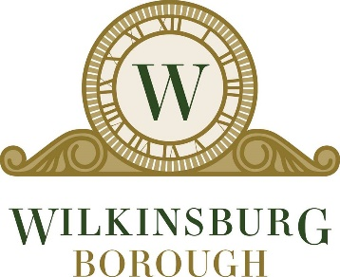
WILKINSBURG: DEMOGRAPHICS
66.6% population is Black, and 28.3% White.
3.2% are of two or more races, 1% Asian, and less than 0.5% are Native American and Pacific Islander
One of two majority Black municipalities in Allegheny County
About 38% of households are owner occupied and 62% are renter occupied
The median household income in the Borough is $29,620, and the median income for a family is $39,685
About 16.5% of families and 21.87% of the total population are below the poverty line

Slide 4
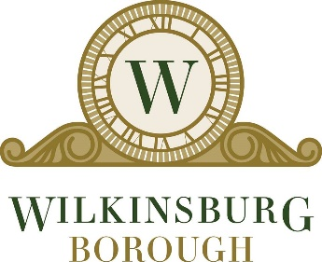
WILKINSBURG: CHALLENGES
Similar to neighboring communities, Wilkinsburg experienced the negative effects of the steel mill decline of the 1970s
Increasing taxes, failing school district, white flight to suburbs, crack epidemic, and gang violence resulted in blight and safety concerns
In 2016, 18% of properties were counted to be vacant and abandoned (around 800 parcels)
Negative perception of Borough

Slide 5
WILKINSBURG RISING
Wilkinsburg School District lowered school taxes – a positive outcome of partnership with Pittsburgh Public Schools
Renewed partnership with State and County leadership which has provided over $2.2 million in funding towards demolitions of blighted properties, investments in our infrastructure, and beautifying greenspace among other needs.
Many community based organizations and social services for residents
Hunter Building Project

