Slide 1
September 25, 2015
Discussion of “Can individual investors time bubbles?”
James Choi

Slide 2
Paper summary
Finnish traders whose flows successfully predict Finnish stock market return from 1995 to 2002 also successfully predict market return from 2002 to 2009
Unsuccessful 1995-2002 timers also tend to be unsuccessful in 2002-2009
Successful minus unsuccessful timer flows predict Finnish stock market return

Slide 3
Adding to the evidence
Individual stock-picking skill is persistent (Coval, Hirshleifer, and Shumway, 2005; Che, Norli, and Priestly, 2009)
Individual market timing skill is persistent (Che, Norli, and Priestly, 2012)
High-IQ investors are better stock pickers and market timers (Grinblatt, Keloharju, and Linnainmaa, JFE 2012)

Slide 4
“In examining individual investor performance… ‘market timing’ has largely been ignored.”

Slide 5
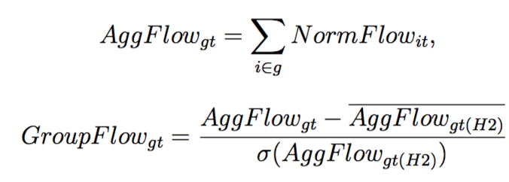
Constructing the predictor
Sort traders into quintiles based on 1995-2002 value of corr(Flow_{it}, Return_{t+1})
Compute
Computed
using future
information

Slide 6
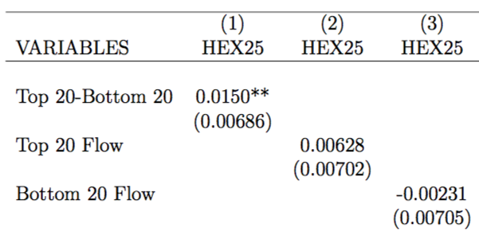
Single-group flows don’t predict market return

Slide 7
Both groups’ flows needed

Slide 8
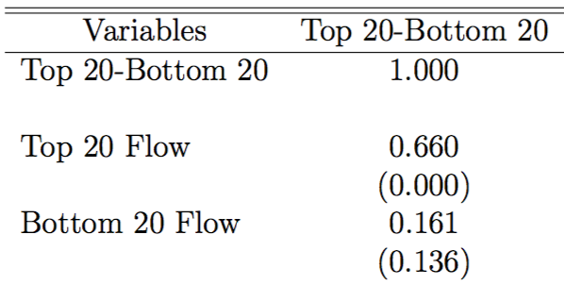
A puzzling correlation
Why isn’t this negative?

Slide 9
How it can happen
Cov(Y, X – Y) = Cov(Y, X) – Var(Y) > 0
Cov(Y, X) > Var(Y) > 0

Slide 10
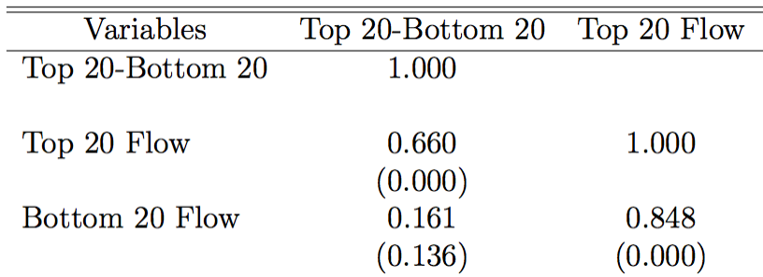

Slide 11
Implication
Will tend to predict that market do well when both good and bad timers are going into market, but good timers are going in more aggressively (relative to past aggressiveness)

Slide 12
Could the Fed use this info?
I don’t know from the paper

Slide 13
Out-of-sample exercise
Predict month t + 1’s return using only flow data available up to month t
Alternative naïve prediction: Historical average return of market up to month t
Compute mean squared prediction error of both predictions

Slide 14
Delivering on the abstract’s promise
“Our evidence suggests that it is possible to use the trading patterns of these smart investors to anticipate market movements, lending some credibility to the view that market bubbles are identifiable in real time.”

