Slide 1
Discussion of
Measuring Uncertainty Based on Rounding: New Method and Application to Inflation Expectations by Carola C. Binder
Randal Verbrugge
September 25, 2015

Slide 2
Disclaimers
These are the views of the author, not necessarily those of the Federal Reserve Bank of Cleveland, nor of the Board of Governors of the Federal Reserve System.

Slide 3
Summary
Inflation expectations are a big deal in monetary policy context (anchored expectations)
In a wide variety of survey contexts, rounding is associated with higher uncertainty
Binder applies this general principle to University of Michigan Survey of inflation expectations (multiples of 5%)
Constructs monthly measures of inflation uncertainty. Key: long time series.
Measure appears to pass formal and informal tests
Interesting discussion of uncertainty vs. disagreement, and a second paper hidden in this one.

Slide 4
General remarks
I think this is a very good paper on an important and timely topic
I find it remarkable that there is any signal to be had in this survey
The measure Binder constructs appears to behave like we think it should
It will be useful in a variety of contexts
Here, I have one main quibble.
(I am sure the next version will address it!)

Slide 5
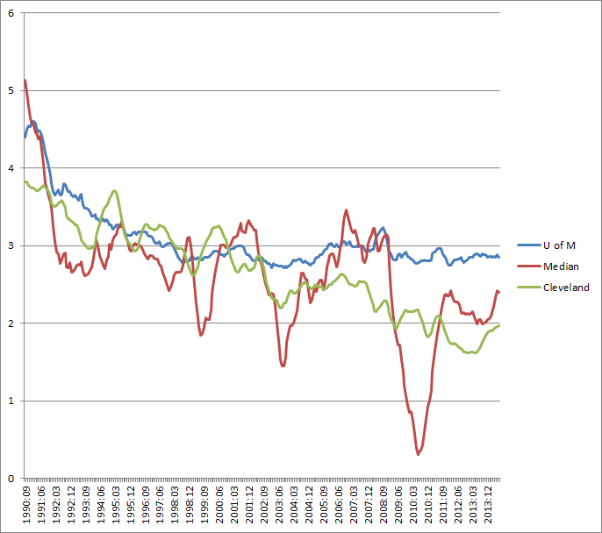
Consumers have odd beliefs
Wording: “prices in general” > “rate of inflation” (NY Fed: Armentier et al.)
Signal?!

Slide 6
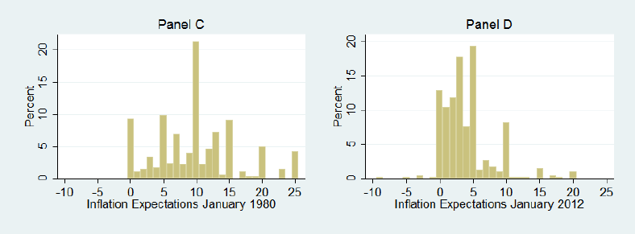
A Key Figure (and, more on odd beliefs)
Binder tests for whether this comes from one distribution, a mixture of two, or more than two. Conclusion: two.

Slide 7
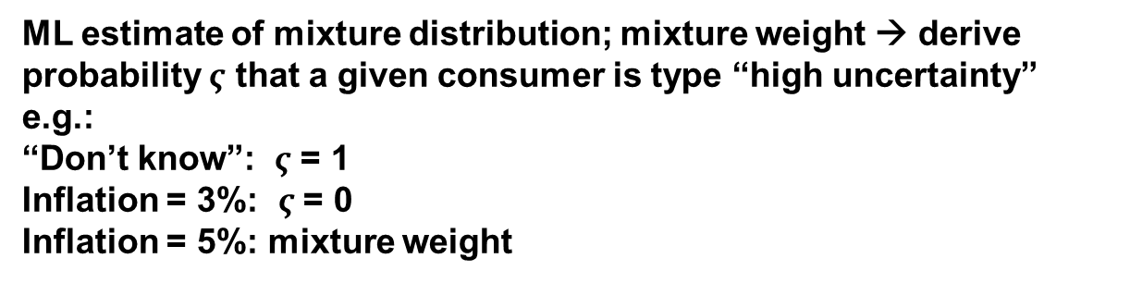

Measure of Uncertainty
$$U_{t}=\frac{1}{N}\sum_{i=1}^{N}{ς_{it}}$$
ML estimate of mixture distribution; mixture weight → derive probability $ς$ that a given consumer is type “high uncertainty”
e.g.:
“Don’t know”: $ς$ = 1
Inflation = 3%: $ς$ = 0
Inflation = 5%: mixture weight

Slide 8
Tests
Forecast revisions and errors
Correlation with NY Fed SCE measures (short time span)
Correlation with demographic data (cross-section)
Time series movements vs. recessions
Careful look at consumption (cross-section)

Slide 9
Tests
Forecast revisions and errors
Correlation with NY Fed SCE measures (short time span)
Correlation with demographic data (cross-section)
Time series movements vs. recessions
Careful look at consumption (cross-section)
Time series correlations … a quibble.

Slide 10
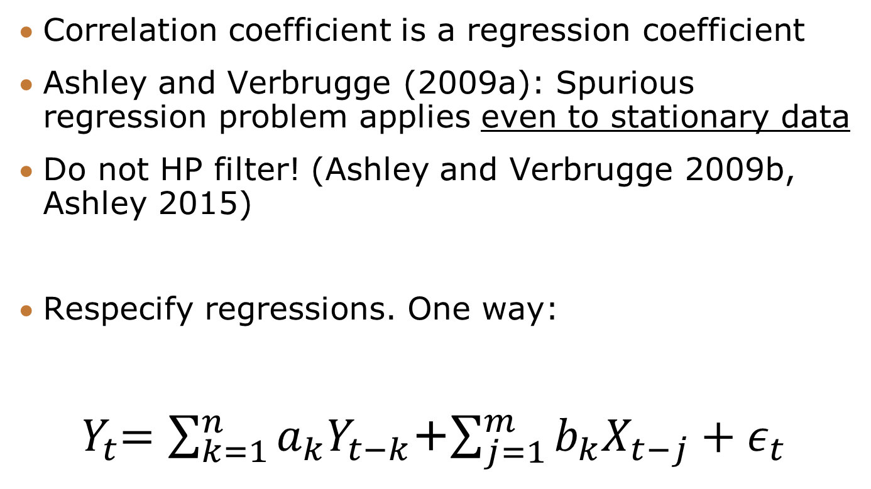
In time series work, correlation coefficient generally invalid
Correlation coefficient is a regression coefficient
Ashley and Verbrugge (2009a): Spurious regression problem applies even to stationary data
Do not HP filter! (Ashley and Verbrugge 2009b, Ashley 2015)
Respecify regressions. One way:
${ Y}_{t}=\sum_{k=1}^{n}{a_{k}Y_{t−k}}$+$\sum_{j=1}^{m}{b_{k}X_{t−j}+ε_{t}}$

Slide 11
Results (p-value of F-test):
Output (CFNAI): 0.05
Unemployment rate: 0.4
Consumer sentiment: 0.2
Consumer confidence: 0.3
Cleveland inflation expectations: 0.2
U of M inflation expectations: 0.8
Relative gas price change: 0.11
Relative food price change: 0.8

Slide 12
Relationship to consumption
Strong relationship in theory; e.g., more uncertainty about income → save more (e.g., Kimball, Lusardi, Carroll)
Uncertainty about inflation? = Real return uncertainty. See Dotsey/Sarte, Appendix E: save more
Durables: higher uncertainty → increased option value of waiting (e.g., Knotek/Khan, Dixit/Pindyck)

Slide 13
Consumption, cont’d
Simple aggregate relationship (specification as in previous “correlation” check)
  Real retail sales: P-value = 0.4
  Real PCE: P-value = 0.01 (???)
But, Appendix F (basically a paper by itself)
X-section; builds on Bachmann et al. 2013
Small, statistically significant results
Very, very interesting part on interest sensitivity: less certain consumers are less sensitive.
A big deal for monetary policy (see, again, Bachmann; Zandweghe/Braxton; Bloom)

Slide 14
What Uncertainty is Not
Uncertainty relates to density forecast at the agent level.
Disagreement relates to differences in point forecasts.
Conditional volatility of inflation? Only to the extent that agents know the DGP.
For professional forecasters, historically, disagreement tends to lines up with uncertainty.
However, consumers could (hypothetically) have less disagreement on the point forecast, while being much less certain about that forecast

Slide 15
Conclusion
Very good work
Provides a new historical inflation uncertainty measure
Clarifies what uncertainty is, and isn’t
Must think carefully about how inflation uncertainty relates to other variables

