Slide 1
Liquidity Constraints and Credit Card Delinquency: Evidence from Raising Minimum Payments
By d'Astous and Shore
Discussion by Noah Stoffman, Indiana University

Slide 2
Background
Credit Card Accountability Responsibility and Disclosure (CARD) Act
issuers must disclose the time needed to pay down the balance if making only the minimum payment; and
monthly payment required to pay down the balance in 36 months
Nudged some people to increase payments
This paper is not about a nudge:
Data from a large bank that raised the minimum payment from 3% to 5% (with a $10 minimum in either case)
Card users can use credit card to access two types of account:
Revolving loans → increased minimum payment
Term loans (fixed interest rate and payment schedule) → no change

Slide 3
“Credit card debt puzzle”
Why do borrowers have a large amount of revolving credit card debt while simultaneously holding low-yield liquid assets?
Could be liquidity constraints or hyperbolic discounting
I’d add mental accounts
“This reduced spending—coupled with increased payments—leads to a drop in their revolving balance, and suggests migration away from a product providing an undesirable repayment schedule. These results are consistent with forward-looking behavior and inconsistent with naive hyperbolic discounting.” (p. 3)

Slide 4
What would we expect to see?
No effect on payments by people who have been paying:
More than 5%
Less than 2%
People paying between 2% and 5%:
No effect?
More delinquencies and write-offs?
Less spending?
Maybe it would affect some people in the >5% group
Keys and Wang (2014): “While raising required minimum payment levels encouraged consumers with low credit card balances to pay a larger fraction of their debt, it also nudged some high-balance borrowers to pay less than they previously did.”

Slide 5
The treatments
Borrower exposure to change:
Affected borrowers:
Why focusing on 20% cutoff?

Slide 6
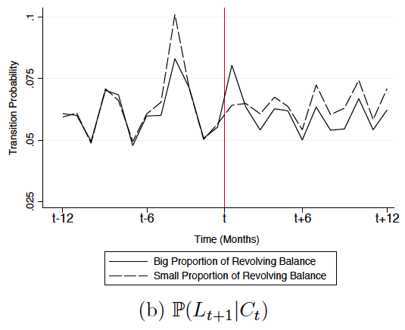
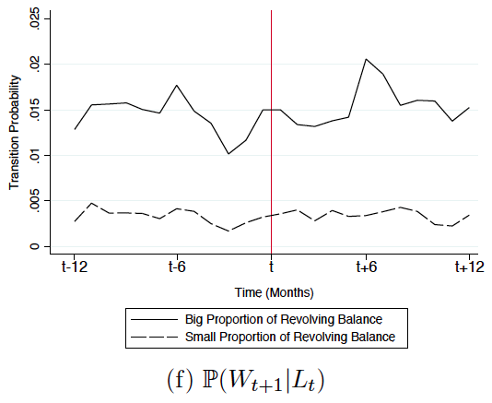
Frequency of transition to delinquency

Slide 7
Payment distribution

Slide 8
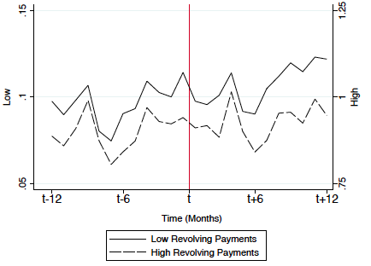
Spending
“The figure does not show an obvious difference in spending between affected
and unaffected borrowers.”
?
“The results show a decline in purchases made each month and suggest
borrowers who valued low minimum payments the most are migrating away from this card.”
What are these?

Slide 9
Suggestions
Provide a clear null hypothesis with more discussion to highlight the key results of the paper
Focus on the results that are from the perspective of the borrower
The results about the issuer’s exposure at default seem like a distraction
Explain what the Regression Kink Design is adding, or remove it
I think there are interesting results here, but they’re being obscured by extraneous analysis!

