Slide 1
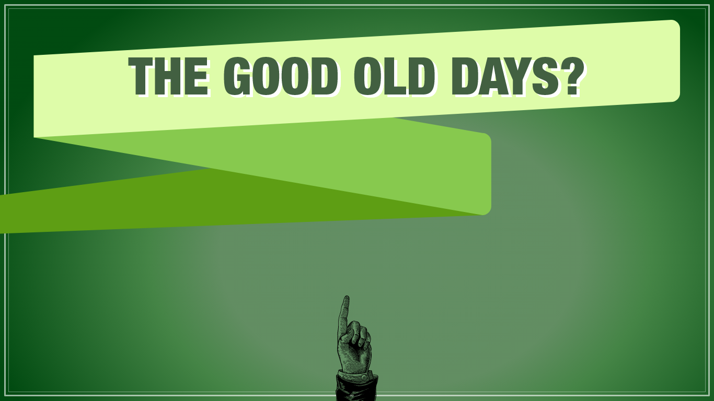
Learn how much things cost and how much people earned

Slide 2

People often look back on the days when everything cost less and say they were the "good old days.”
But were they really so good?
Things did cost less, but people earned less, too.
See how much things cost and how much people earned in
“the good old days…”

Slide 3
1950s
The “baby boomers” are born, families migrate to the suburbs, and the civil rights movement and rock and roll take hold.
What it cost… |  | What people earned…
1950

Slide 4
1960s
Martin Luther King Jr delivers his “I Have a Dream” speech. We walk on the moon, and the US joins the Vietnam War.
What it cost… |  | What people earned…
1950
1960

Slide 5
1970s
Women enter the workforce in record numbers. The computer age dawns. Japan emerges as an economic power.
What it cost… |  | What people earned…
1950
1960
1970

Slide 6
1980s
The “war on drugs” begins, and scientists identify the virus that causes AIDS.
1950
1960
1970
What it cost… |  | What people earned…
1980

Slide 7
1990s
The Soviet Union breaks apart and globalization increases. The Internet, cell phones, and e-mail take hold.
1950
1960
1970
What it cost… |  | What people earned…
1980
1990

Slide 8
2000s
Terrorism increases. We continue to make advances in health care, computers, and consumer electronic products.
1950
1960
1970
What it cost… |  | What people earned…
1980
1990
2000

Slide 9
2010s
Technology continues to advance—computers become smaller and cell phones become smarter.
1950
1960
1970
What it cost… |  | What people earned…
1980
1990
2000
2010

Slide 10

So that’s inflation…
…when prices and wages rise steadily.
Inflation means that
$1 was more valuable
in 1955 than it is today.

